Slide 1
Jewish Missions in the Warsaw Ghetto
Presented by Dr. Mitch Glaser

Slide 2
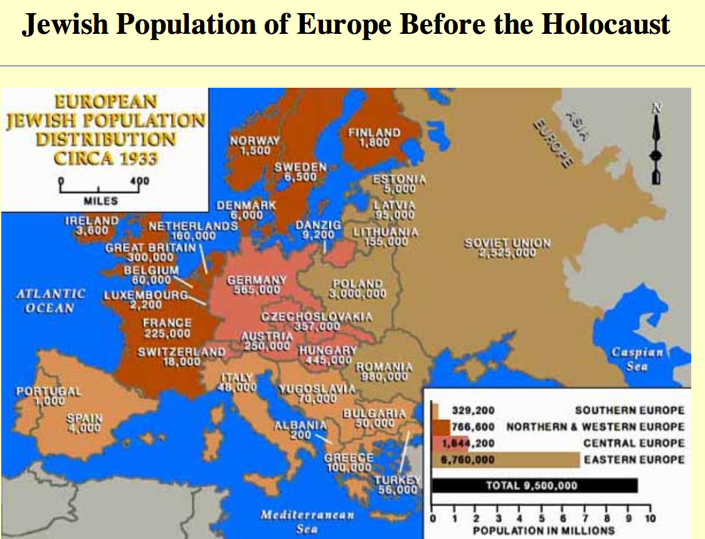



Slide 3
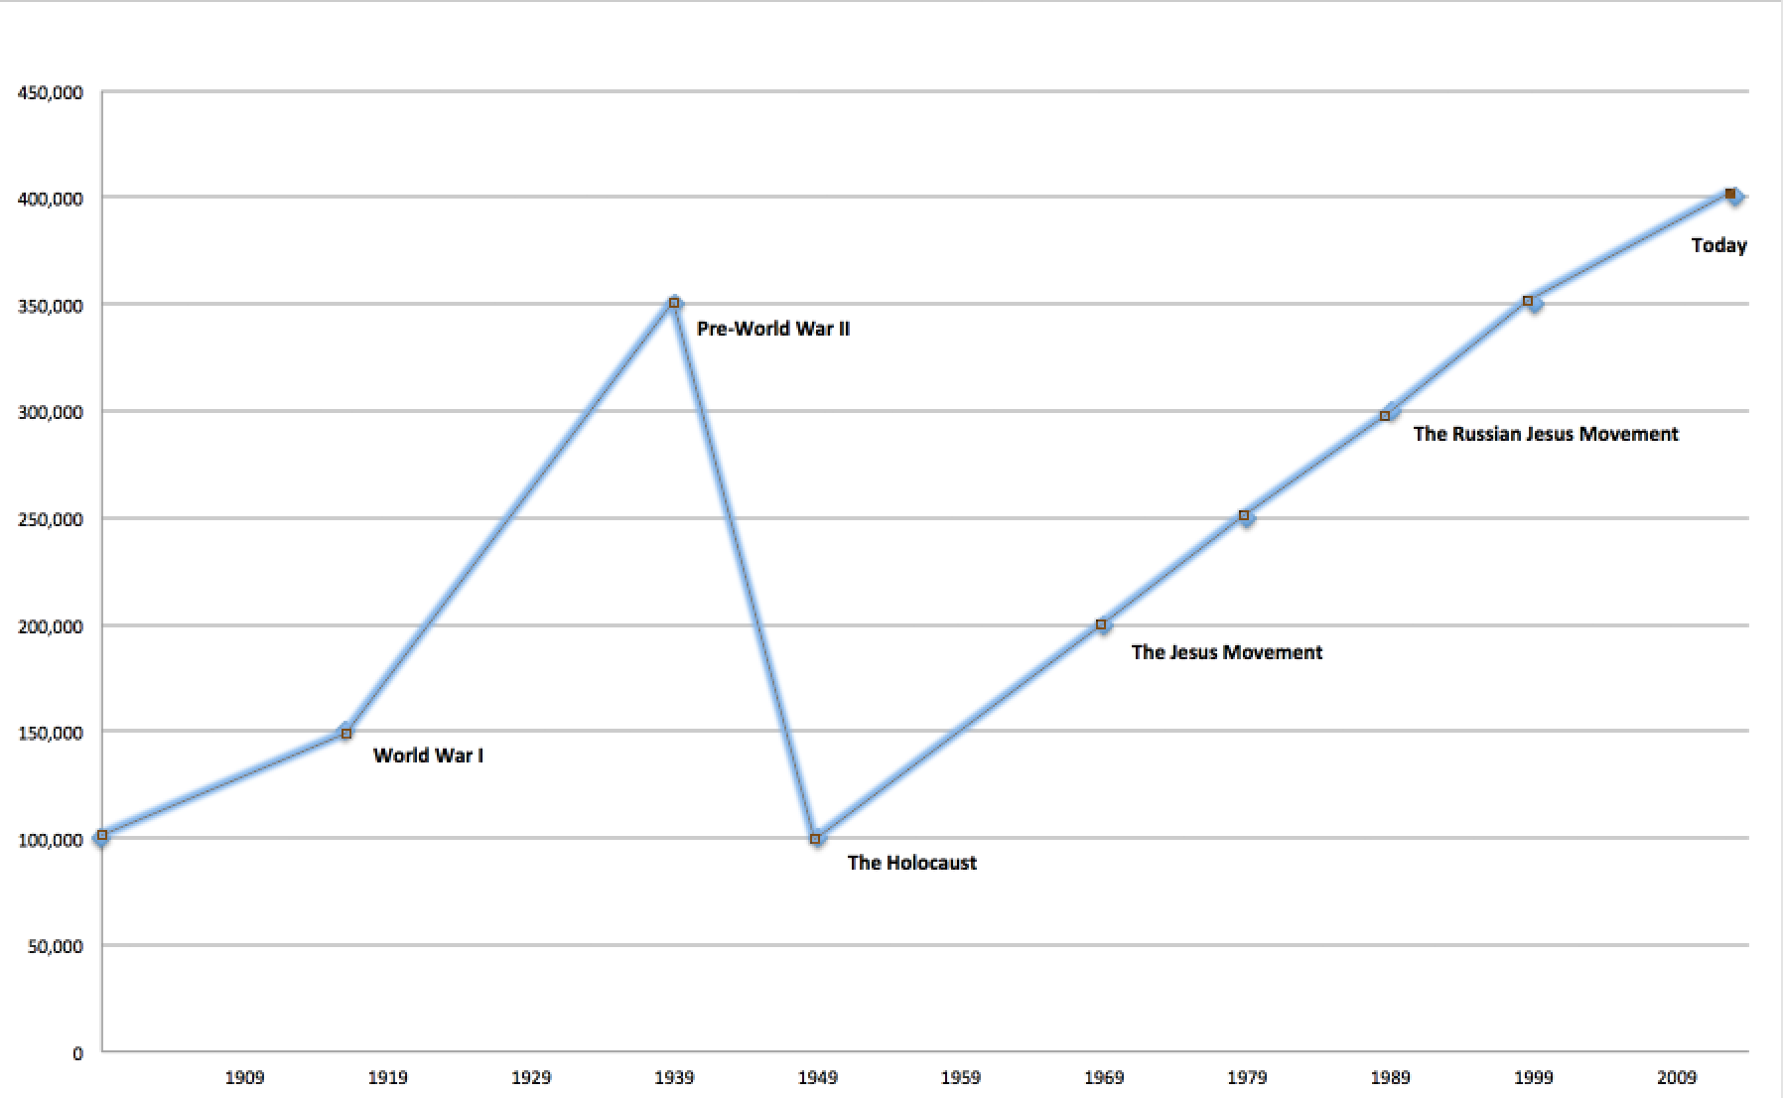
The Messianic Jewish Movement

Slide 4
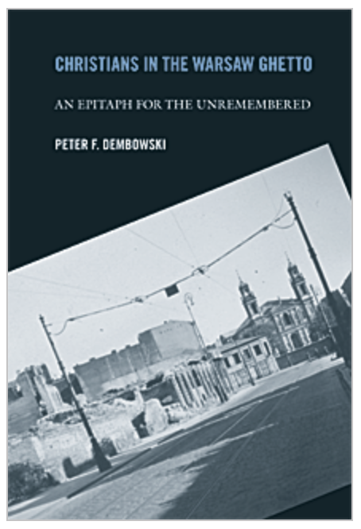
The Messianic Jewish Movement

Slide 5
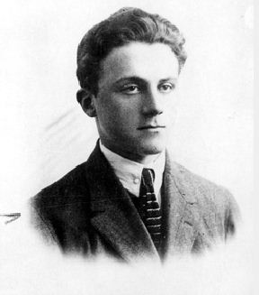
Important Individuals
Emanuel Ringelblum - Jewish historian in the Warsaw Ghetto who preserved many documents

Slide 6
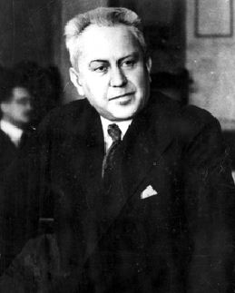
Important Individuals
Dr. Ludwik Hirszfeld – Catholic Jewish believer, physician,
later became famous, discovered inheritance of ABO blood type

Slide 7
Timeline – Four Major Stages
Oct 1939 – Nov 1940: Anti-Jewish decrees and the isolation of the Jewish population
Nov 1940 – July 1942: Ghetto sealed off from the rest of the city
July 22, 1942 – Sept 15, 1942: The Aktion: a mass deportation of 300,000 Jews
Oct 1942 – May 1943: More deportations, the Ghetto uprising, and final destruction of the Ghetto

Slide 8
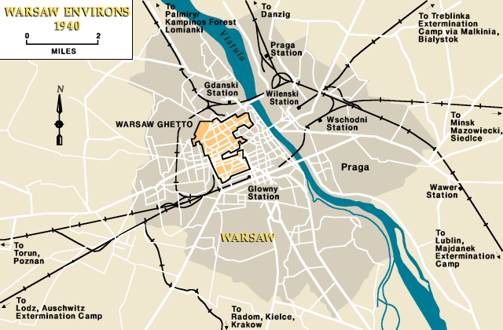
The Warsaw Ghetto

Slide 9
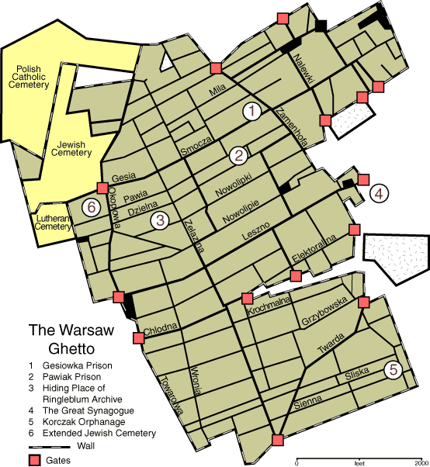
The Warsaw Ghetto

Slide 10
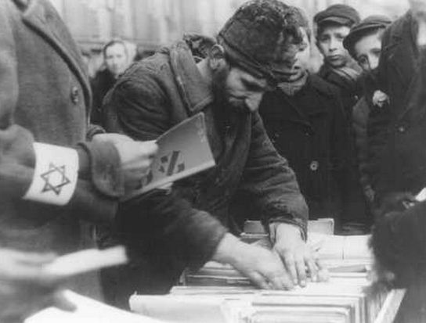
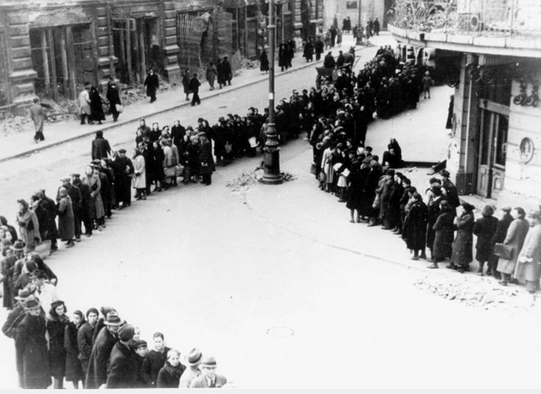
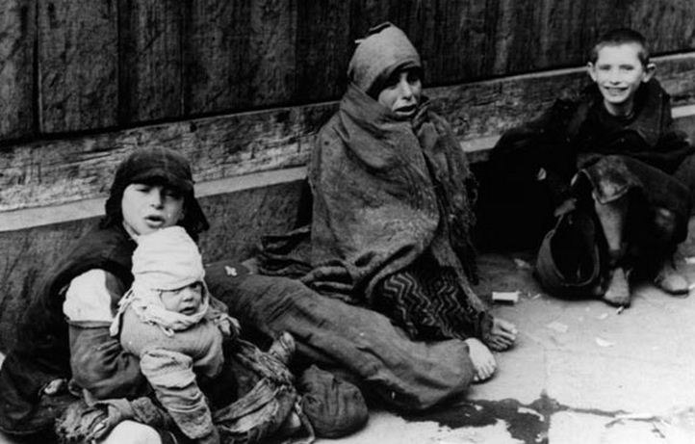
Life in the Warsaw Ghetto
Isolation and starvation

Slide 11
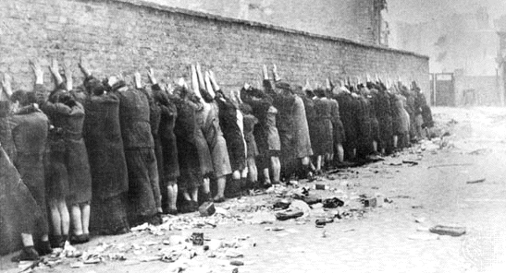
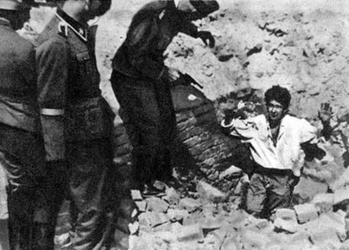
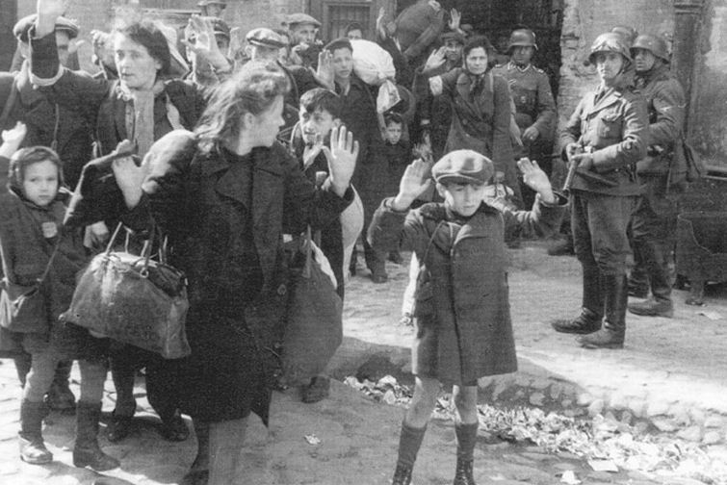
Life in the Warsaw Ghetto
Deportation to death camps

Slide 12
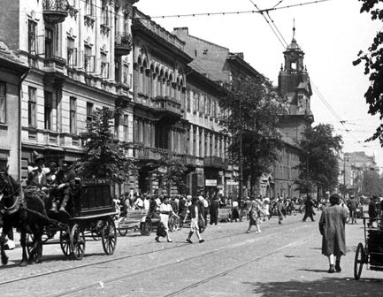
Churches in the Warsaw Ghetto
St. Maria’s Church – Leszno Street

Slide 13
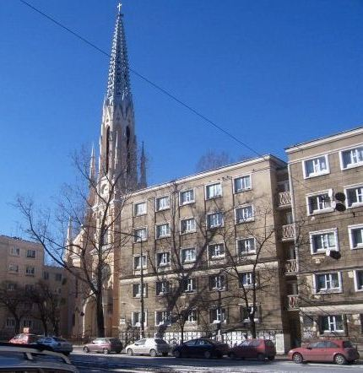
Churches in the Warsaw Ghetto
This church had a tunnel underneath for evacuating children and bringing in arms for the uprising
Church of the Nativity of the Blessed Virgin Mary – Leszno Street

Slide 14
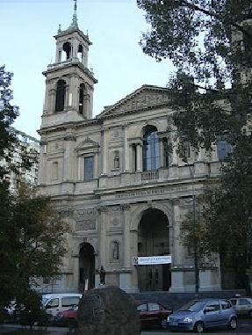
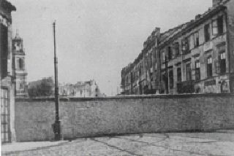
Churches in the Warsaw Ghetto
All Saints’ Church – Gryzbowski Square

Slide 15
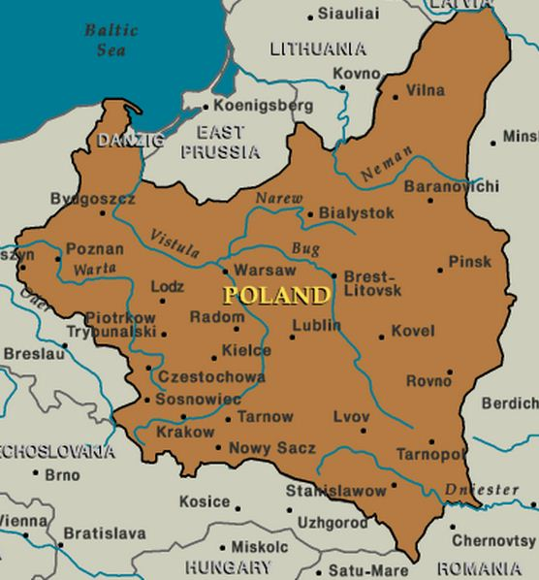
Jewish Ministry in Poland

Slide 16
Jewish Ministries Operating in Warsaw and Poland
Church’s Ministry Among the Jews (CMJ) – Emmanuel Hall in Warsaw
American Board of Missions to the Jews (ABMJ, now Chosen People Ministries) – Warsaw Ministries
Mildmay Mission to the Jews – Hall in Jewish quarter of Warsaw helping poorer Jews
American European Fellowship – Warsaw children’s ministry, villa at Radoso used in summer

Slide 17
Jewish Missions Operating in Warsaw and Poland
Bethel Mission – Evangelistic Center and Colony at Lodz
Danish Mission – Lvov
British Society for the Propagation of the Gospel Among the Jews
The Barbican Mission
Hebrew Christian Alliance Groups (IMJA)

Slide 18
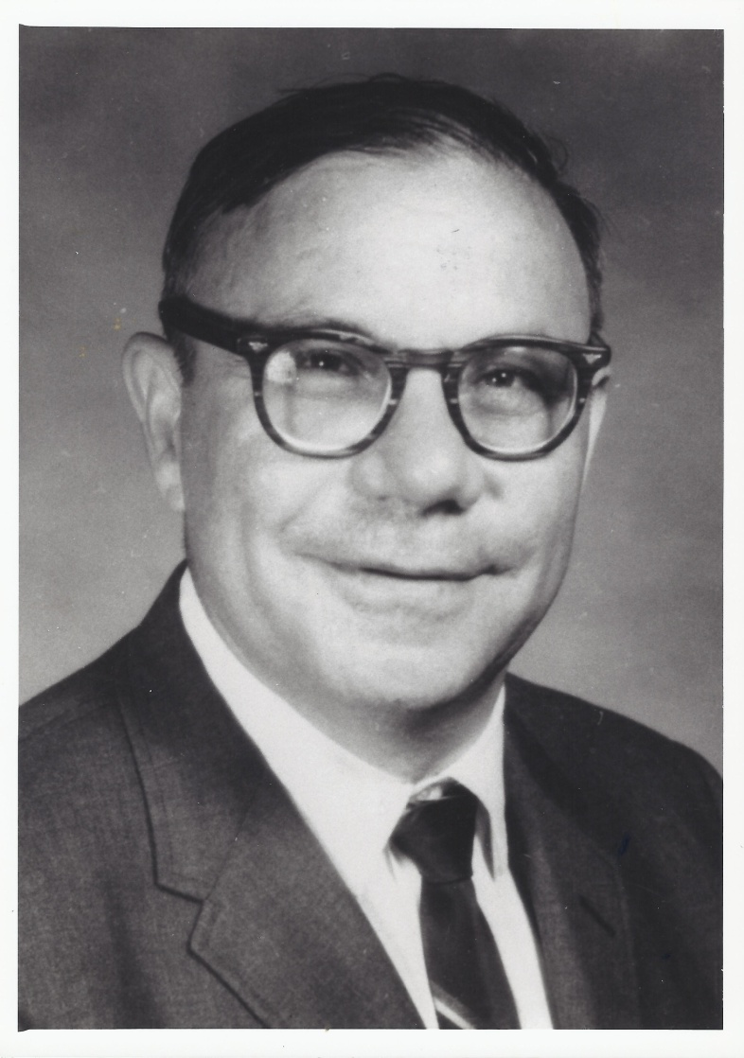
Important Individuals
Rachmiel Frydland – well-known Messianic Jewish survivor of the Warsaw Ghetto

Slide 19
Important Individuals
Dr. Ludwik Hirszfeld – Catholic Jewish believer, physician,
later became famous, discovered inheritance of ABO blood type

Slide 20
Lessons to Learn from Jewish Believers in the Ghetto
As believers in Yeshua, we will often be viewed negatively by the Jewish community; even if we are suffering alongside our people.
Due to the negative history between Jews and Christians, our motivation for believing in Yeshua will always be a matter of suspicion on the part of the Jewish community.
The notion that historically, some of the greatest anti-Semites were Jews who converted to Christianity, is part of the stigma we live with because of our faith in Yeshua

Slide 21
Lessons to Learn from Jewish Believers in the Ghetto
Our identification with the Jewish community is not always a matter of choice, but could result from a series of external circumstances.
Be encouraged! The words of Romans 11:1-5 are true, as the Lord will preserve a remnant of Jewish followers of Yeshua in every age and even under unusual circumstances!

