Slide 1
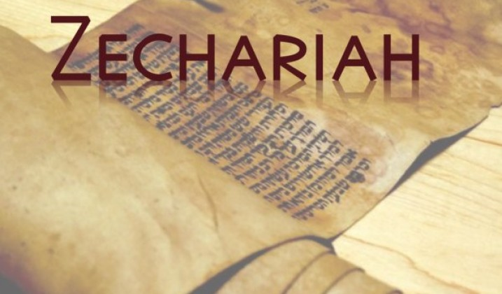

Slide 2
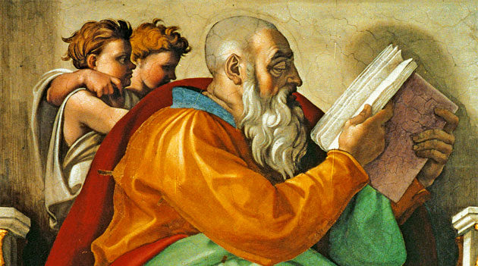

Slide 3
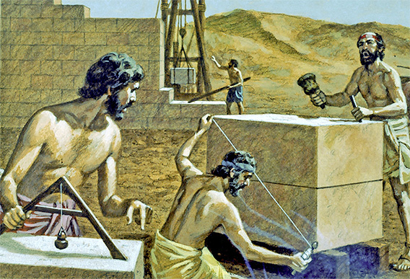

Slide 4
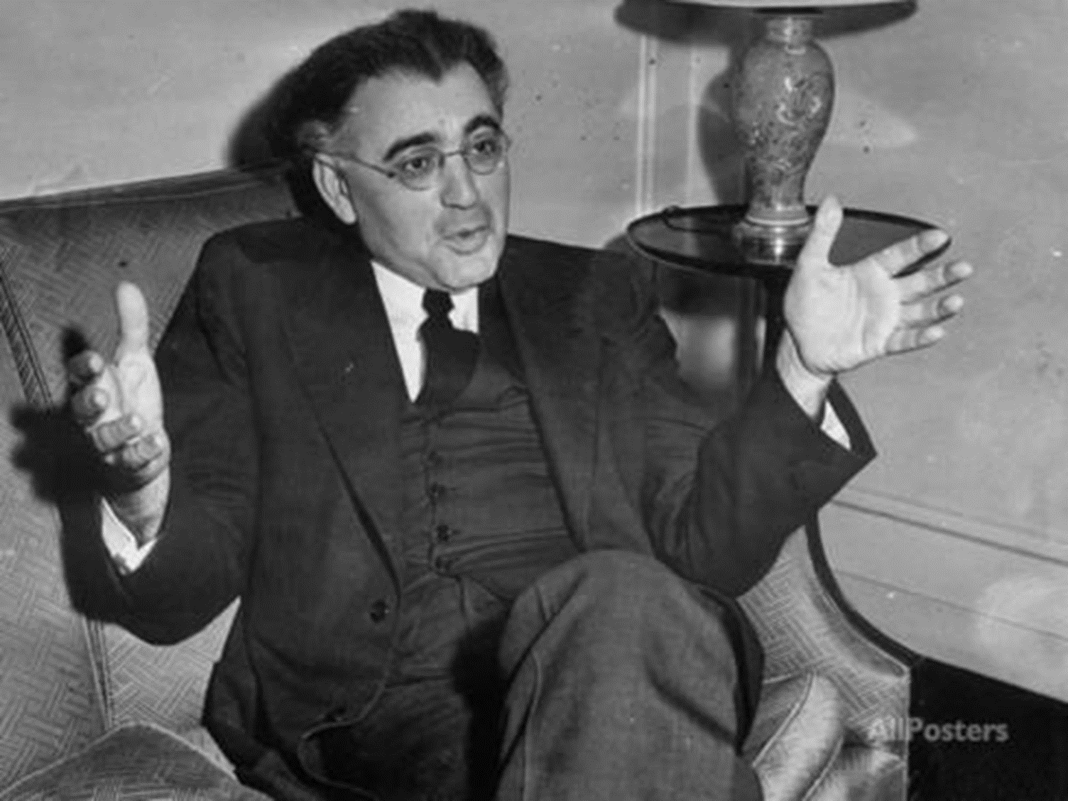
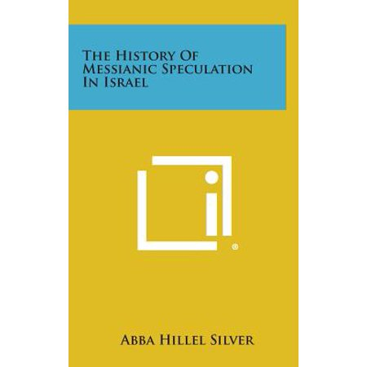

Slide 5
Zechariah 3:8-9
8 Now listen, Joshua the high priest, you and your friends who are sitting in front of you—indeed they are men who are a symbol, for behold, I am going to bring in My servant the Branch (tsemach). 9 For behold, the stone that I have set before Joshua; on one stone are seven eyes. Behold, I will engrave an inscription on it,’ declares the Lord of hosts, ‘and I will remove the iniquity of that land in one day.
Zechariah 6:12-13
12 Then say to him, ‘Thus says the Lord of hosts, “Behold, a man whose name is Branch (tsemach), for He will branch out from where He is; and He will build the temple of the Lord. 13 Yes, it is He who will build the temple of the Lord, and He who will bear the honor and sit and rule on His throne. Thus, He will be a priest on His throne, and the counsel of peace will be between the two offices.”’

Slide 6
Zechariah 3:8-9
8 Now listen, Joshua the high priest, you and your friends who are sitting in front of you—indeed they are men who are a symbol, for behold, I am going to bring in My servant the Branch (tsemach). 9 For behold, the stone that I have set before Joshua; on one stone are seven eyes. Behold, I will engrave an inscription on it,’ declares the Lord of hosts, ‘and I will remove the iniquity of that land in one day.

Slide 7
Isaiah 4:2
In that day the Branch (tsemach) of the Lord will be beautiful and glorious, and the fruit of the earth will be the pride and the adornment of the survivors of Israel.

Slide 8
Isaiah 11:1-2
Then a shoot (miggeza) will spring from the stem of Jesse, And a branch (nezer) from his roots will bear fruit. 2 The Spirit of the Lord will rest on Him, The spirit of wisdom and understanding, The spirit of counsel and strength, The spirit of knowledge and the fear of the Lord.

Slide 9
Jeremiah 23:5-6
“Behold, the days are coming,” declares the Lord, “When I will raise up for David a righteous Branch (tsemach); And He will reign as king and act wisely And do justice and righteousness in the land. 6 “In His days Judah will be saved, And Israel will dwell securely; And this is His name by which He will be called, ‘The Lord our righteousness.’

Slide 10
Jeremiah 33:15-16; 15
In those days and at that time I will cause a righteous Branch (tsemach) of David to spring forth; and He shall execute justice and righteousness on the earth. 16 In those days Judah will be saved and Jerusalem will dwell in safety; and this is the name by which she will be called: the Lord is our righteousness.’

Slide 11
Zechariah 3:8-9
8 Now listen, Joshua the high priest, you and your friends who are sitting in front of you—indeed they are men who are a symbol, for behold, I am going to bring in My servant the Branch (tsemach). 9 For behold, the stone that I have set before Joshua; on one stone are seven eyes. Behold, I will engrave an inscription on it,’ declares the Lord of hosts, ‘and I will remove the iniquity of that land in one day.

Slide 12
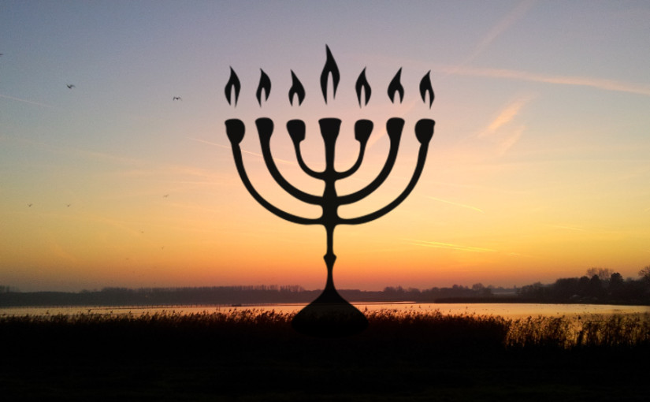
The Branch passages refer to the coming Messiah.
Tsemach texts refer to Zerubbabel; Nezer texts refer to Messiah.
The Branch fulfillment is either Joshua or Zerubbabel.

Slide 13
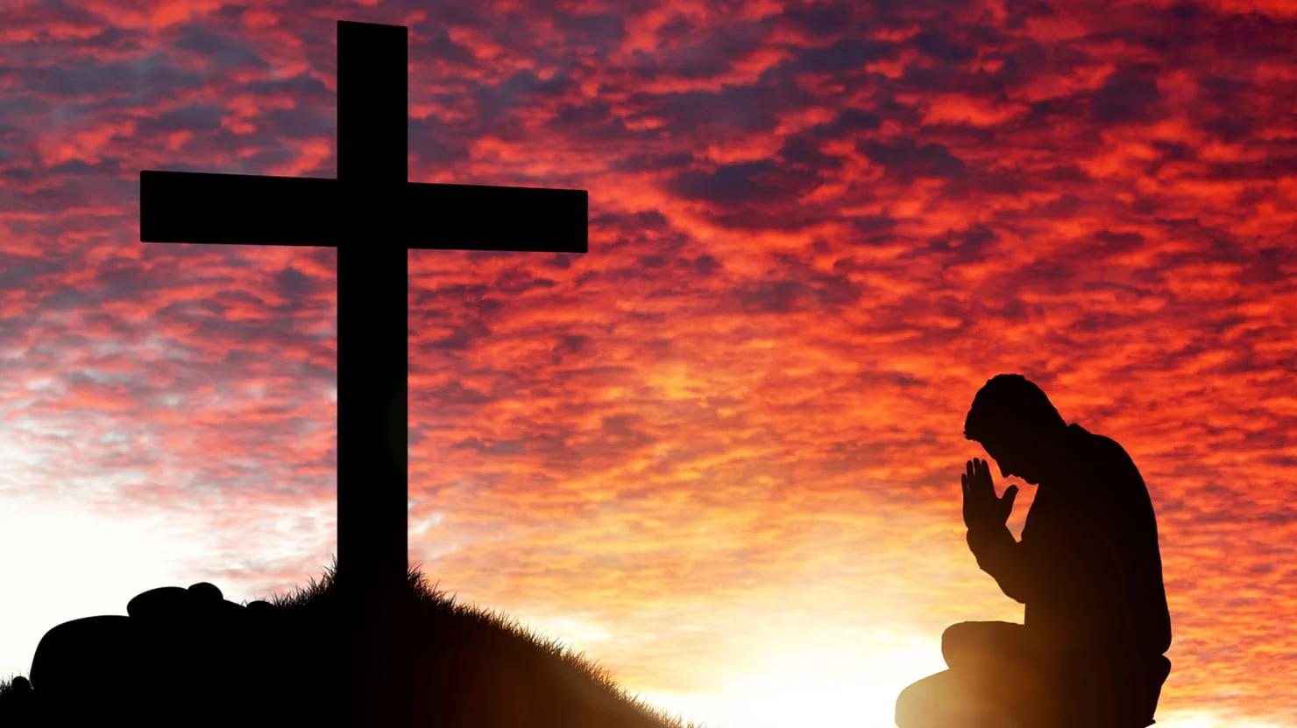
My-Servant = Servant Messiah of Isaiah.
Joshua the High Priest and Branch are distinct in these texts.
Zerubbabel was a governor, not a king.
Someone greater is required to fulfill the Branch prophecy.

Slide 14
Matthew 2:22-23
But when he heard that Archelaus was reigning over Judea in place of his father Herod, he was afraid to go there. Then after being warned by God in a dream, he left for the regions of Galilee, and came and lived in a city called Nazareth. This was to fulfill what was spoken through the prophets: “He shall be called a Nazarene.

Slide 15
Zechariah 6:10-11
10 Take an offering from the exiles, from Heldai, Tobijah and Jedaiah; and you go the same day and enter the house of Josiah the son of Zephaniah, where they have arrived from Babylon. 11 Take silver and gold, make an ornate crown and set it on the head of Joshua the son of Jehozadak, the high priest.

Slide 16
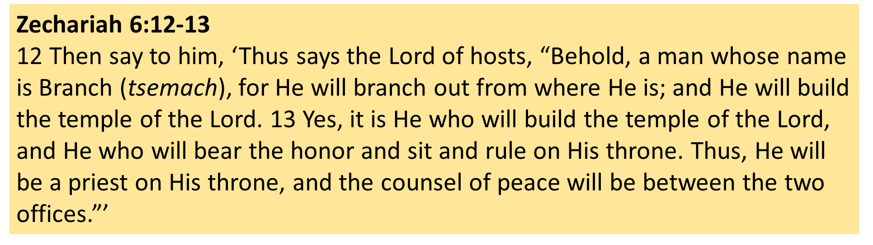

Slide 17
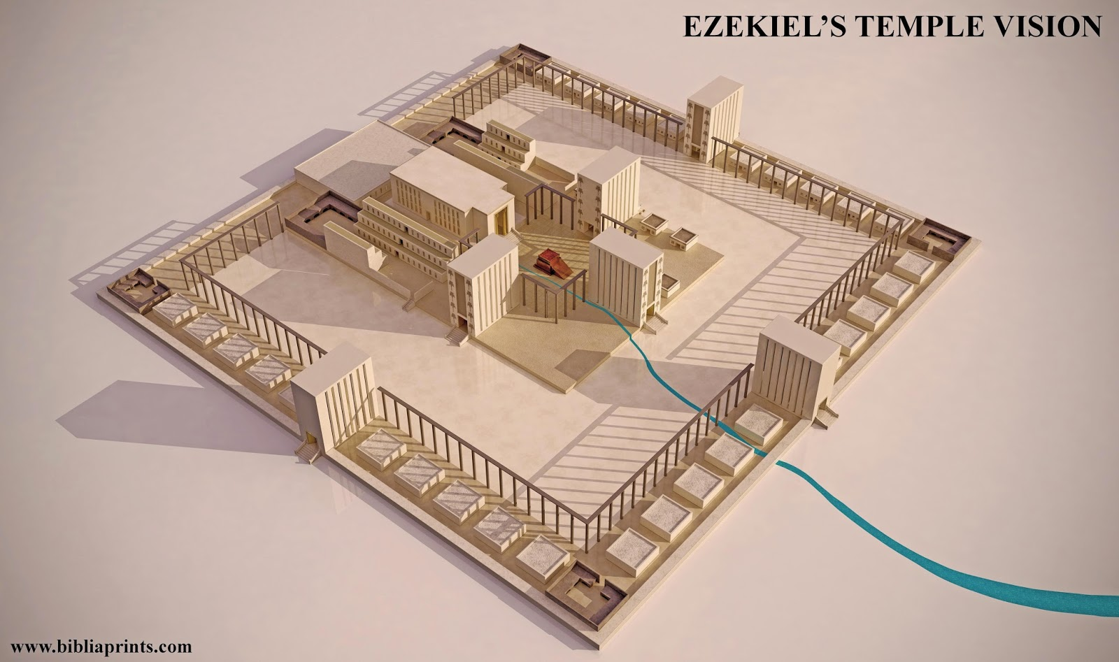

Slide 18
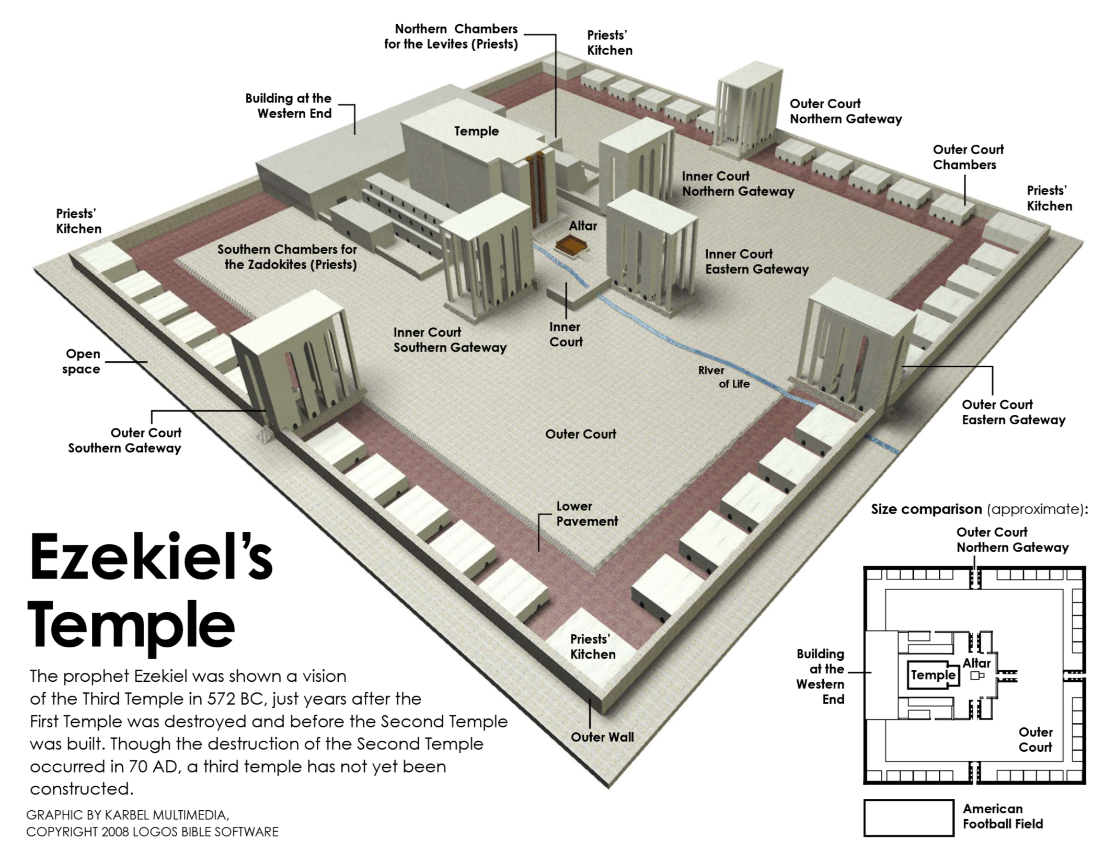

Slide 19
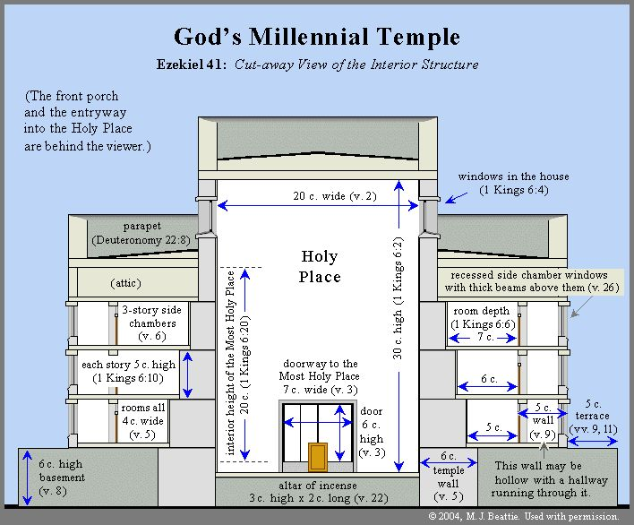

Slide 20
The Branch was fulfilled during the time of Zerubbabel’s Temple.
Zerubbabel, Joshua, or BOTH would rightly be the Branch.
Joshua as Priest would subordinate himself to Zerubbabel as king.

Slide 22
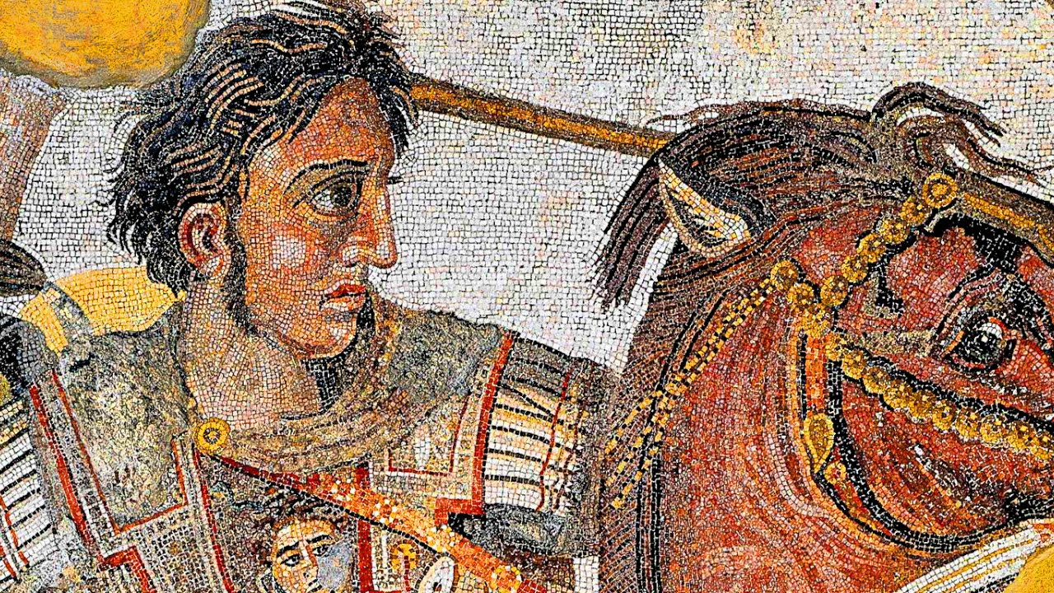

Slide 23
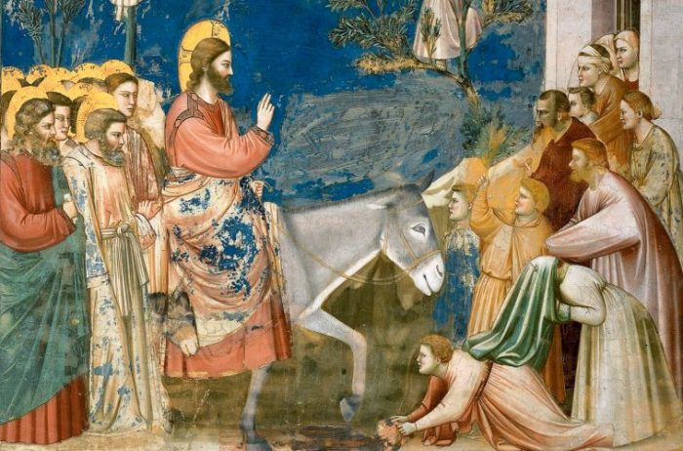

Slide 24
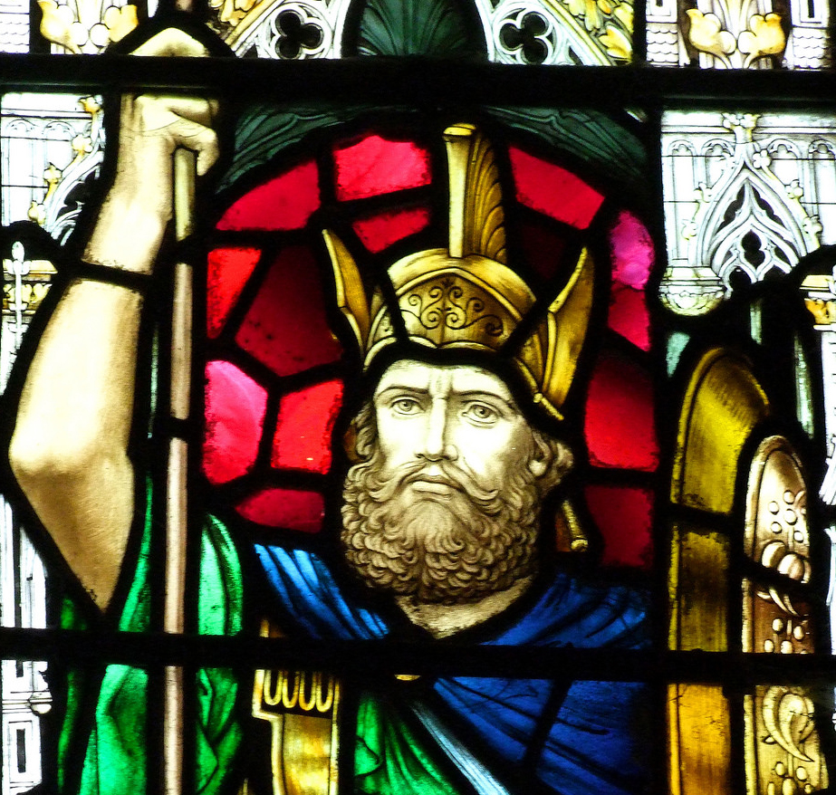

Slide 25
Zechariah 9:9-10
9 Rejoice greatly, O daughter of Zion!
Shout in triumph, O daughter of Jerusalem!
Behold, your king is coming to you;
He is just and endowed with salvation,
Humble, and mounted on a donkey,
Even on a colt, the foal of a donkey.
10 I will cut off the chariot from Ephraim
And the horse from Jerusalem;
And the bow of war will be cut off.
And He will speak peace to the nations;
And His dominion will be from sea to sea,
And from the River to the ends of the earth.

Slide 26
Psalm 72:8-11
May he also rule from sea to sea, And from the River to the ends of the earth. 9 Let the nomads of the desert bow before him, And his enemies lick the dust. 10 Let the kings of Tarshish and of the islands bring presents; The kings of Sheba and Seba offer gifts. 11 And let all kings bow down before him, All nations serve him.

Slide 27
John 12:14-15
Jesus, finding a young donkey, sat on it; as it is written, 15 “Fear not, daughter of Zion; behold, your King is coming, seated on a donkey’s colt.” Also in Mark 11:1-11, with 11:2 as focal, Jesus said to them, “Go into the village opposite you, and immediately as you enter it, you will find a colt tied there, on which no one yet has ever sat; untie it and bring it here.”

Slide 28
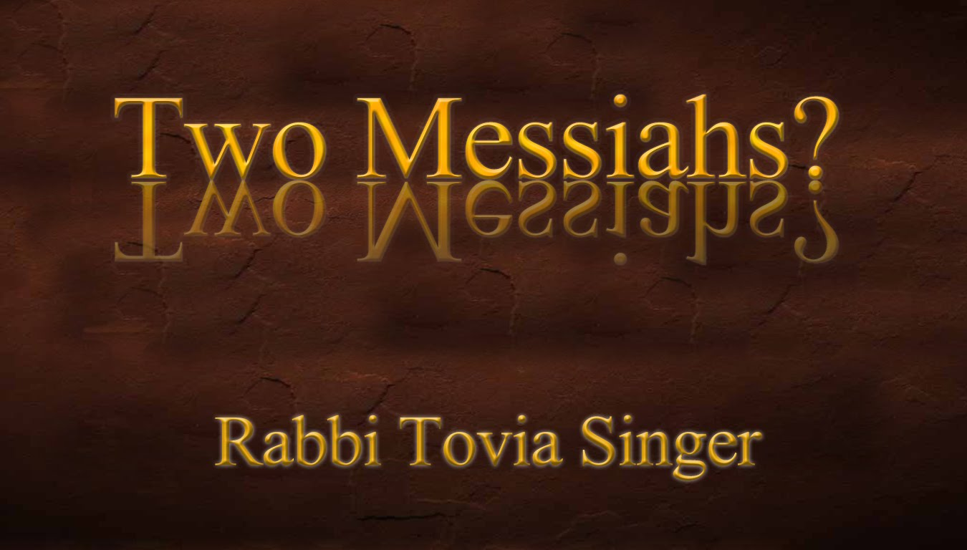
Judas Maccabaeus was the rider on the donkey.
Nehemiah was the rider on the donkey.
Messiah is the rider….but no Messiah-Jesus.

Slide 29
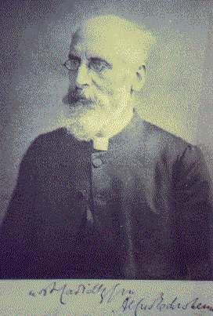
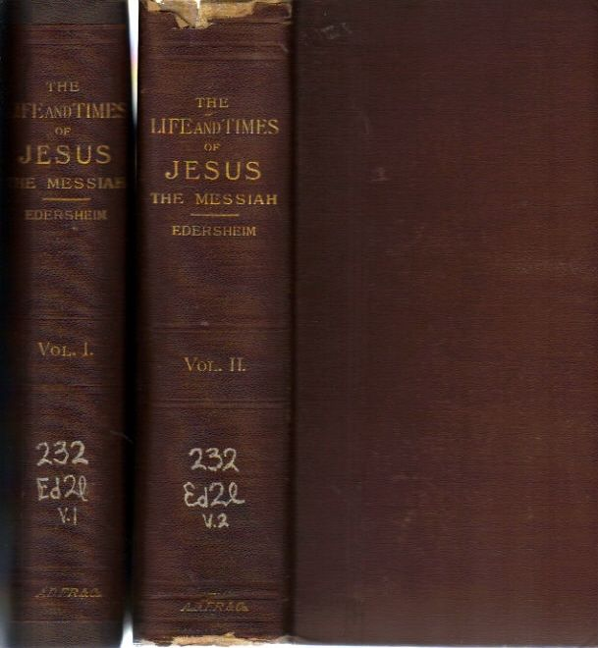

Slide 30
Zechariah 9:9 in Matthew 21:5 and John 12:15.
Zechariah 9:10 is not quoted in the gospels.

Slide 31
Zechariah 12:9-11
9 And in that day I will set about to destroy all the nations that come against Jerusalem.
10 “I will pour out on the house of David and on the inhabitants of Jerusalem, the Spirit (ruach) of grace (hen) and of supplication (hanah), so that they will look on Me whom they have pierced (dakar); and they will mourn for Him, as one mourns for an only son, and they will weep bitterly over Him like the bitter weeping over a firstborn. 11 In that day there will be great mourning in Jerusalem, like the mourning of Hadadrimmon in the plain of Megiddo.

Slide 32
Zechariah 12:11-14
11 In that day there will be great mourning in Jerusalem, like the mourning of Hadadrimmon in the [i]plain of [j]Megiddo. 12 The land will mourn, every family by itself; the family of the house of David by itself and their wives by themselves; the family of the house of Nathan by itself and their wives by themselves; 13 the family of the house of Levi by itself and their wives by themselves; the family of the Shimeites by itself and their wives by themselves; 14 all the families that remain, every family by itself and their wives by themselves.

Slide 33
Psalm 22:16
For dogs have surrounded me; A band of evildoers has encompassed me; They pierced (kereh) my hands and my feet.

Slide 34
Isaiah 53:5
But He was pierced through (chalal) for our transgressions, He was crushed for our iniquities; The chastening for our well-being fell upon Him, And by His scourging we are healed.

Slide 35
Luke 2:35
Simeon regarding Mary the mother of Jesus; “and a sword will pierce even your own soul—to the end that thoughts from many hearts may be revealed.

Slide 36
John 19:31-37
31 Then the Jews, because it was the day of preparation, so that the bodies would not remain on the cross on the Sabbath (for that Sabbath was a high day), asked Pilate that their legs might be broken, and that they might be taken away. 32 So the soldiers came, and broke the legs of the first man and of the other who was crucified with Him; 33 but coming to Jesus, when they saw that He was already dead, they did not break His legs. 34 But one of the soldiers pierced His side with a spear, and immediately blood and water came out. 35 And he who has seen has testified, and his testimony is true; and he knows that he is telling the truth, so that you also may believe. 36 For these things came to pass to fulfill the Scripture, “Not a bone of Him shall be broken.” 37 And again another Scripture says, ‘They shall look on Him whom they pierced.’

Slide 37
Revelation 1:7
Behold, He is coming with the clouds, and every eye will see Him, even those who pierced Him; and all the tribes of the earth will mourn over Him. So it is to be. Amen.

Slide 38
CAN GOD BE PIERCED?

Slide 39
1. The nation Israel has been pierced.
2. Mourning that even a single person might be killed in battle.
3. The Nations who mourn of Jews fallen in battle.

Slide 40
In fact, the Israelites are quite secure and safe under God’s hand at this time:
• Zechariah 12:4 – I will watch over the house of Judah…
• Zechariah 12:6 – the inhabitants of Jerusalem (will) again dwell on their own sites in Jerusalem…
• Zechariah 12:8 – the Lord will defend the inhabitants of Jerusalem….the one who is feeble will be like David.

Slide 41
1. The nation Israel has been pierced.
2. Mourning that even a single person might be killed in battle.
3. The Nations who mourn of Jews fallen in battle.
4. A Jewish person pierced in Zechariah’s time.
5. Messiah ben Joseph who would be put to death.

Slide 43
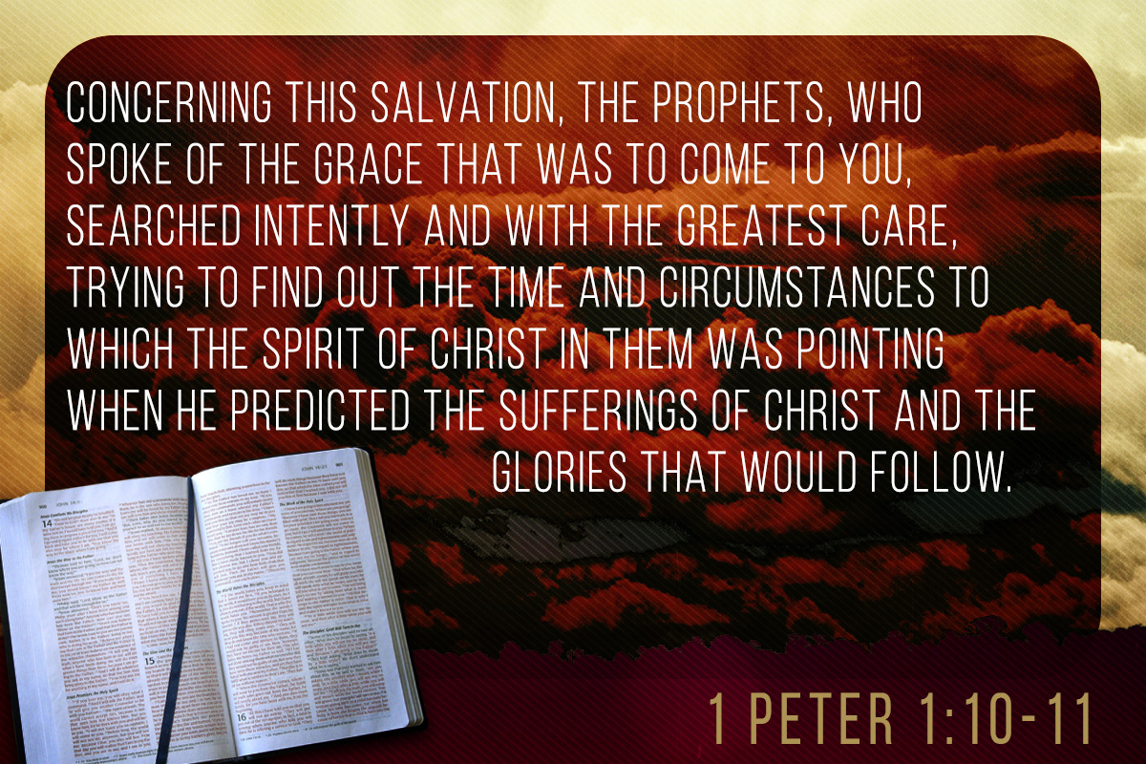

Slide 44
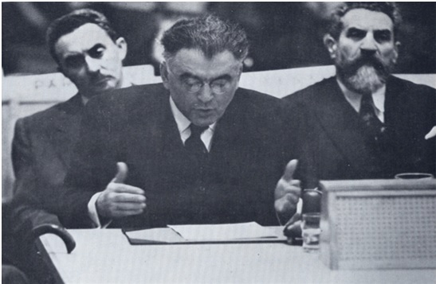

Slide 45
Zechariah 12:2-5
2 Behold, I am going to make Jerusalem a cup that causes reeling to all the peoples around; and when the siege is against Jerusalem, it will also be against Judah. 3 It will come about in that day that I will make Jerusalem a heavy stone for all the peoples; all who lift it will be severely injured. And all the nations of the earth will be gathered against it. 4 In that day, declares the Lord, “I will strike every horse with bewilderment and his rider with madness. But I will watch over the house of Judah, while I strike every horse of the peoples with blindness. 5 Then the clans of Judah will say in their hearts, ‘A strong support for us are the inhabitants of Jerusalem through the Lord of hosts, their God.’

