Slide 1

RICHARD R. SCHMIDT, D.MIN.
Church Ministries Field Representative
RSchmidt@FOI.org (414) 788-6010
Schedule Us for One Service to Multi-Day Prophecy Conference

Slide 2
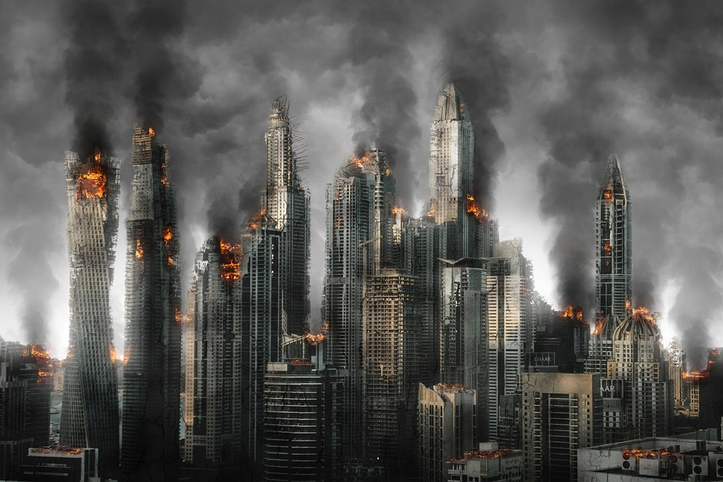



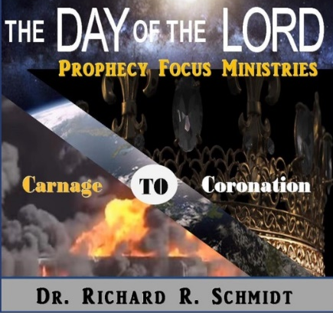


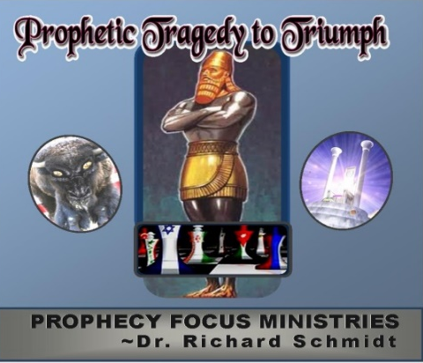

RESOURCES
ProphecyFocusMinistries.com
Prophecy CD’s
Prophecy Books

Slide 3
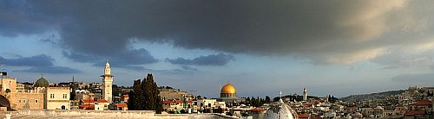

Prophecy Focus
THE PRE-TRIBULATION RAPTURE
Scripture’s
Most Compelling
Argument
Richard R. Schmidt, D.Min.

Slide 4

UNFULFILLED PROPHECY
The RAPTURE OF THE CHURCH is the next major prophetic event in God’s prophetic calendar
The RAPTURE, or removal of the CHURCH AGE SAINTS, was NOT prophesied in the Old Testament. WHY?

Slide 5
UNFULFILLED PROPHECY
The prophetic event immediately after the rapture of the church is the commencement of the 70th week of Daniel, or the 7-year TRIBULATION PERIOD (Daniel 9:27).
There is a plethora of Scriptural material regarding the seven years of tribulation throughout the Scriptures.
The Tribulation is the period that is designed to purge the earth of those who are against the coming King and prepare the earth for the SECOND COMING or SECOND ADVENT of the Lord Jesus Christ, the one and only true MESSIAH!

Slide 6
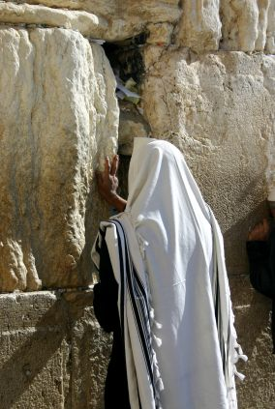
RAPTURE MEANING
The Greek word from which we take the term “RAPTURE” appears in 1 THESSALONIANS 4:17, translated “caught up.” The Latin translation of this verse used the word rapturo.
The Greek word it translates is harpazo, which means to snatch or take away.

Slide 7
RAPTURE MEANING
Elsewhere harpazo is used to describe how the Spirit caught up Philip near Gaza and brought him to Caesarea (ACTS 8:39) and to describe Paul’s experience of being caught up into the third heaven (2 CORINTHIANS 12:2-4). Thus there can be no doubt that the word is used in1THESSALONIANS 4:17 to indicate the actual removal of people from earth to heaven.

Slide 8
RAPTURE MEANING
The Rapture Of The Church Means The Carrying Away Of The Church Age Saints From Earth To Heaven.

Slide 9
PROPHETIC CHRONOLOGY
Tribulation
Second Advent
Battle of Armageddon
Nations Judged
Millennial Kingdom
RAPTURE

Slide 10


PROPHETIC CHRONOLOGY
Tribulation
Second Advent
Battle of Armageddon
Nations Judged
Millennial Kingdom
RAPTURE

Slide 11
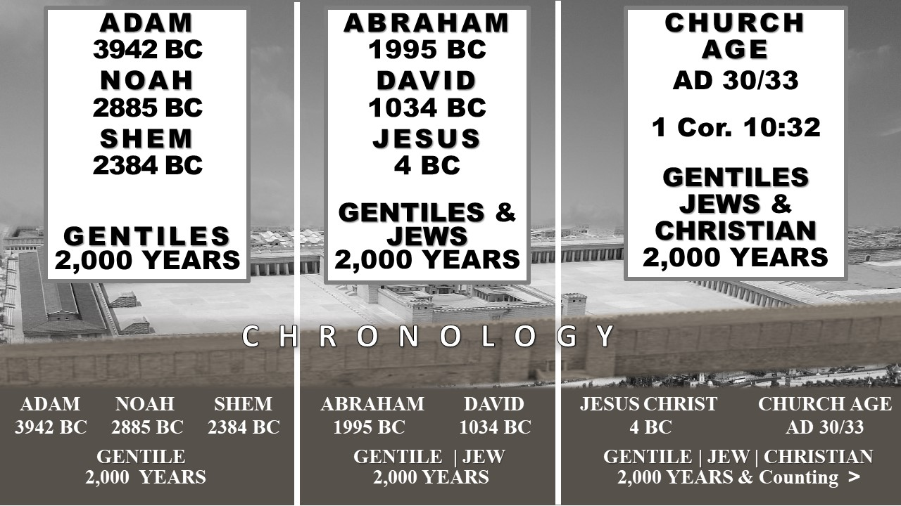
THE CHRONOLOGY OF THE THREE PEOPLE GROUPS
CHRONOLOGYN

Slide 12
Command to rebuild Jerusalem’s walls by
Artaxerxes
*MARCH 14, 445 B.C.
NEHEMIAH 2
DANIEL 9:24-27
The Most Spectacular Literal Dating
Of The Prophetic Time Line
WEEKS 1-69 GAP Week 70 MILLENNIUM
TRIBULATION 1,000
69 Weeks x 7 Years 1 x 7=7 Years Years
483 YEARS Daniel 9:27
WHY the GAP in the Prophetic Time Table?
The GAP exists as the mystery kept secret from the foundation of the world by God
(EPHESIANS 3:1-7; COLOSSIANS1:24-29; ROMANS 16:25)
The GAP includes the CHURCH AGE in which we now live, which will end when the CHURCH is removed from this earth at the event termed the RAPTURE (1 THESSALONIANS 4:16-18; 1 CORINTHIANS 15:51-54)
*Sir Robert Anderson, The Coming Prince

Slide 13
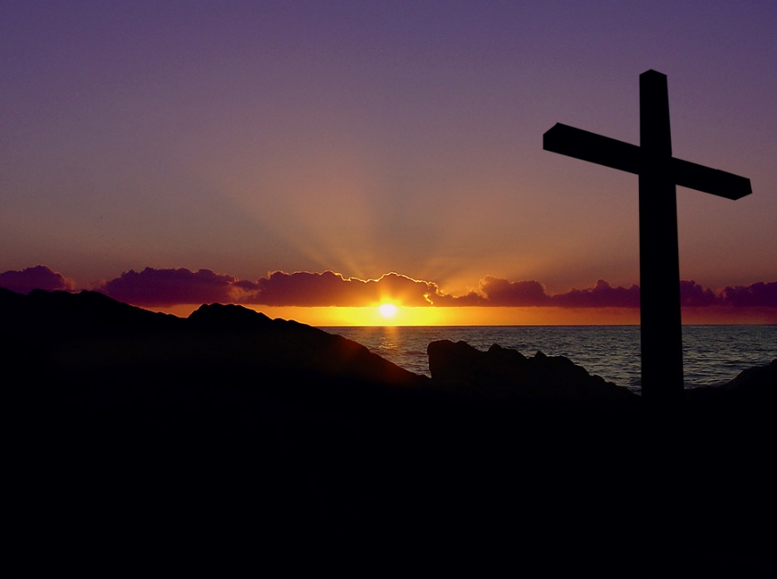
TIMELINE
Christ’s
Bodily Resurrection
“Firstfruits”
RAPTURE
Church Age Saints
BODIES Resurrected
Antichrist CONFIRMS Covenant With Israel
2nd ADVENT of Christ
Final Battle of Armageddon
“FIRST Resurrection” JUDGMENT of Nations
Time Span NOT
Revealed in
Scripture
7 YEAR TRIBULATION
~CHURCH AGE~
CURRENTLY IN PROGRESS
3.5 Years
3.5 Years
Antichrist’s ONE WORLD System
1000 Year
MILLENNIAL
Kingdom

Slide 14
TRANSITIONAL PERIOD – JUDAISM to Christianity
ACTS 2-7
ACTS 8
ACTS 9
ACTS 10
Jews & Proselytes
²²“Men of Israel
¹⁴ Men of Judea
³⁶ all the house of Israel
Acts 2:10
Samaritans
Acts 8:25
Ethiopian
Proselyte
Acts 8:26-40
Saul
Converted,
Gentiles,
Kings,
Israel
Acts 9
Gentiles
Acts 10:45
Men of Israel
Acts 3:12
Hellenists Acts 6:1
Nicolas, a Proselyte Acts 6:5
ACTS 1:8
“But you shall receive power when the Holy Spirit has come upon you; and you shall be witnesses to Me in, and in all JERUSALEM, JUDEA and SAMARIA, and to the END OF THE EARTH.”
Captain of Temple
Priests Sadducees
Acts 4:1; 5:24
Stephen Preaches the Exodus to His People-Martyred
Acts 7
Elders
Children of Israel
Acts 5:21
Notes:
T

Slide 15
PRE-TRIBULATION RAPTURE
I. THE DISTINCTIVE TIME FOR THE PRE- TRIBULATION RAPTURE / Daniel’s 70 Week Prophecy (Daniel 9:24-27)
A. First Period: 49 years = 7 Prophetic Weeks 445 to 396 b.c. (Daniel 9:25)
B. Second Period: 434 years = 62 Prophetic Weeks 396 B.C. to A.D. 32 (Daniel 9:25-26)
C. The Prophesied GAP: A.D. 32 - A.D. 70 (Daniel 9:26)
D. The Mystery GAP: Present Church Age (Ephesians 3:1-7; Colossians 1:24-29)
E. Third Period Future: 7 years = 1 Prophetic Week (Daniel 9:27)

Slide 16
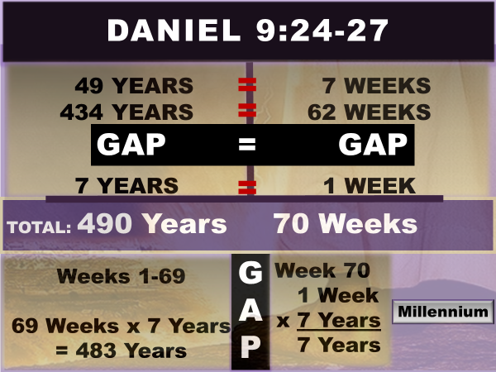

Slide 17
PRE-TRIBULATION RAPTURE
I. THE DISTINCTIVE TIME FOR THE PRE- TRIBULATION RAPTURE / Daniel’s 70 Week Prophecy (Daniel 9:24-27)
A. First Period: 49 years = 7 Prophetic Weeks 445 to 396 b.c. (Daniel 9:25)
B. Second Period: 434 years = 62 Prophetic Weeks 396 B.C. to A.D. 32 (Daniel 9:25-26)
C. The Prophesied GAP: A.D. 32 - A.D. 70 (Daniel 9:26)
D. The Mystery GAP: Present Church Age (Ephesians 3:1-7; Colossians 1:24-29)
E. Third Period Future: 7 years = 1 Prophetic Week (Daniel 9:27)

Slide 18

DANIEL’S 70 WEEK, 490 YEAR PROPHECY
JEWISH
PEOPLE IN
BABYLONIAN
CAPTIVITY
JERUSALEM &
TEMPLE PLUNDERED
A.D. 70
CHURCH REMOVED
1 Thessalonians 4:13-18
1 Corinthians 15:50-54
Revelation 4 -19
3.5
Y
E
A
R
S
3.5
Y
E
A
R
S
CHRIST’S
MILLENNIAL
KINGDOM
Revelation
20:1-7
DANIEL 9:25
7 Weeks
=
49 Years
DANIEL 9:25
62 Weeks =
434 Years
CHURCH AGE
Ephesians 3:1-7
Colossians 1:24-29
Romans 16:25,26
DANIEL 9:25
69 Weeks =
483 Years
INTERLUDE
ALLOWANCE
Daniel 9:26
Dan. 9:27
1 Week =
7 Year
Tribulation
GAP BETWEEN 69th & 70th Weeks of Daniel
Daniel 9:27
Daniel’s
70th Week

Slide 19
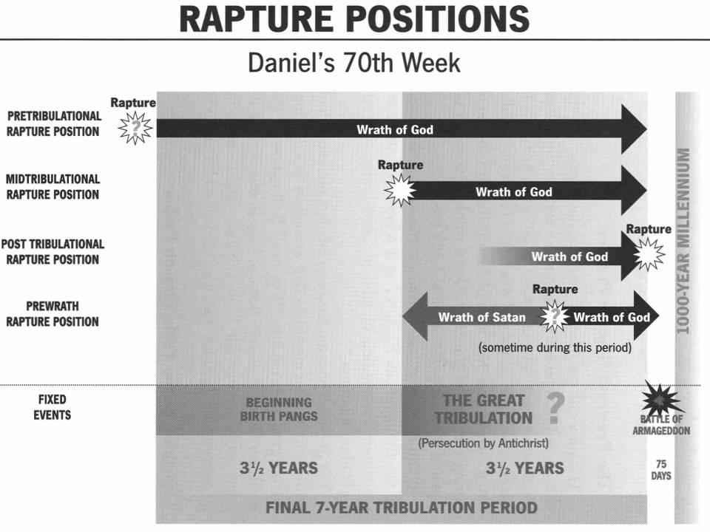
COMPARISON OF RAPTURE POSITIONS

Slide 20
PRE-TRIBULATION RAPTURE
II. THE DISTINCTIVE TRANSITION OF THE PRE-TRIBULATION RAPTURE
(1 THESSALONIANS 4:13-18)
A. The Solace of the Rapture (1 Thessalonians 4:13-15)
B. The Sounds of the Rapture (1 Thessalonians 4:16)
C. The Sequence of the Rapture (1 Thessalonians 4:16-17)

Slide 21
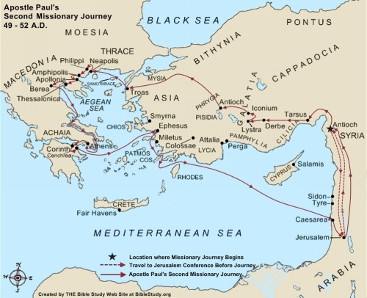
CITIES VISITED BY PAUL

Slide 22
The RAPTURE or TAKING AWAY of the Current Church Age Saints by Jesus Christ
UNFULFILLED PROPHECY
JOHN 14:1-4 ¹ "Let not your heart be troubled; you believe in God, believe also in Me. ² In My Father's house are many mansions; if it were not so, I would have told you. I go to prepare a place for you. ³ And if I go and prepare a place for you, I will come again and receive you to Myself; that where I am, there you may be also. ⁴ And where I go you know, and the way you know."

Slide 23
The RAPTURE or TAKING AWAY of the Current Church Age Saints by Jesus Christ
UNFULFILLED PROPHECY
1 THESSALONIANS 4:15-18
¹⁵For this we say to you by the word of the Lord, that we who are alive and remain until the coming of the Lord will by no means precede those who are asleep (Dead).
¹⁶For the Lord Himself will descend from heaven with a shout, with the voice of an archangel, and with the trumpet of God. And the dead in Christ will rise first. ¹⁷Then we who are alive and remain shall be caught up together with them in the clouds to meet the Lord in the air. And thus we shall always be with the Lord. ¹⁸Therefore comfort one another with these words.

Slide 24

The RAPTURE or TAKING AWAY of the Current Church Age Saints by Jesus Christ
UNFULFILLED PROPHECY

Slide 25
PRE-TRIBULATION RAPTURE
II. THE DISTINCTIVE TRANSITION OF THE PRE-TRIBULATION RAPTURE
(1 THESSALONIANS 4:13-18)
A. The Solace of the Rapture (1 Thessalonians 4:13-15)
B. The Sounds of the Rapture (1 Thessalonians 4:16)
C. The Sequence of the Rapture (1 Thessalonians 4:16-17)

Slide 26
RAPTURE-1 THESSALONIANS 4
The Return of Christ (1Thessalonians 4:16)
The Resurrection of Church Age Saints (1Thessalonians 4:16)
The Rapture/Catching Away of the Saints (1Thessalonians 4:17)
The Reunion with Christ (1Thessalonians 4:17)
The Reassurance of Comfort / Encouragement (1Thessalonians 4:18)

Slide 27
TIMELINE
Christ’s
Bodily Resurrection
“Firstfruits”
RAPTURE
Church Age Saints
BODIES Resurrected
Antichrist CONFIRMS Covenant With Israel
2nd ADVENT of Christ
Final Battle of Armageddon
“FIRST Resurrection” JUDGMENT of Nations
Time Span NOT
Revealed in
Scripture
7 YEAR TRIBULATION
~CHURCH AGE~
CURRENTLY IN PROGRESS
3.5 Years
3.5 Years
Antichrist’s ONE WORLD System
1000 Year
MILLENNIAL
Kingdom

Slide 28
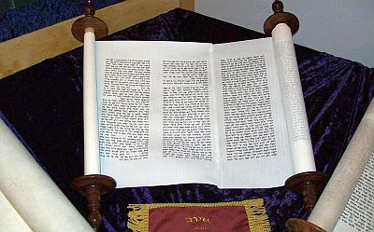
PRE-TRIBULATION RAPTURE
II. THE DISTINCTIVE TRANSFORMATION IN THE PRE-TRIBULATION RAPTURE
(1 CORINTHIANS 15:50-54)
A. The Mystery of the Rapture (1 Corinthians 15:51)
B. The Metamorphosis During the Rapture (1 Corinthians 15:51-54)
C. The Marvelous Victory of the Rapture (1 Corinthians 15:54)

Slide 29
UNFULFILLED PROPHECY
The RAPTURE or TAKING AWAY of the Current Church Age Saints by Jesus Christ
1 CORINTHIANS 15:50 - 53
⁵⁰Now this I say, brethren, that flesh and blood cannot inherit the kingdom of God; nor does corruption inherit incorruption. ⁵¹Behold, I tell you a mystery: We shall not all sleep (DIE), but we shall all be changed— ⁵²in a moment, in the twinkling of an eye, at the last trumpet. For the trumpet will sound, and the dead will be raised incorruptible, and we shall be changed.
⁵³For this corruptible must put on incorruption, and this mortal must put on immortality.

Slide 30
TIMELINE
Christ’s
Bodily Resurrection
“Firstfruits”
RAPTURE
Church Age Saints
BODIES Resurrected
Antichrist CONFIRMS Covenant With Israel
2nd ADVENT of Christ
Final Battle of Armageddon
“FIRST Resurrection” JUDGMENT of Nations
Time Span NOT
Revealed in
Scripture
7 YEAR TRIBULATION
~CHURCH AGE~
CURRENTLY IN PROGRESS
3.5 Years
3.5 Years
Antichrist’s ONE WORLD System
1000 Year
MILLENNIAL
Kingdom

Slide 31
The RAPTURE or TAKING AWAY of the Current Church Age Saints by Jesus Christ
UNFULFILLED PROPHECY
ZECHARIAH 14:4 ^{4 “}And in that day His feet will stand on the Mount of Olives, which faces Jerusalem on the east. And the Mount of Olives shall be split in two, From east to west, Making a very large valley; Half of the mountain shall move toward the north and half of it toward the south.”

Slide 32
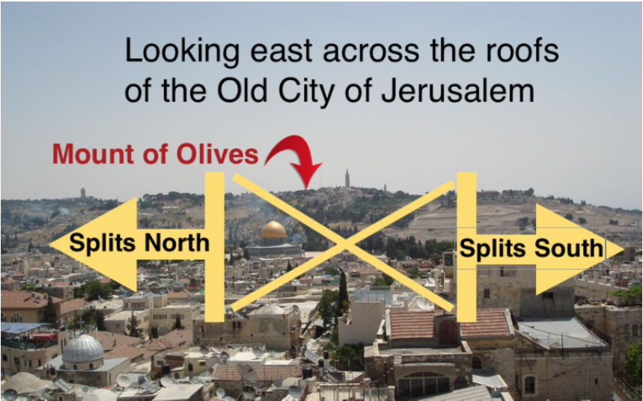
The RAPTURE or TAKING AWAY of the Current Church Age Saints by Jesus Christ
UNFULFILLED PROPHECY

Slide 33
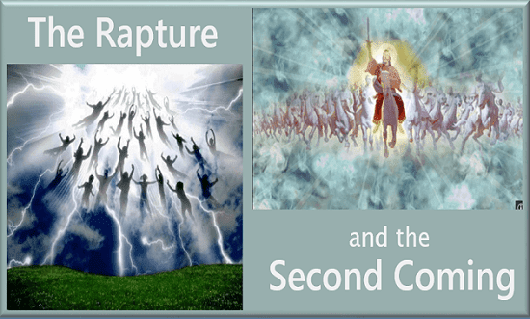
UNFULFILLED PROPHECY
The Rapture
and the
Second Coming

Slide 34


Slide 35
Prophecy Focus
THE PRE-TRIBULATION RAPTURE
Scripture’s
Most Compelling
Argument
Richard R. Schmidt, D.Min.

Slide 36
RICHARD R. SCHMIDT, D.MIN.
Church Ministries Field Representative
RSchmidt@FOI.org (414) 788-6010
Schedule Us for One Service to Multi-Day Prophecy Conference

Slide 37

PROPHECY FOCUS
Bible Teacher: Richard Schmidt , D. Min.
ProphecyFocusMinistries.com
MINISTRIES

