Slide 1
Bethel Church and the
New Apostolic Reformation
Part 1, Origins, Characteristics, and Excesses
Dr. G. Allen Gunn
Shasta Bible College and Graduate School

Slide 2
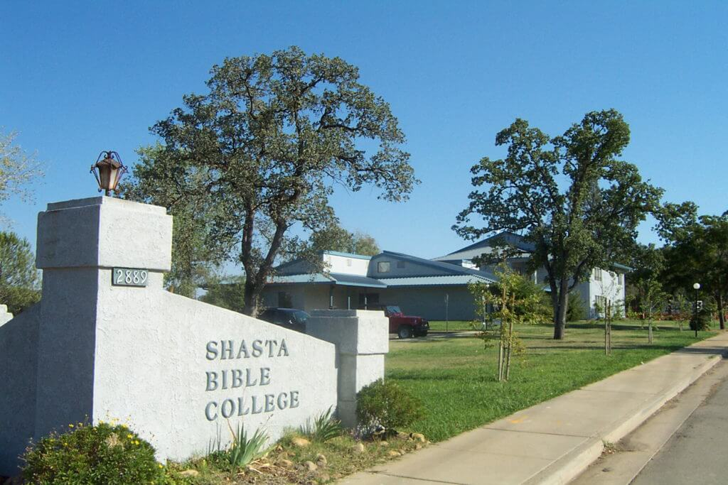

Slide 3
Why this topic at a prophecy conference?
2 Timothy 3:1–5 But realize this, that in the last days difficult times will come. For men will be lovers of self, lovers of money, boastful, arrogant, revilers, disobedient to parents, ungrateful, unholy, unloving, irreconcilable, malicious gossips, without self-control, brutal, haters of good, treacherous, reckless, conceited, lovers of pleasure rather than lovers of God, holding to a form of godliness, although they have denied its power; Avoid such men as these.
(See also 1 Timothy 4:1-2; 2 Peter 3:3; Jude 17-18)

Slide 4

Bill & Beni Johnson
Apostle and Prophet at Bethel Church, Redding

Slide 5
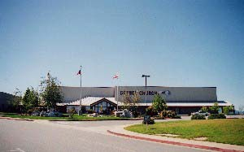



Slide 6
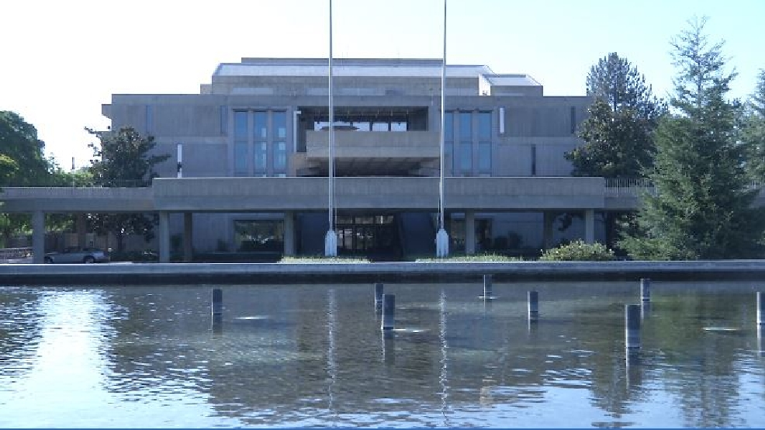
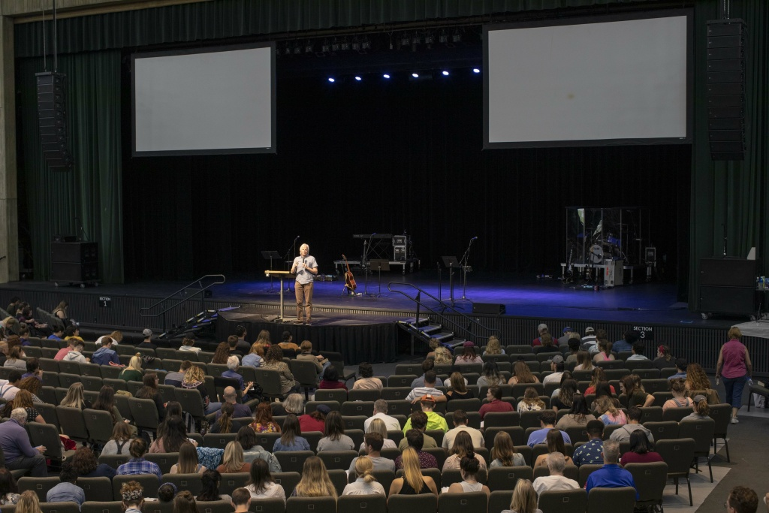
Redding Civic Auditorium, rented by BSSM
BSSM class to first year class of about 1,200 students

Slide 7


Slide 8
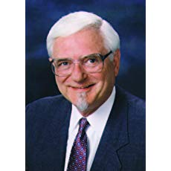
Bethel Church and NAR – Origins
C. Peter Wagner (August 15, 1930 – October 21, 2016)
Missionary
Prof. of Church Growth, Fuller Theological Seminary
Founder, International Coalition of Apostles
Used phrase “New Apostolic Reformation” (1996) – an advance upon the third wave movement

Slide 9
Bethel Church and NAR – Origins
We are now living in the midst of one of the most epochal changes in the structure of the Church that has ever been recorded. I like to call it the “Second Apostolic Age.”
—C. Peter Wagner, Apostles Today: Biblical Government for Biblical Power (Regal Books, 2006)

Slide 10

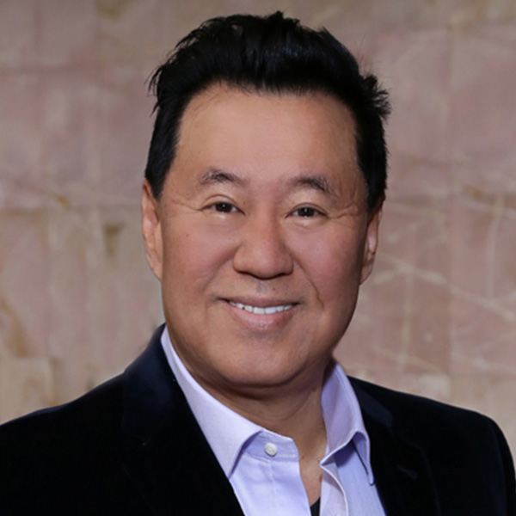
Bethel Church and NAR – Origins
A controversial and highly publicized apostolic decree was made on June 23, 2008, when Todd Bentley was formally commissioned as an evangelist to lead the Lakeland Revival in Florida. Under Wagner’s leadership, prominent apostles gathered for the ceremony, which was broadcast worldwide by GOD TV. The purpose of the ceremony was to decree the apostolic alignment of Bentley with three apostles—Ché Ahn of Pasadena, California; Bill Johnson of Redding, California; and John Arnott of Toronto, Canada. By becoming apostolically aligned with these three apostles, who represent an apostolic network called Revival Alliance, Bentley was agreeing to come under their authority. This is in line with the NAR teaching that all offices of the church, including the office of evangelist, must submit to apostles. During the ceremony, Wagner referred to Ahn, Johnson, and Arnott as “apostolic pillars of today’s church.”
R. Douglas Geivett and Holly Pivec, A New Apostolic Reformation?: A Biblical Response to a Worldwide Movement (Bellingham, WA: Lexham Press, 2014), 210.

Slide 11
Bethel Church and NAR – Previous Outbreaks
Phenomenon of false prophets in Bible

Slide 12
Jeremiah 28 ¹ Now in the same year, in the beginning of the reign of Zedekiah king of Judah, in the fourth year, in the fifth month, Hananiah the son of Azzur, the prophet, who was from Gibeon, spoke to me in the house of the Lord in the presence of the priests and all the people, saying, ² “Thus says the Lord of hosts, the God of Israel, ‘I have broken the yoke of the king of Babylon. ³ ‘Within two years I am going to bring back to this place all the vessels of the Lord’s house, which Nebuchadnezzar king of Babylon took away from this place and carried to Babylon. ⁴ ‘I am also going to bring back to this place Jeconiah the son of Jehoiakim, king of Judah, and all the exiles of Judah who went to Babylon,’ declares the Lord, ‘for I will break the yoke of the king of Babylon.’ ”

Slide 13
⁵ Then the prophet Jeremiah spoke to the prophet Hananiah in the presence of the priests and in the presence of all the people who were standing in the house of the Lord, ⁶ and the prophet Jeremiah said, “Amen! May the Lord do so; may the Lord confirm your words which you have prophesied to bring back the vessels of the Lord’s house and all the exiles, from Babylon to this place. ⁷ “Yet hear now this word which I am about to speak in your hearing and in the hearing of all the people! ⁸ “The prophets who were before me and before you from ancient times prophesied against many lands and against great kingdoms, of war and of calamity and of pestilence. ⁹ “The prophet who prophesies of peace, when the word of the prophet comes to pass, then that prophet will be known as one whom the Lord has truly sent.” [Deut. 18:22]

Slide 14
¹⁰ Then Hananiah the prophet took the yoke from the neck of Jeremiah the prophet and broke it. ¹¹ Hananiah spoke in the presence of all the people, saying, “Thus says the Lord, ‘Even so will I break within two full years the yoke of Nebuchadnezzar king of Babylon from the neck of all the nations.’ ”

Slide 15
Then the prophet Jeremiah went his way. ¹² The word of the Lord came to Jeremiah after Hananiah the prophet had broken the yoke from off the neck of the prophet Jeremiah, saying, ¹³ “Go and speak to Hananiah, saying, ‘Thus says the Lord, “You have broken the yokes of wood, but you have made instead of them yokes of iron.” ¹⁴ ‘For thus says the Lord of hosts, the God of Israel, “I have put a yoke of iron on the neck of all these nations, that they may serve Nebuchadnezzar king of Babylon; and they will serve him. And I have also given him the beasts of the field.” ’ ”

Slide 16
¹⁵ Then Jeremiah the prophet said to Hananiah the prophet, “Listen now, Hananiah, the Lord has not sent you, and you have made this people trust in a lie. ¹⁶ “Therefore thus says the Lord, ‘Behold, I am about to remove you from the face of the earth. This year you are going to die, because you have counseled rebellion against the Lord.’ ” ¹⁷ So Hananiah the prophet died in the same year in the seventh month.

Slide 17
Bethel Church and NAR – Previous Outbreaks
Phenomenon of false prophets in Bible
Montanism, 2nd century Anatolia, Montanus, the promised Paraclete
Zwickau prophets, encountered by Martin Luther in 16th century
Irvingites (1830s)
Kansas City Prophets (1980s)
International House of Prayer (1990s), and the Toronto Blessing

Slide 18
Bethel Church and NAR – 3 Characteristics
Restoring apostolic authority
Restoring prophetic authority
Restoring dominion authority

Slide 19

(Destiny Image: 2013)
Postmillennial
Replacement Theology
Unconstitutional

Slide 20
“Bill Johnson, senior leader of Bethel Church in Redding, California, opens this book with a foundational teaching on dominion theology. In simple terms, dominion theology is the idea that Christian believers are called to not only preach the Gospel and win converts to Christ but also to establish the Kingdom of God on the earth. Bill encourages all believers to learn how to walk in the full authority of the Gospel so they can heal the sick, raise the dead, and see people touched and transformed by the power of God.... How does the Church invade Babylon? ... By confidently infiltrating every area of life with the Kingdom of God.”
Invading Babylon: The 7 Mountain Mandate, by Bill Johnson, Lance Wallnau, Alan Vincent, C. Peter Wagner, Che Ahn, and Patricia King (Shhippensburg, PA: Destiny Image, 2013), p. 1.

Slide 21
“The Seven Mountain revelation helps us strategically identify different aspects of society so that cultural transformation can become a manageable task. All of us are called to at least one of these seven mountains: religion, arts, media, business, government, family, and education.... As we begin taking land for our King, we will undoubtedly face great resistance.... The third chapter of this book ... offers a profound teaching about taking spiritual ground by occupying the spiritual gates of our cities. Gates represent the spiritual powers that rule over geographical areas.”
Invading Babylon: The 7 Mountain Mandate, by Bill Johnson, Lance Wallnau, Alan Vincent, C. Peter Wagner, Che Ahn, and Patricia King (Shhippensburg, PA: Destiny Image, 2013), p. 1. [Emphasis mine].

Slide 22
Here are the seven mountains, according to the seven mountain mandate:
  Education
  Religion
  Family
  Business
  Government/Military
  Arts/Entertainment
  Media

Slide 23
Bethel Church and NAR – Characteristics
Restoring apostolic authority
Restoring prophetic authority
Restoring dominion authority
Signs and Wonders

Slide 24
Bethel Church and NAR – Odd Phenomena
Glory Cloud (gold dust)
Angel feathers
Diamonds and gems
Grave soaking (picking up a fallen mantle)

Slide 25
Grave Soaking
When asked by Dr. Michael Brown whether Bethel Church teaches grave soaking, Bill Johnson replied:
  “We don’t talk to the dead. We don’t seek imprintation from the dead. I have gone to the grave of Charles Finney and prayed, ‘God, do through us what You did through him.’ It’s a point of reminder, but not to receive from them.”
  “The Line of Fire with Dr. Michael Brown”
  May 11, 2019
  https://www.youtube.com/watch?v=uCes2PZVFC4

Slide 26
Grave Soaking
However, in the book The Physics of Heaven (Destiny Image, 2012), Chapter 4 “Recovering Our Spiritual Inheritance,”
  “Where do we start? We can begin by recovering secrets, mysteries, mantles, and realms of God that have been abandoned and ignored for decades, some of them for centuries…. We’ve been given an inheritance of hundreds of years of mystics, of revivalists, of those who broke into realms of the Spirit to leave something as an inheritance, and it needs to matter to someone.”

Slide 27
Grave Soaking
However, in the book The Physics of Heaven (Destiny Image, 2012), Chapter 4 “Recovering Our Spiritual Inheritance,”
  “There are anointings, mantles, revelations, and mysteries that have lain unclaimed, literally where they were lefg, because the generation that walked in them never passed them on. I believe it’s possible for us to recover realms of anointing, realms of insight, realms of God that have been untended for decades simply by choosing to reclaim them and perpetuate them for future generations.”

Slide 28
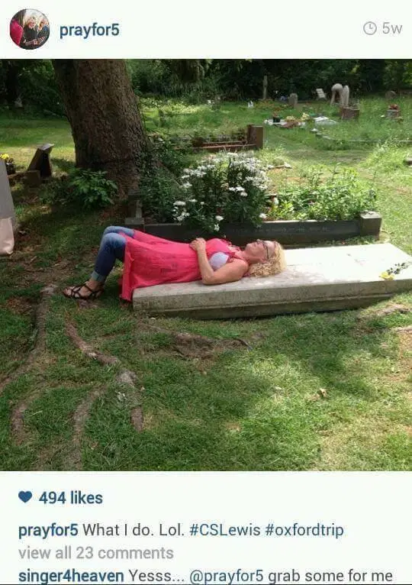
“prayfor5” is Beni Johnson’s twitter handle.

Slide 29
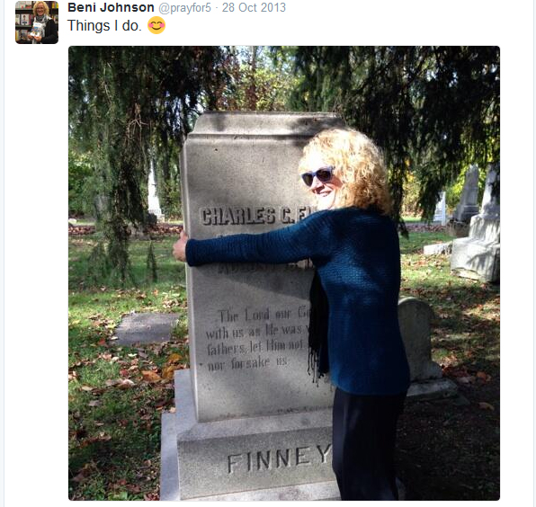
“prayfor5” is Beni Johnson’s twitter handle.

Slide 30
Bethel Church and NAR – Odd Phenomena
Glory Cloud (gold dust)
Angel feathers
Diamonds and gems
Grave soaking (picking up a fallen mantle)
Prayer for an individual’s resurrection from the dead

Slide 31
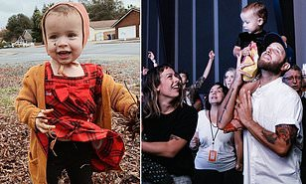
December 14, 2019 a talented young couple, Andrew and Kalley Heilingenthal, lost their two-year-old child, Olive. The girl simply stopped breathing early December 14, 2019, and when she arrived at the hospital, she was declared dead, and her
body taken to the morgue. The young grieving couple, members of Bethel Church in Redding, believed that God might perform a miracle and restore Olive’s life. The church supported them in this hope and organized a series of highly public prayer events seeking to raise the little girl back to life. Bill Johnson said during a sermon on December 20, “We have done this in accordance with the Bible.”

Slide 32
Bethel Church and the
New Apostolic Reformation
Part 2, A Biblical Evaluation
Dr. G. Allen Gunn
Shasta Bible College and Graduate School

Slide 33
Bethel Church and the New Apostolic Reformation
Three doctrinal aberrations:
Restoration of the Apostolic Office
Restoration of the Prophetic Office
Dominion Theology

Slide 34
Bethel Church and the New Apostolic Reformation
Three doctrinal aberrations:
Restoration of the Apostolic Office
False apostles, Rev. 2:2 (to Ephesus) I know your deeds and your toil and perseverance, and that you cannot tolerate evil men, and you put to the test those who call themselves apostles, and they are not, and you found them to be false.

Slide 35
Bethel Church and the New Apostolic Reformation
Three doctrinal aberrations:
Restoration of the Apostolic Office
Restoration of the Prophetic Office
False prophets, Rev. 2:20 (to Thyatira) But I have this against you, that you tolerate the woman Jezebel, who calls herself a prophetess, and she teaches and leads My bond-servants astray so that they commit acts of immorality and eat things sacrificed to idols.

Slide 36
Bethel Church and the New Apostolic Reformation
Three doctrinal aberrations:
Restoration of the Apostolic Office
Restoration of the Prophetic Office
Dominion Theology
False Jews, Rev. 3:9 (to Philadelphia) Behold, I will cause those of the synagogue of Satan, who say that they are Jews and are not, but lie—I will make them come and bow down at your feet, and make them know that I have loved you.

Slide 37
Restoration of the Apostolic Office
Technical use of the term “apostle” (ἀπόστολος)
Used as the term for the office of apostle

Slide 38
Restoration of the Apostolic Office
Technical use of the term “apostle” (ἀπόστολος)
Matthew 10:2–4 Now the names of the twelve apostles are these: The first, Simon, who is called Peter, and Andrew his brother; and James the son of Zebedee, and John his brother; ³ Philip and Bartholomew; Thomas and Matthew the tax collector; James the son of Alphaeus, and Thaddaeus; ⁴ Simon the Zealot, and Judas Iscariot, the one who betrayed Him.

Slide 39
Restoration of the Apostolic Office
Technical use of the term “apostle” (ἀπόστολος)
Acts 5:28–29 “We gave you strict orders not to continue teaching in this name, and yet, you have filled Jerusalem with your teaching and intend to bring this man’s blood upon us.” But Peter and the apostles answered, “We must obey God rather than men.

Slide 40
Restoration of the Apostolic Office
Technical use of the term “apostle” (ἀπόστολος)
Romans 1:1 Paul, a bond-servant of Christ Jesus, called as an apostle, set apart for the gospel of God,

Slide 41
Restoration of the Apostolic Office
Technical use of the term “apostle” (ἀπόστολος)
Non-technical use of the term “apostle” (ἀπόστολος)
Used as a term for a gift or ministry description.

Slide 42
Restoration of the Apostolic Office
Technical use of the term “apostle” (ἀπόστολος)
Non-technical use of the term “apostle” (ἀπόστολος)
Philippians 2:25 But I thought it necessary to send to you Epaphroditus, my brother and fellow worker and fellow soldier, who is also your messenger (ἀπόστολος) and minister to my need.

Slide 43
Restoration of the Apostolic Office
Technical use of the term “apostle” (ἀπόστολος)
Non-technical use of the term “apostle” (ἀπόστολος)
2 Corinthians 8:23 As for Titus, he is my partner and fellow worker among you; as for our brethren, they are messengers (ἀπόστολος) of the churches, a glory to Christ.

Slide 44
Restoration of the Apostolic Office
C. Peter Wagner’s vision was to restore a 5-fold ministry, based on Ephesians 4:11
And He gave some as apostles, and some as prophets, and some as evangelists, and some as pastors and teachers.

Slide 45
A Daily Invitation to Friendship with God: Dreaming with God to Transform Your World
A Life of Miracles: 365-Day Guide to Prayer and Miracles
Defining Moments: God-Encounters with Ordinary People Who Changed the World
Dreaming with God: Co-Laboring with God for Cultural Transformation
Encountering the Goodness of God: 90 Daily Devotions
The Essential Guide to Healing: Equipping All Christians to Pray for the Sick
Experience the Impossible: Simple Ways to Unleash Heaven's Power on Earth
Face to Face With God: Get Ready for a Life-Changing Encounter with God
God is Good: He's Better Than You Think
God is Really Good
Hosting the Presence Every Day: 365 Days to Unveiling Heaven's Agenda for Your Life
Hosting the Presence: Unveiling Heaven's Agenda
Jesus Christ is Perfect Theology
      Meeting God Face to Face: Daily Encouragement to Seek His Presence and Favor
      The Mind of God: How His Wisdom Can Transform Our World
      The Power of Communion: Accessing Miracles Through the Body and Blood of Jesus
      Power That Changes the World: Creating Eternal Impact in the Here and Now
      Raising Giant-Killers: Releasing Your Child's Divine Destiny Through Intentional Parenting
      Releasing the Spirit of Prophecy: The Supernatural Power of Testimony
      The Resting Place: Living Immersed in the Presence of God
      The Supernatural Power of a Transformed Mind: Access to a Life of Miracles
      The Supernatural Power of a Transformed Mind Expanded Edition: Access to a Life of Miracles
      The Supernatural Ways of Royalty: Discovering Your Rights and Privileges of Being a Son or Daughter of God
      The War in Your Head: A Feature Message from the Supernatural Power of a Transformed Mind
      The Way of Life: Experiencing the Culture of Heaven on Earth
      When Heaven Invades Earth

Slide 46
Testing False Apostles
Rev. 2:2 (to Ephesus) I know your deeds and your toil and perseverance, and that you cannot tolerate evil men, and you put to the test those who call themselves apostles, and they are not, and you found them to be false.

Slide 47
Testing False Apostles
2 Corinthians 11:13 For such men are false apostles, deceitful workers, disguising themselves as apostles of Christ.

Slide 48
Testing False Apostles – 5 Characteristics
They must literally have seen the resurrected Lord (1 Corinthians 9:1).
They must have received a specific commission by Christ in the fashion of those first commissioned during the Apostolic Age (Matthew 10:1-5; Luke 6:13; Acts 1:21-26).
They must perform miracles that attest to their authority as apostles of Christ (2 Corinthians 12:12).
Any new teachings or practices they promote must be supported in Scripture (Acts 17:11).
They must exhibit an exemplary quality of ministry and lives of the highest level of virtue and integrity.

Slide 49
Genuine apostles of Christ will be willing to endure great suffering in fulfillment of their commission, as did the apostle Paul (2 Cor. 1:5, 8–9; 11:23–28). They will not use methods that are deceitful or that “tamper” with Scripture (2 Cor. 4:2). They will be motivated by sincerity (2 Cor. 1:12) and marked by the character traits of self-sacrifice (1 Cor. 9:1–15, 19) and humility (2 Cor. 11:7).
R. Douglas Geivett and Holly Pivec, A New Apostolic Reformation?:
A Biblical Response to a Worldwide Movement (Bellingham, WA: Lexham Press, 2014), 94.

Slide 50
Restoration of the Prophetic Office
Are New Testament prophets different from Old Testament prophets?

Slide 51
Testing of Prophets
In the New Testament:
Rev. 2:20 (to Thyatira) But I have this against you, that you tolerate the woman Jezebel, who calls herself a prophetess, and she teaches and leads My bond-servants astray so that they commit acts of immorality and eat things sacrificed to idols.
1 John 4:1 Beloved, do not believe every spirit, but test the spirits to see whether they are from God, because many false prophets have gone out into the world.

Slide 52
Testing of Prophets
In the New Testament:
1 Corinthians 12:10 to another [is given] the effecting of miracles, and to another prophecy, and to another the distinguishing of spirits, to another various kinds of tongues, and to another the interpretation of tongues.
1 Corinthians 14:29 Let two or three prophets speak, and let the others pass judgment.

Slide 53
Testing of Prophets
In the New Testament:
1 Thessalonians 5:20–21 Do not despise prophetic utterances. But examine everything carefully; hold fast to that which is good.
2 Thessalonians 2:2 Be not quickly shaken from your composure or be disturbed either by a spirit or a message or a letter as if from us, to the effect that the day of the Lord has come.

Slide 54
Testing of Prophets
In the New Testament:
In the Old Testament:
  The test of fulfillment
Deuteronomy 18:20–22 But the prophet who speaks a word presumptuously in My name which I have not commanded him to speak, or which he speaks in the name of other gods, that prophet shall die. You may say in your heart, “How will we know the word which the Lord has not spoken?” When a prophet speaks in the name of the Lord, if the thing does not come about or come true, that is the thing which the Lord has not spoken. The prophet has spoken it presumptuously; you shall not be afraid of him.

Slide 55
Testing of Prophets
In the New Testament:
In the Old Testament:
  The test of fulfillment
  The test of doctrine
Deuteronomy 13:1–3 If a prophet or a dreamer of dreams arises among you and gives you a sign or a wonder, and the sign or the wonder comes true, concerning which he spoke to you, saying, “Let us go after other gods (whom you have not known) and let us serve them,” you shall not listen to the words of that prophet or that dreamer of dreams; for the Lord your God is testing you to find out if you love the Lord your God with all your heart and with all your soul.

Slide 56
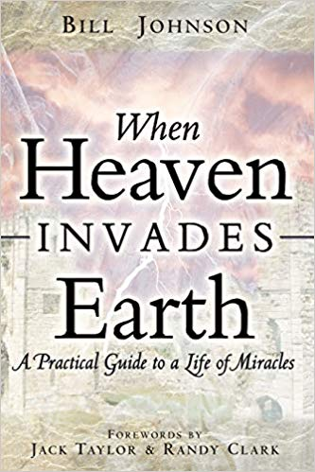
Bill Johnson:
“He [Jesus] laid His divinity aside (see Phil 2:5–7) as He sought to fulfill the assignment given to Him by the Father.”
When Heaven Invades Earth, Destiny Image, 2005, pp. 87-88.

Slide 57
John 20:30–31 Therefore many other signs Jesus also performed in the presence of the disciples, which are not written in this book; but these have been written so that you may believe that Jesus is the Christ, the Son of God; and that believing you may have life in His name.

Slide 58
Luke 8:39 “Return to your house and describe what great things God has done for you.” So he went away, proclaiming throughout the whole city what great things Jesus had done for him.

Slide 59
Philippians 2:6–7 Who, although He existed in the form of God, did not regard equality with God a thing to be grasped, but emptied Himself, taking the form of a bond-servant, and being made in the likeness of men.

Slide 60

1 Kings 5:3–4 You know that David my father was unable to build a house for the name of the Lord his God because of the wars which surrounded him, until the Lord put them under the soles of his feet. But now the Lord my God has given me rest on every side; there is neither adversary nor misfortune.

Slide 61
Bill Johnson writes: “The word for adversary here is Satan. Was Solomon embellishing? Or was he saying the devil no longer existed in Israel? Or was he saying the devil existed, but could not cause problems? Or was he saying something completely different?
“Jesus stated that the devil had nothing in Him – no connection whatsoever (see John 14:30)… But is this reality possible for us? Is it possible in a city? Is it possible for wisdom, and its corresponding grace for reigning in life, to enable people to live completely free of the enemy’s influence?

Slide 62
“I believe to live free from the enemy’s influence is not only possible, but is also absolutely necessary in order for us to fulfill our assignment. Jesus set the example – first for the individual, and second for the family unit, third for a church family, and fourth and finally, for a city.
“Truth is meant to find its ultimate expression in cities and nations… Solomon, in some measure, had a similar experience to Jesus’ in the sense of the devil having no place…”
  Bill Johnson, The Power that Changes the World
  (Minneapolis: Chosen Books, 2015), 167-168.

Slide 63
1 John 1:8 If we say that we have no sin, we are deceiving ourselves and the truth is not in us.
Proverbs 20:9 Who can say, “I have cleansed my heart, I am pure from my sin”?

Slide 64

Dominion Theology
Seven Mountain Mandate
Media
Government
Education
Economy
Religion
Entertainment
Family

Slide 65
From the Introduction to Invading Babylon: The Seven Mountain Mandate by Lance Wallnau and Bill Johnson (Destiny Image, 2013) pp. 9-10:
Bill Johnson, senior leader of Bethel Church in Redding, California, opens this book with a foundational teaching on dominion theology. In simple terms, dominion theology is the idea that Christian believers are called to not only preach the Gospel and win converts to Christ but also to establish the Kingdom of God on the earth. Bill encourages all believers to learn how to walk in the full authority of the Gospel so they can heal the sick, raise the dead, and see people touched and transformed by the power of God. One must believe that we are all called to minister to the world, regardless of our titles and vocations, as this supernatural lifestyle is a natural part of the Christian life. Miraculous ministry is not just for pastors, evangelists, and missionaries. It is for everyone.

Slide 66
Dominion Theology
Historical Background:
      Earliest Christians made no efforts to invade or conquer society or government.
      4th century Constantine legalized Christianity.
      Augustine, in his City of God, explained how the church would bring in the kingdom of God.
      Roman Catholicism and Eastern Orthodoxy (Byzantine) both understood the church as the vehicle for bringing in the kingdom of God.
      Protestant Reformation began to break away from this concept, but did not succeed entirely.
      1980s a new form of Postmillennialism known as “Dominion Theology,” “Christian Reconstructionism,” or “Theonomy.”
      Most recent form is in the NAR as envisioned by men like C. Peter Wagner, Bill Johnson, and others.

Slide 67
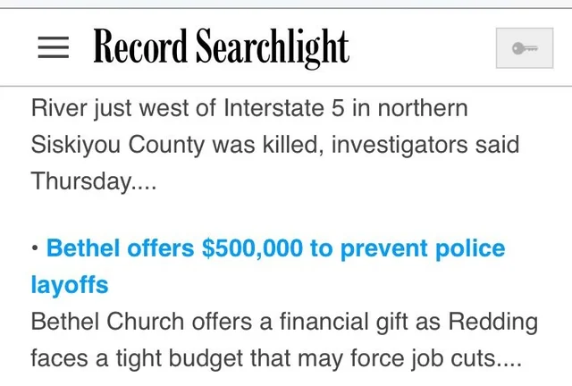
In April 2017, Bethel offered to donate $500,000 to the city of Redding to assist in funding the salary for police officers. Some in the community thought the church was trying to pay off the city for future building permits, an assertion Pastor Kris Vallotton refuted at a city council meeting. The city ultimately voted to receive the donation. Seven
months after receiving the donation, Redding City Council unanimously approved a $96 million new Bethel campus, despite dozens of formally submitted citizen concerns. The city councilperson who is a member of Bethel recused herself from voting.

Slide 68
Proper Christian Relationship to Government
1 Timothy 2:1–4 First of all, then, I urge that entreaties and prayers, petitions and thanksgivings, be made on behalf of all men, for kings and all who are in authority, so that we may lead a tranquil and quiet life in all godliness and dignity. This is good and acceptable in the sight of God our Savior, who desires all men to be saved and to come to the knowledge of the truth.
Pray for them
We carry on the work of the gospel (“desires all men to be saved”)

Slide 69
Proper Christian Relationship to Government
Romans 13:1–4 Every person is to be in subjection to the governing authorities. For there is no authority except from God, and those which exist are established by God. Therefore whoever resists authority has opposed the ordinance of God; and they who have opposed will receive condemnation upon themselves. For rulers are not a cause of fear for good behavior, but for evil. Do you want to have no fear of authority? Do what is good and you will have praise from the same; for it is a minister of God to you for good. But if you do what is evil, be afraid; for it does not bear the sword for nothing; for it is a minister of God, an avenger who brings wrath on the one who practices evil.

Slide 70
Proper Christian Relationship to Government
1 Peter 2:13–17 Submit yourselves for the Lord’s sake to every human institution, whether to a king as the one in authority, or to governors as sent by him for the punishment of evildoers and the praise of those who do right. For such is the will of God that by doing right you may silence the ignorance of foolish men. Act as free men, and do not use your freedom as a covering for evil, but use it as bondslaves of God. Honor all people, love the brotherhood, fear God, honor the king.
Submit
Recognize that government is God’s servant in its own sphere.

Slide 71
Proper Christian Relationship to Government
Matthew 22:21 “Render to Caesar the things that are Caesar’s; and to God the things that are God’s.” Two separate realms, each operating under their own responsibility to God.

Slide 72
Bethel Church and the NAR:
Error? Apostasy? Heresy?
False Apostles
False Prophets
False Eschatology
Kenotic view of Christ
Possibility of perfection for the believer

