Slide 1

America In Bible Prophecy

Slide 2
America In Bible Prophecy

Slide 3

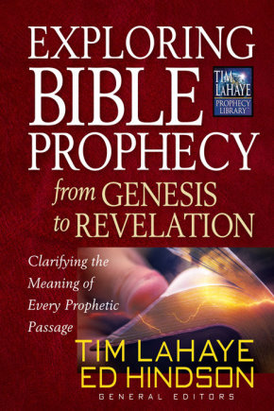
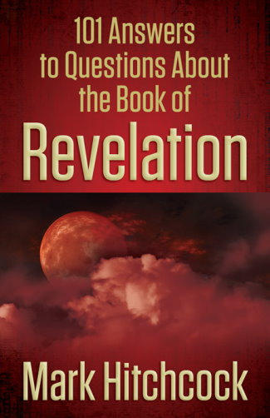
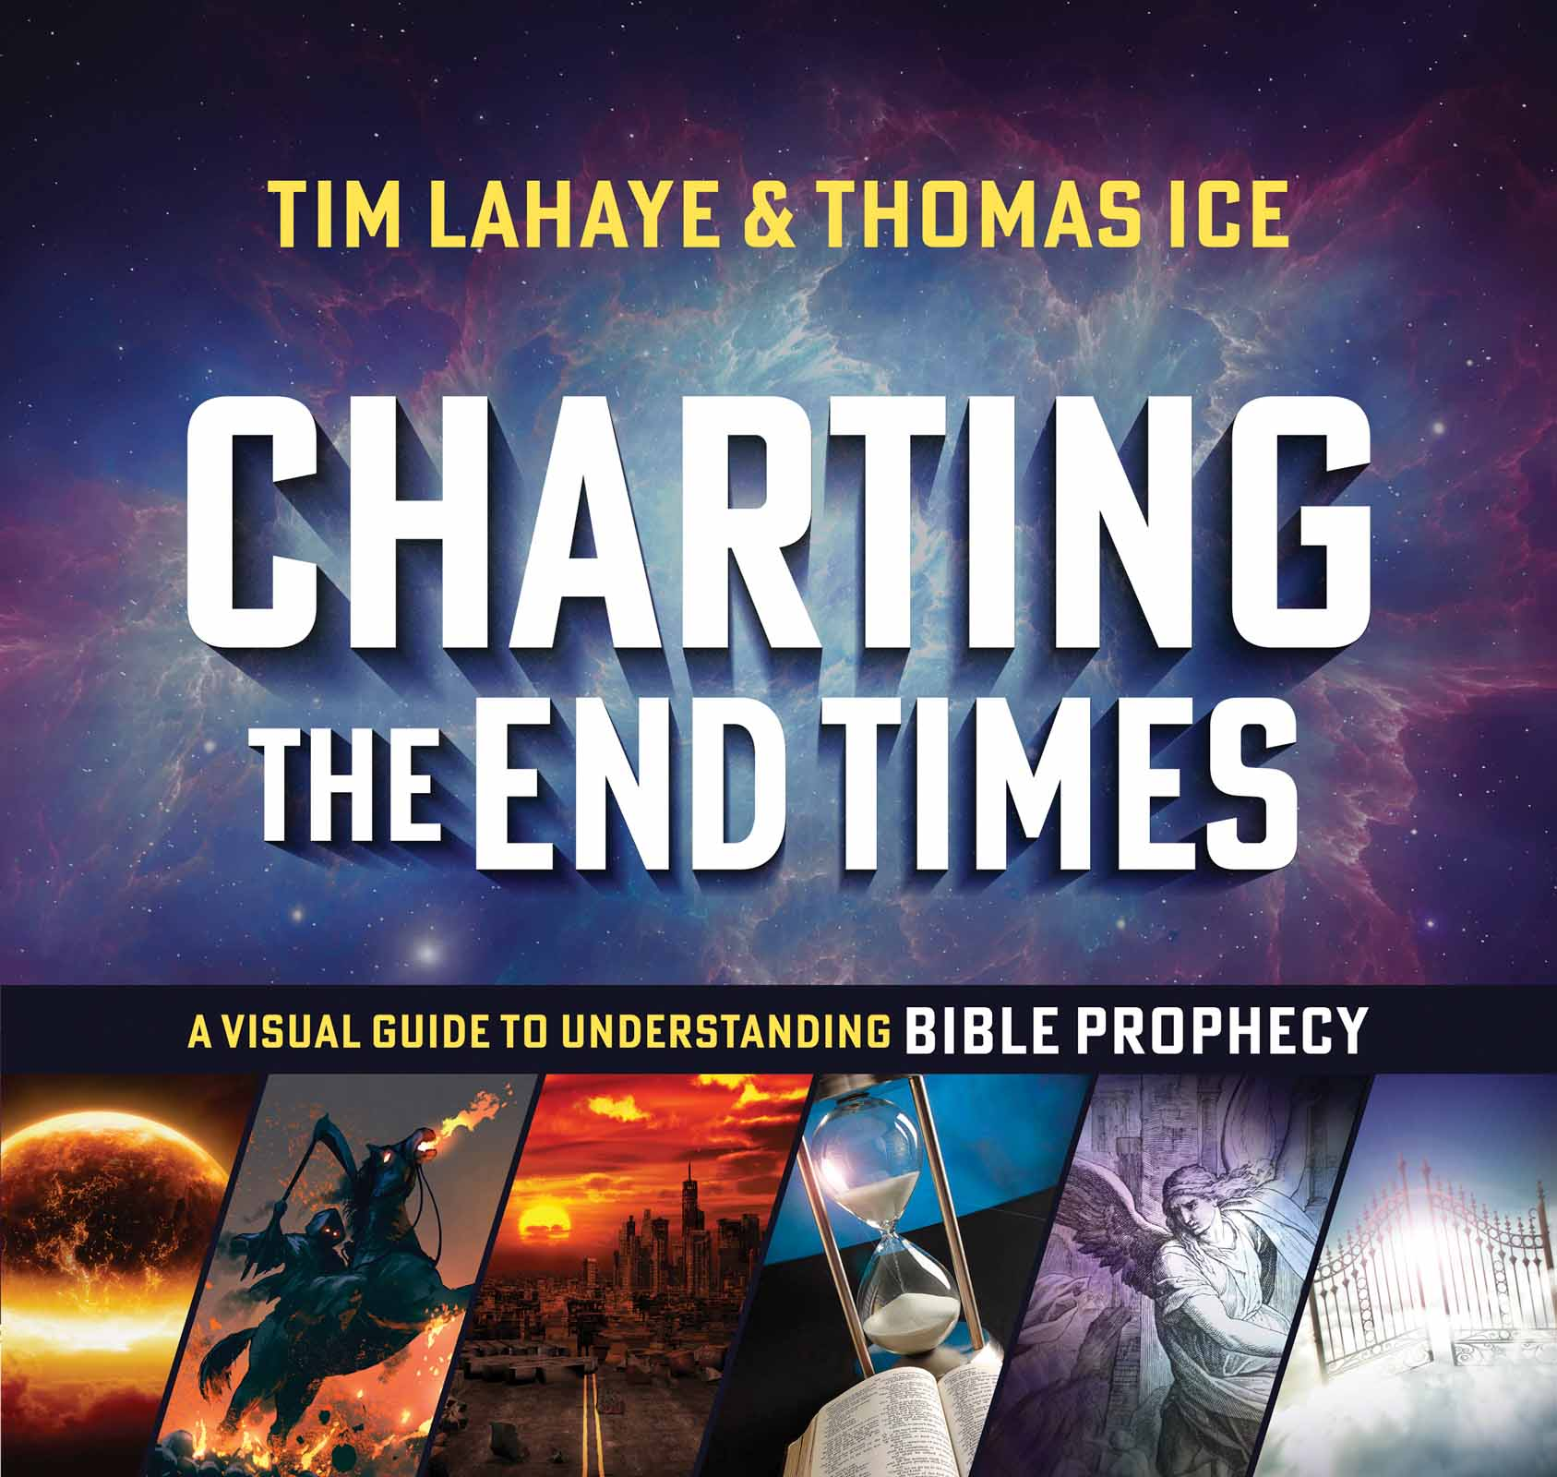
According To Prophecy Ministries Resources
Resources from According To Prophecy Ministries

Slide 4
According To Prophecy Ministries Resources
Resources from According To Prophecy Ministries

Slide 5


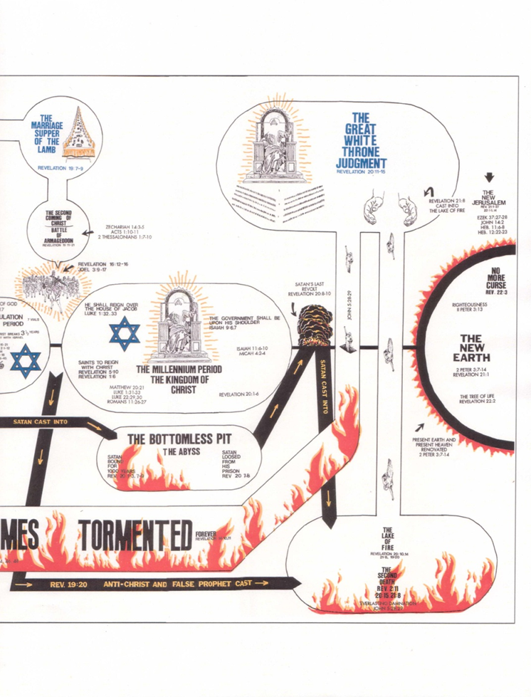

Slide 6





Visit our website:

Slide 8

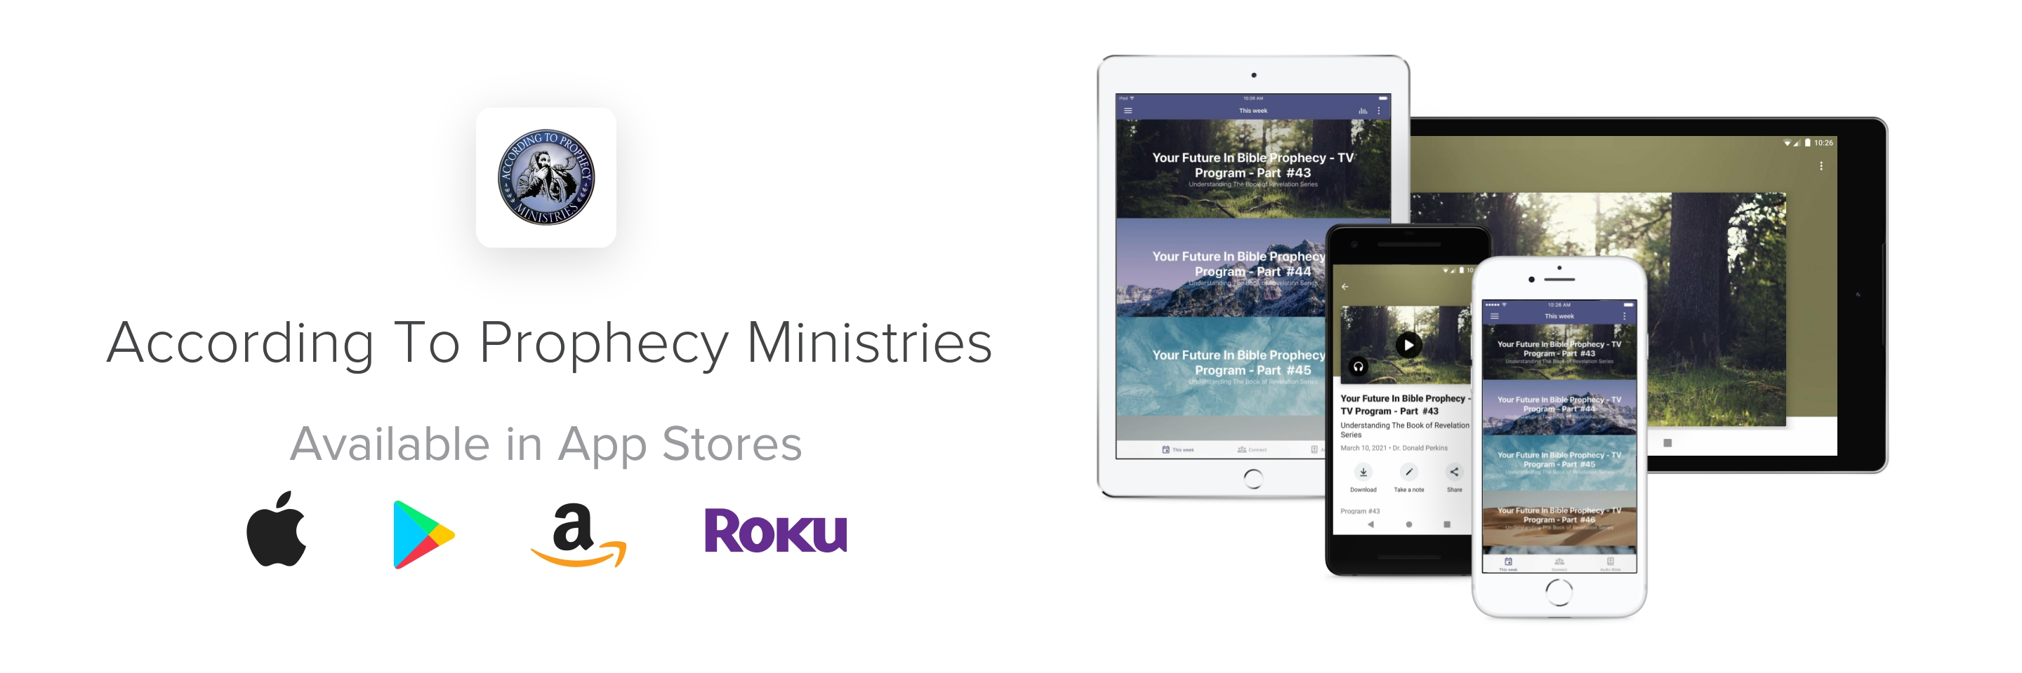
Download our New Ministry App
from your favorite App Store today!

Slide 9
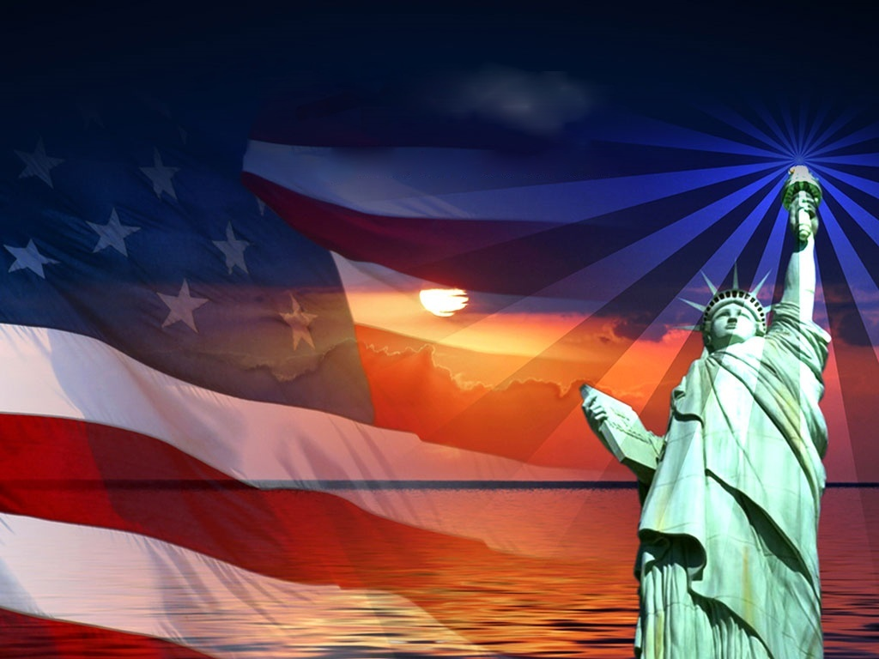
Is America In Bible Prophecy?

Slide 10
Topics of discussion
America In Bible Prophecy
Views of America’s place in Bible Prophecy
My observations of America in Bible Prophecy
The Founders of America in their own words
The sins of a Nation reaching to Heaven
Has America’s judgment begun?
America’s only Hope for God’s Mercy

Slide 11
America In Bible Prophecy
Psalm 33:12
Blessed is the nation whose God is the Lord; and the people whom he hath chosen for his own inheritance.
America In Bible Prophecy

Slide 12
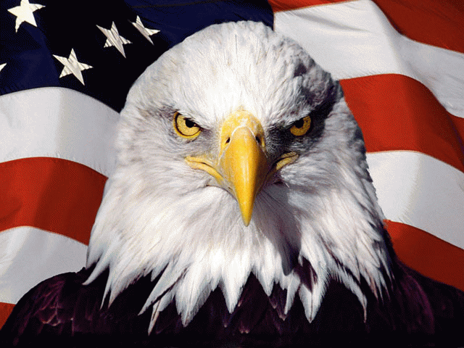
One of the most frequently asked questions in Bible Prophecy is “Where is America in Bible Prophecy?” America’s place of prominence in the world today, has caused many to believe that she will always be around as “America the Great.” One would figure that since God has blessed her more than any other nation in history, He must have a place for her in His Prophetic Word.
America In Bible Prophecy

Slide 13
Many have tried to find America in Bible Prophecy and some have even gone to great lengths to make America fit into Bible Prophecy. But I don’t believe America is in Prophecy in the same way as Israel, Russia, Iran and other nations. Some look at this as a sign that America may not have a place of influence in the future. My personal belief is that America will be around in the future but will not have the superpower status that we are experiencing today.
America In Bible Prophecy

Slide 14
America In Bible Prophecy
Views of America’s
Place in Bible Prophecy

Slide 15

Dr. David Reagan, America the Beautiful
“The persistent question about America’s future has motivated many prophecy experts to resort to their imaginations. The unfortunate result has been the “discovery” of the United States in some very unusual passages… This imaginative approach to the interpretation of Bible Prophecy is one of several factors that have motivated contempt for the whole field of prophetic studies, prompting many people to write it off as “a playground for fanatics.” pg. 65
America In Bible Prophecy

Slide 16
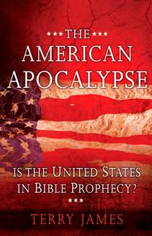
Terry James - The American Apocalypse,
Is The United States in Bible Prophecy
“The very fact of America’s spectacular achievement…, one would think, secures its place within the final prophetic disposition of nations. Yet this nation is referenced by name nowhere in Bible Prophecy That no mention of the most powerful and wealthiest nation in recorded history is made in the Bible seems a profoundly strange omission. Recognizing and acknowledging that this super nation-state is not even alluded to by name, there nonetheless remains room to ponder.” Pg. 14.

Slide 17
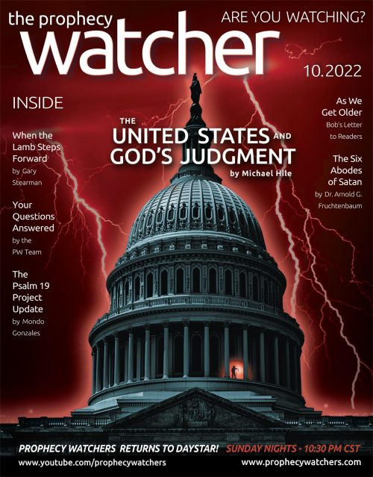
Where is the United States found in the Scriptures?
“Although the United States is not directly mentioned by name in the Bible, some believe the presence of the United States is inferred in the prophetic scriptures, due to the major political, economic, military, and technological roles exercised by the United States in the world today.” “There are many scriptures in the Bible that have been linked to the United States by Bible teachers. Some of the Scriptures that have been used include: Isaiah chapters 13; 14; 18:1, 2; 21, 24; 47:5, 6, 8, 10-13; 48; Jeremiah chapters 50: 12, 16, 23; 51:13, 44, 53; Ezekiel chapters 38:13, 39:6; Daniel 7:4, and Revelation chapters 12:14; 13:11-17; 17; 18 and 19.”
America In Bible Prophecy

Slide 18
Where is the United States found in the Scriptures?
“Although God is the only One who knows what the future holds for the United States and the rest of the nations of the world, there are some intriguing prophetic scriptures in both the Old and New Testaments that may provide clues concerning specific nations or kingdoms that will arise on the scene before Christ returns to set up His kingdom. These “end time” nations and kingdoms may already be active in the world today helping establish a global government that will eventually give rise to the “Antichrist.”
America In Bible Prophecy

Slide 19
Views of America’s Place in Bible Prophecy
America In Bible Prophecy
1) Isaiah 18:2, 7 - A Scattered and Peeled People (Tall & Smooth)
2) Ezekiel 38:13 - The Merchants of Tarshish and all the Young Lions
3) Revelation 12:13-17 - The Great Eagle
4) Revelation 18:1-24 - Babylon the Great
5) The Name Jerusalem

Slide 20
America In Bible Prophecy
Jerusalem
usa

Slide 21
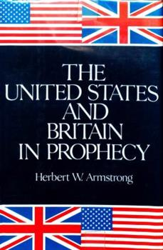
Armstrong’s view of United States in Prophecy:
In this book, Armstrong makes the claim that the peoples of the United States, the British Commonwealth nations and the nations of Northwestern Europe are descendants of the Ten Lost Tribes of Israel. This belief, called British Israelism, formed the central basis of the theology of the Worldwide Church of God. Wikipedia
America In Bible Prophecy

Slide 22
America In Bible Prophecy
My observations of
America in
Bible Prophecy

Slide 23
I do believe that America is in Bible Prophecy, but not in the examples we have just seen. America can be found when it is compared to Israel in its’ relationship with God. God will respond favorably or unfavorably to America as long as she obeys His Word. As long as Israel obeyed and honored God, she was a blessed nation. America was founded on Godly principles. The forefathers of this great nation knew that in order for America to be a great nation, in the eyes of God, it must first obey and honor the God of Heaven.
America In Bible Prophecy

Slide 24

America was a great nation at one time, but today she has lost her moral footing. It was known as a Christian nation, and looked upon as the moral conscience of the world. Almighty God has blessed America with great wealth, strength and influence. But somewhere in the abundances of her blessings, she has forgotten the God of her forefathers who made her great. The Scriptures declare:
America In Bible Prophecy

Slide 25
America In Bible Prophecy
Luke 12:48
“…For unto whomsoever much is given, of him shall be much required…”

Slide 26
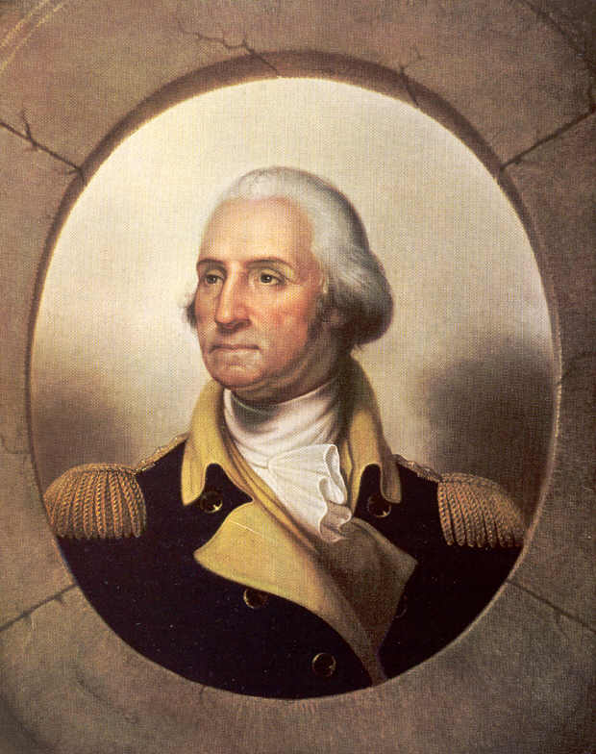
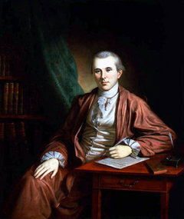
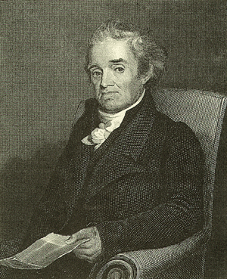
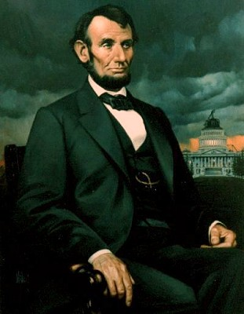
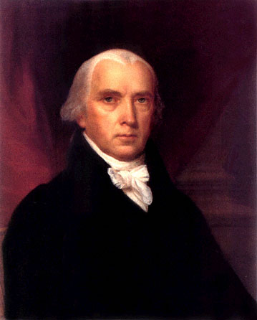
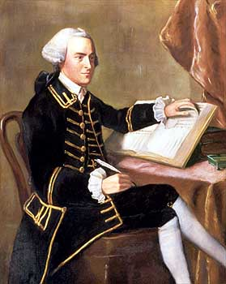
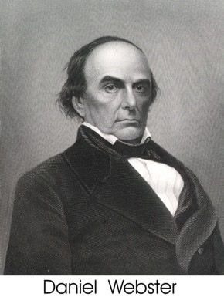
America In Bible Prophecy
The Founders of America
in their own words!

Slide 27
James Madison
SIGNER OF THE CONSTITUTION; AUTHOR OF THE FEDERALIST PAPERS; FRAMER OF THE BILL OF RIGHTS; SECRETARY OF STATE; FOURTH PRESIDENT OF THE UNITED STATES
“A watchful eye must be kept on ourselves lest, while we are building ideal monuments of renown and bliss here, we neglect to have our names enrolled in the Annals of Heaven.”
America In Bible Prophecy

Slide 28
Benjamin Rush
SIGNER OF THE DECLARATION OF INDEPENDENCE; SURGEON GENERAL OF THE CONTINENTAL ARMY; RATIFIER OF THE U. S. CONSTITUTION; “FATHER OF AMERICAN MEDICINE”; TREASURER OF THE U. S. MINT; “FATHER OF PUBLIC SCHOOLS UNDER THE CONSTITUTION”
The Gospel of Jesus Christ prescribes the wisest rules for just conduct in every situation of life. Happy they who are enabled to obey them in all situations! . . . My only hope of salvation is in the infinite transcendent love of God manifested to the world by the death of His Son upon the Cross. Nothing but His blood will wash away my sins (Acts 22:16). I rely exclusively upon it. Come, Lord Jesus! Come quickly! (Revelation 22:20)
America In Bible Prophecy

Slide 29
Abraham Lincoln, SERVED IN THE U.S. HOUSE OF REPRESENTATIVES (1847–1849), THE SIXTEENTH PRESIDENT OF THE UNITED STATES (1861-1865).
“The Lord is always on the side of the right, but it is my constant anxiety and prayer that I and this nation should be on the Lord’s side.”
“We have been the recipients of the choicest bounties of Heaven. We have been preserved these many years in peace and prosperity. We have grown in numbers, wealth and power as no other nation has ever grown.”
“But we have forgotten God. We have forgotten the gracious Hand which preserved us in peace, and multiplied and enriched and strengthened us; and we have vainly imagined, in the deceitfulness of our hearts, that all these blessings were produced by some superior wisdom and virtue of our own.”
America In Bible Prophecy

Slide 30
Daniel Webster
U. S. SENATOR; SECRETARY OF STATE; “DEFENDER OF THE CONSTITUTION”
The Christian religion – its general principles – must ever be regarded among us as the foundation of civil society.
Whatever makes men good Christians, makes them good citizens.
To the free and universal reading of the Bible… men [are] much indebted for right views of civil liberty.
The Bible is a book… which teaches man his own individual responsibility, his own dignity, and his equality with his fellow man.
America In Bible Prophecy

Slide 31
Noah Webster
REVOLUTIONARY SOLDIER; JUDGE; LEGISLATOR; EDUCATOR; “SCHOOLMASTER TO AMERICA” Author of the first American Speller and the first Dictionary .
“The Christian religion, in its purity, is the basis, or rather the source of all genuine freedom in government. . . . and I am persuaded that no civil government of a republican form can exist and be durable in which the principles of that religion have not a controlling influence.”
“The moral principles and precepts found in the Scriptures ought to form the basis of all our civil constitutions and laws.”
America In Bible Prophecy

Slide 32
Proverbs 29:2
“When the righteous are in authority, the people rejoice: but when the wicked beareth rule the people mourn.”
America In Bible Prophecy

Slide 33
Proverbs 14:34
“Righteousness exalteth a nation: but sin is a reproach to any people.”
America In Bible Prophecy

Slide 34
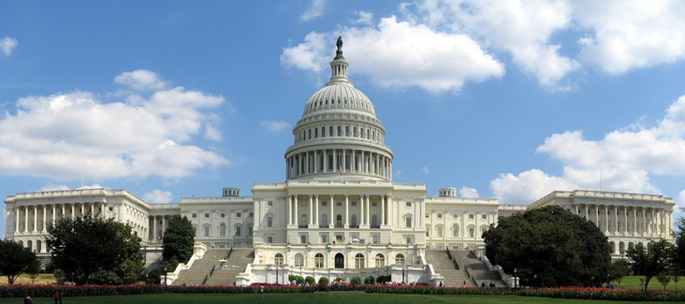
Spiritual Heritage Tour at the
Capital in Washington D.C.

Slide 35
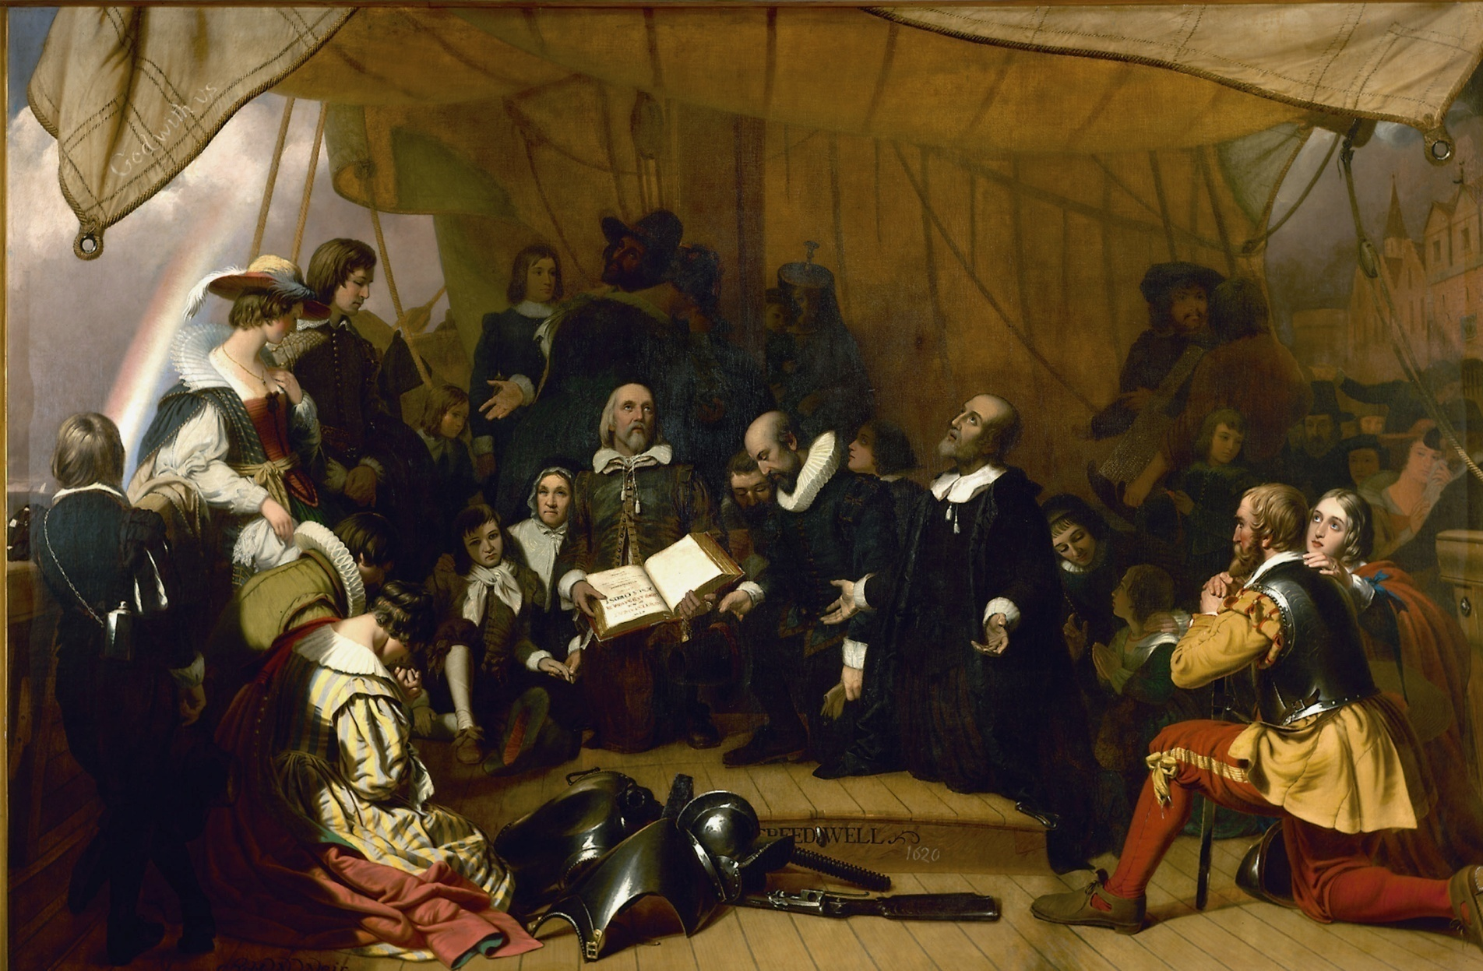
Painting of Pilgrims leaving Holland
in the Capitol’s Rotunda

Slide 36
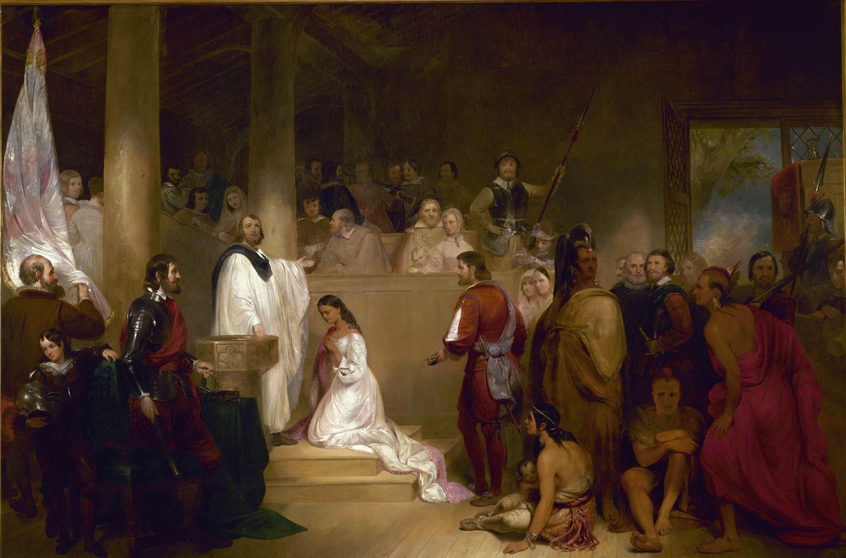
The Baptism of Pocahontas in
the Capitol’s Rotunda

Slide 37
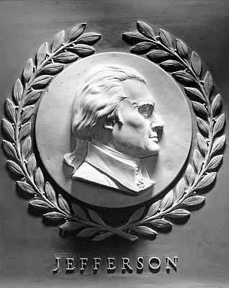
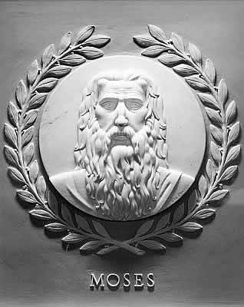
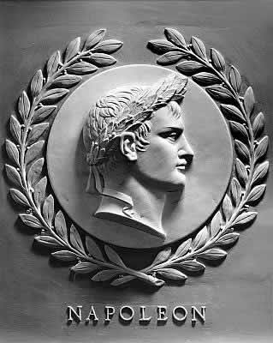
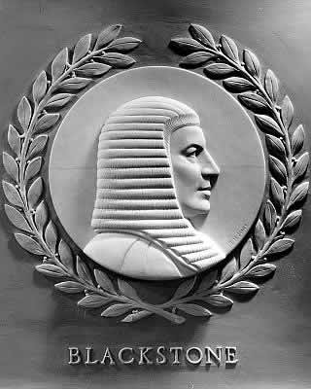
Relief Portraits Plaques of Lawgivers
The United States Capitol Building,
Home of the House and Senate
The plaques each measure 28 inches in diameter. The eleven profiles in the eastern half of the chamber face left and the eleven in the western half face right, so that all look towards the full-face relief of Moses in the center of the north wall.

Slide 38
America In Bible Prophecy
The sins of a Nation reaching to Heaven

Slide 39
Dr. Reagan, asserts the brutal fact that our nation has turned its back on the One who has blessed us so abundantly. He contends that our fundamental problem is not Systemic Racism. Rather, it is Systemic Godlessness. We are a nation that has forgotten God. The consequences are apostate churches and a society consumed with immorality and violence.
America In Bible Prophecy

Slide 40
Dr. Reagan, shares from the Scriptures how God deals with a nation He has blessed that turns against Him. America has crossed the point of no return and is thus on a path to self-destruction.
America In Bible Prophecy

Slide 41
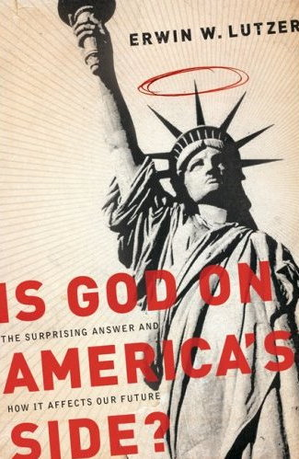
The Banished God, Retrieved
“So after 9/11, to borrow a phrase from R.C. Sproul, God was “allowed off the reservation” for a few months to fulfill His responsibility to bless us. But once our nation felt secure again, God was safely tucked away, church attendance declined, and the so-called wall of separation of Church and state was built a notch higher. God is even less welcome now in the affairs of our public life than He was before 9/11.”

Slide 42
America In Bible Prophecy
America In Bible Prophecy
Psalm 9:17
“The wicked shall be turned into hell, and all the nations that forget God.”

Slide 43
Genesis 19:12-13
“And the men said to Lot, Hast thou here any besides? son-in-law, and thy sons, and thy daughters, and whatsoever thou hast in the city, bring them out of this place: For we will destroy this place, because the cry of them is waxen great before the face of the Lord; and the Lord hath sent us to destroy it.”
America In Bible Prophecy

Slide 44

Dr. David Reagan, America the Beautiful
“When a nation walks in God’s way He prospers it with great leaders who provide freedom and prosperity. When a nation rebels against God’s commandments, He places curses, or remedial judgments, upon the people. Deuteronomy 28 spells out a wide variety of these judgments, including such things as confusing government policies, economic weakness, rebellious youth, rampant disease, crop failures, an epidemic of divorce, foreign domination, and defeat in war.” pg. 26
America In Bible Prophecy

Slide 45
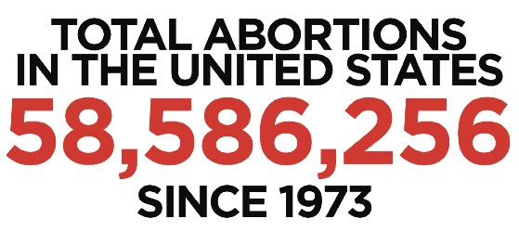
On January 22, 1973 - The U.S. Supreme Court, in a 7-2 decision, affirms the legality of a woman's right to have an abortion under the Fourteenth amendment to the Constitution.
America In Bible Prophecy

Slide 46
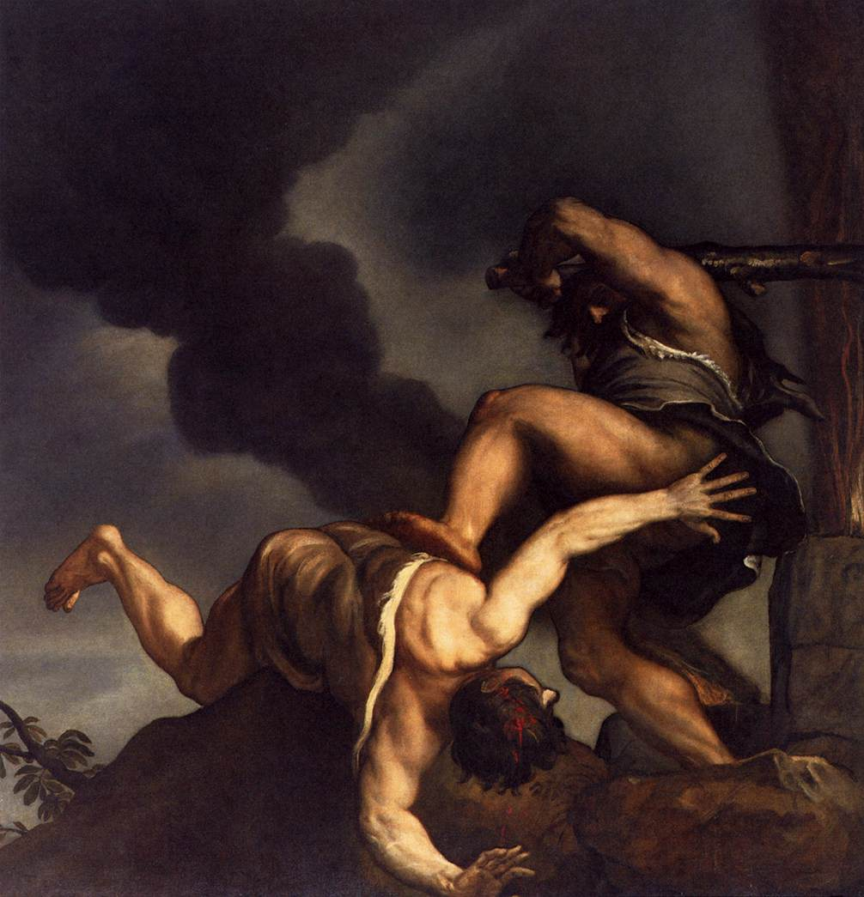
Genesis 4:9-10,
“And the LORD said unto Cain, Where is Abel thy brother? And he said, I know not: Am I my brother's keeper? And he said, What hast thou done? the voice of thy brother's blood crieth unto me from the ground.”
America In Bible Prophecy

Slide 47

Meet the Religious Groups Fighting to Save Abortion Access
America In Bible Prophecy
“The Episcopal Church, United Methodist Church, Presbyterian Church, and Judaism are a few of the many religious groups that support legal abortion.”
“As the future of Roe v. Wade hangs in the balance, many faith leaders, including people affiliated with religious groups that have historically opposed abortion, are taking a stance and fighting for abortion access.”
“In a Pew survey, more than 50 percent of people from different religious groups support legal abortion.” Healthline.com

Slide 48
Meet the Religious Groups Fighting to Save Abortion Access
America In Bible Prophecy
“Religious leaders from many denominations are working to preserve access to abortion care if Roe v. Wade is overturned.”
“While some religious groups, like the Catholic Church or Southern Baptists, oppose abortion in all cases, other groups, like the Episcopal Church and United Methodist Church, support abortion access.”
“On the ground, members of the Religious Coalition for Reproductive Choice have partnered with local clergy and visited abortion clinics to offer spiritual guidance for staff who deal with harassment from anti-abortion protesters.” Healthline.com

Slide 49
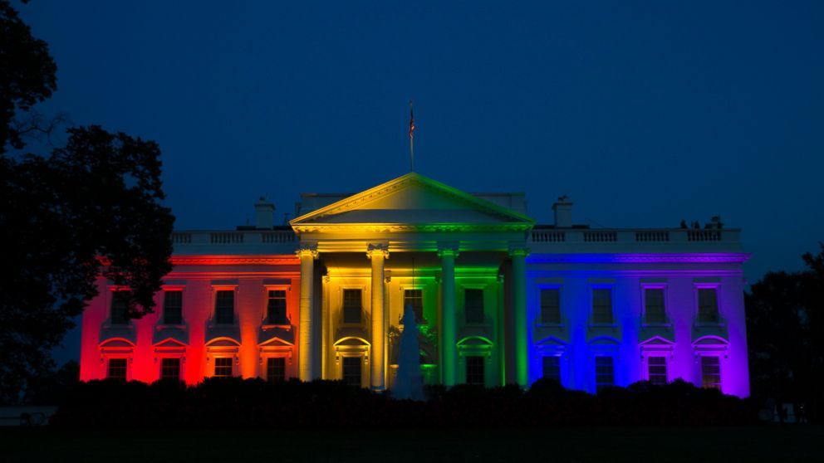
June 26, 2016, was a very SAD day for America, It was the day our Supreme Court legalizes gay marriages in America. The Capital was lit with the colors of the rainbow in celebration of this decision.
America In Bible Prophecy
Quoting Dr David Reagan from his article, “Our Out-of-Control Court” "Note the date: June 26, 2015. It is the date that should be put on the headstone of our nation because it is the day that America died. We have sealed our destruction. We are now a walking-dead nation."

Slide 50
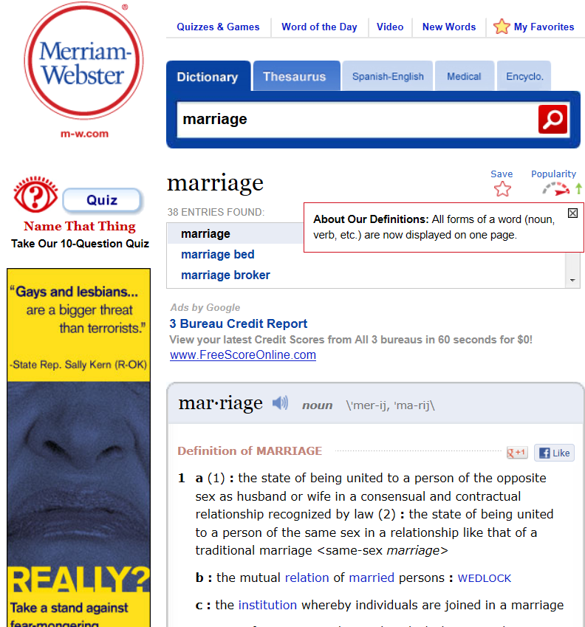
Merriam-Webster has redefined Marriage as follows:
America In Bible Prophecy
(1): the state of being united to a person of the opposite sex as husband or wife in a consensual and contractual relationship recognized by law (2): the state of being united to a person of the same sex in a relationship like that of a traditional marriage <same-sex marriage>”

Slide 51

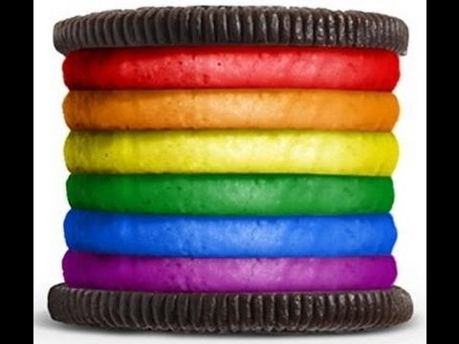


Slide 52

Strange World’ To Feature First Openly Gay Teen Romance in Disney Animated Film
America In Bible Prophecy
“Disney suffered one of its worst theatrical releases ever with its latest animated movie Strange World, which brought in just $18.6 million over the five-day holiday weekend despite being heralded as the first Disney movie to include an openly gay main character.”

Slide 53
Strange World’ To Feature First Openly Gay Teen Romance in Disney Animated Film
America In Bible Prophecy
“The film featured a star-studded cast including voice acting from Jake Gyllenhaal, Dennis Quaid, Lucy Liu, and Gabrielle Union, and sported a massive budget between $120 and $130 million.” The Daily Mail writes

Slide 54
America In Bible Prophecy
Has America’s
Judgment begun?

Slide 55

Romans 15:4
“For whatsoever things were written aforetime were written for our learning, that we through patience and comfort of the scriptures might have hope.”
America In Bible Prophecy

Slide 56
Jude 1:7-8
“Even as Sodom and Gomorrha, and the cities about them in like manner, giving themselves over to fornication, and going after strange flesh, are set for an example, suffering the vengeance of eternal fire. Likewise also these filthy dreamers defile the flesh, despise dominion, and speak evil of dignities.”
America In Bible Prophecy

Slide 57
Isaiah 26:9
“With my soul have I desired thee in the night; yea, with my spirit within me will I seek thee early: for when thy judgments are in the earth, the inhabitants of the world will learn righteousness.”
America In Bible Prophecy

Slide 58
Proverbs 26:2
As the bird by wandering, as the swallow by flying, so the curse causeless shall not come.
America In Bible Prophecy

Slide 59

Public Education Against America
Author: Marlin Maddoux
“Becoming Muslims in the Seventh Grade” Pg. 20
“We discovered that students at the school were required to attend an intensive three-week course in Islam that mandated that they learn the tenets of Islam, study the important figures of the Muslim faith, wear a robe, and read verses from the Koran. They had to memorize twenty-five Islamic terms and learn six Islamic (Arabic) phrases, twenty Islamic proverbs, and the Five Pillars of Faith. They also had to study ten key Islamic prophets and disciples.”
“…the students also had to pick a Muslim name out of a list of thirty and go on a make-believe journey-called the Hijj-to Mecca.
America In Bible Prophecy

Slide 60
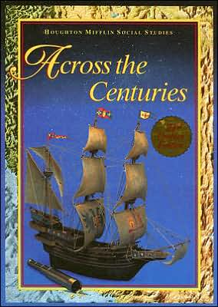
“Public Education Against America”
“Becoming Muslims in the Seventh Grade” Author: Marlin Maddoux, Pg 20.
“From the beginning, you and your classmates will become Muslims.”
Dressing as a Muslim and trying to be involved will increase your learning and enjoyment. Across the Centuries is the name of the text book used for the course. Described as a social studies/history book, it has been adopted by the California school system.”
The textbook Publisher is Houghton Mifflin Company.
America In Bible Prophecy

Slide 61
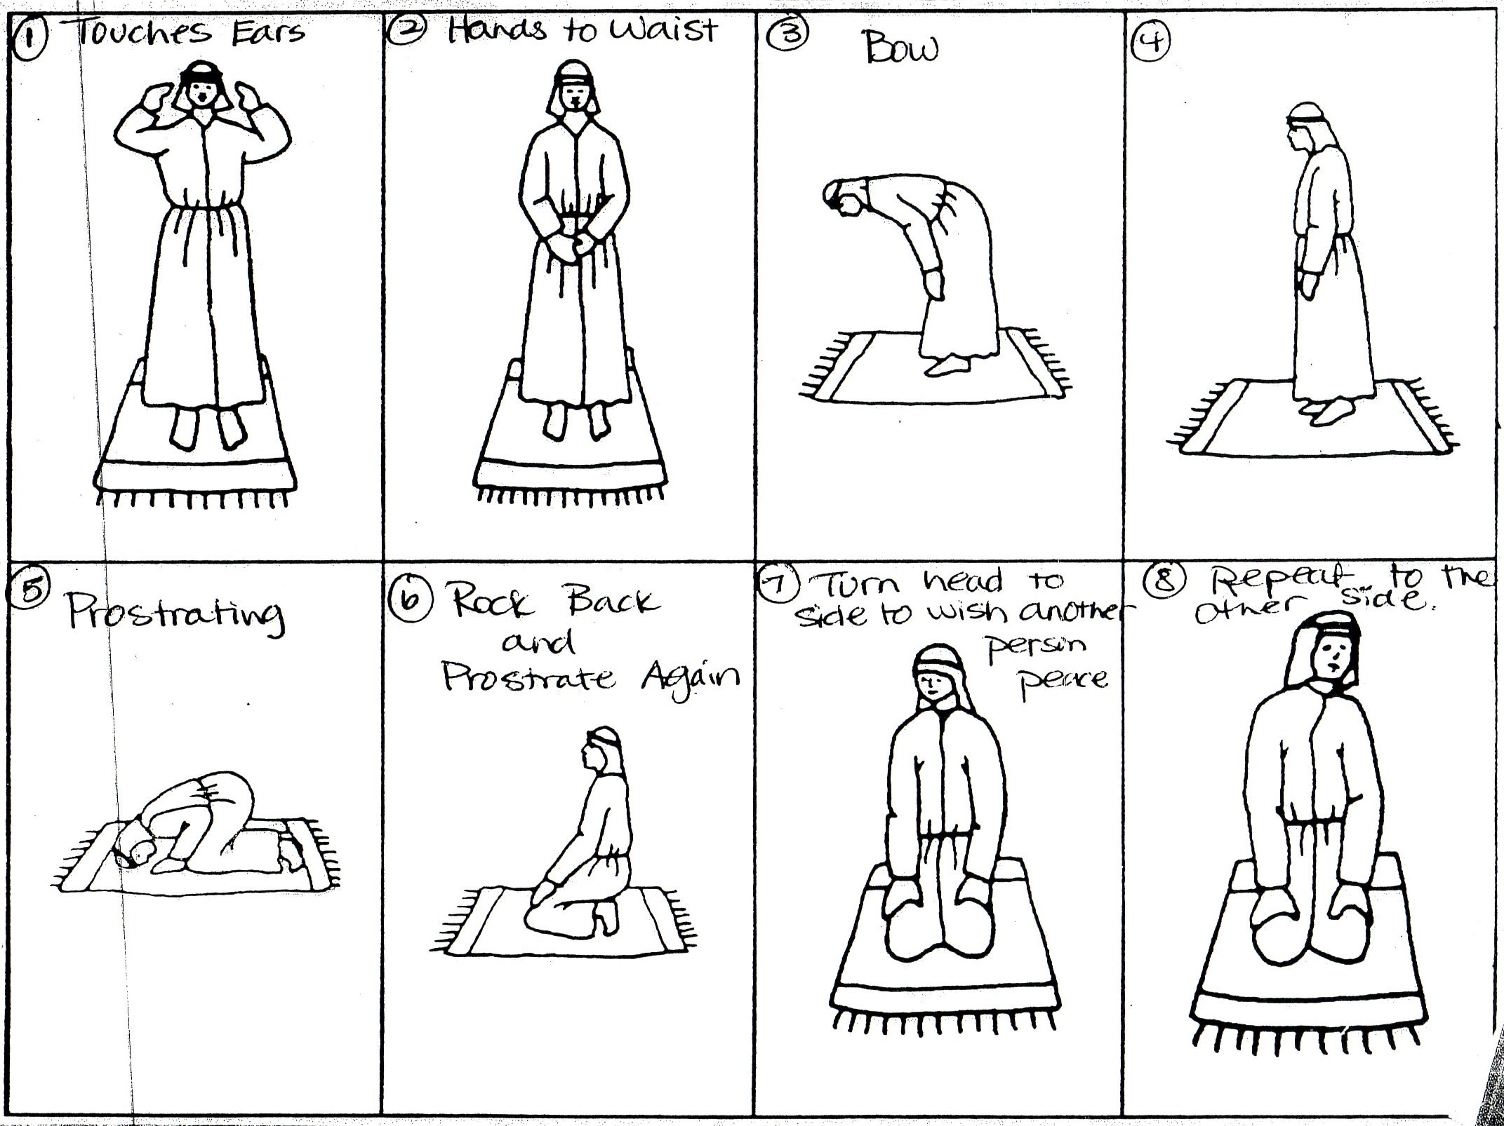
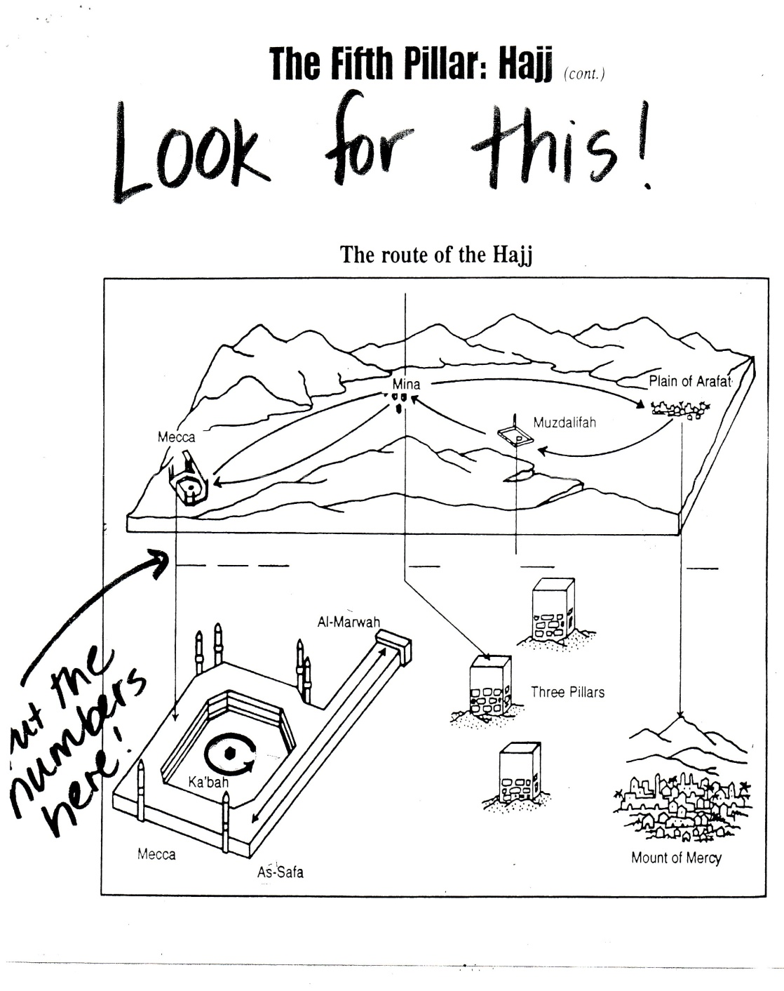
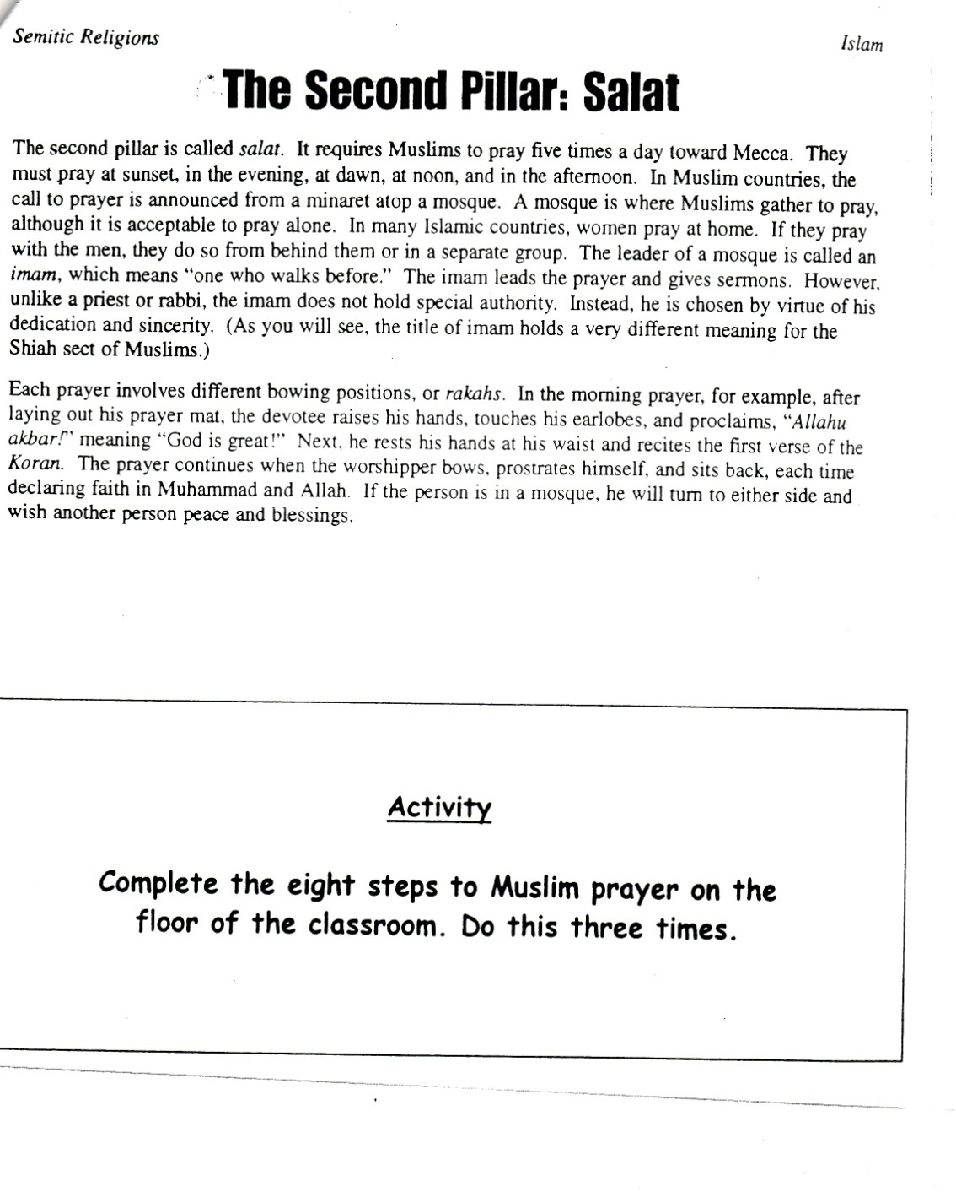
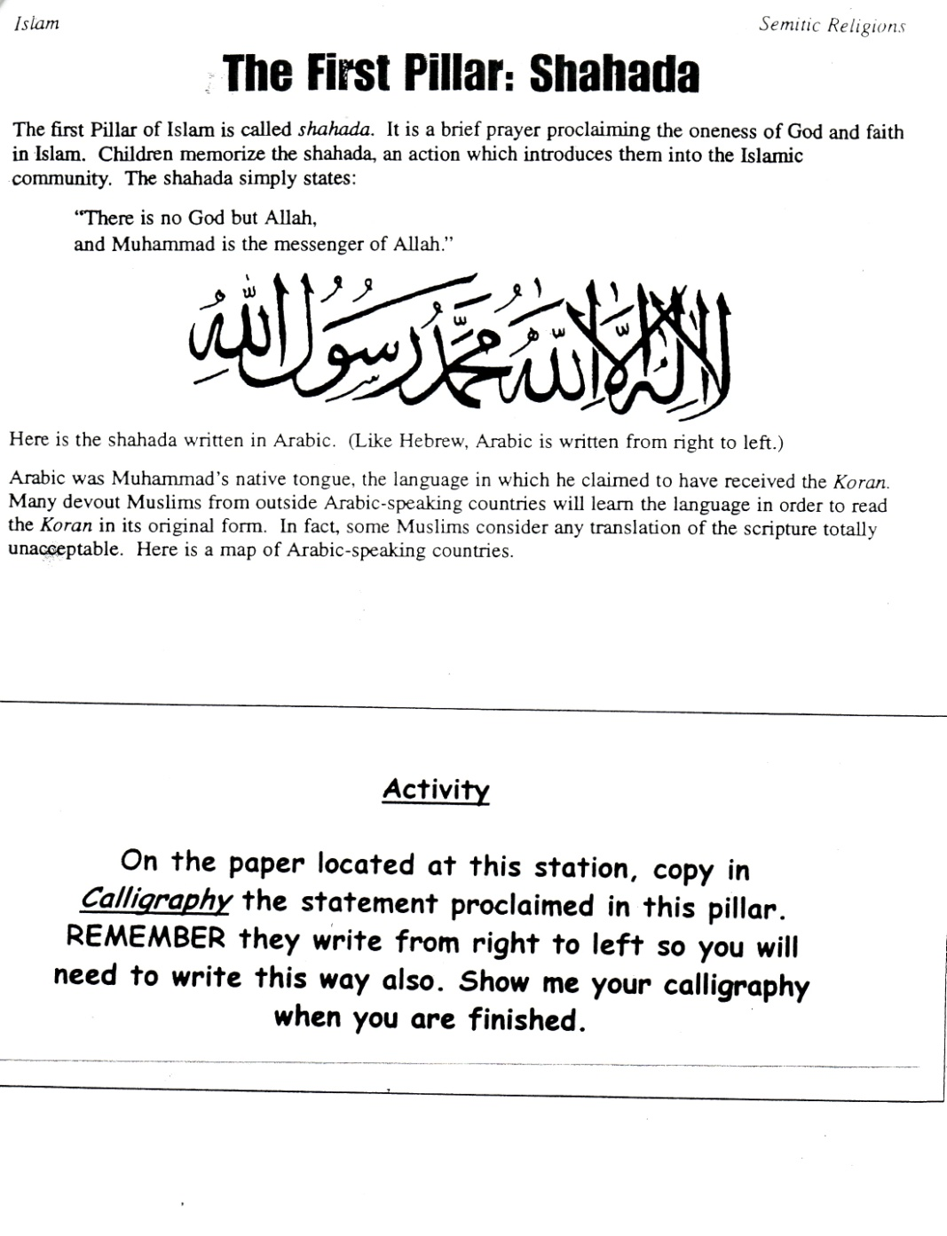
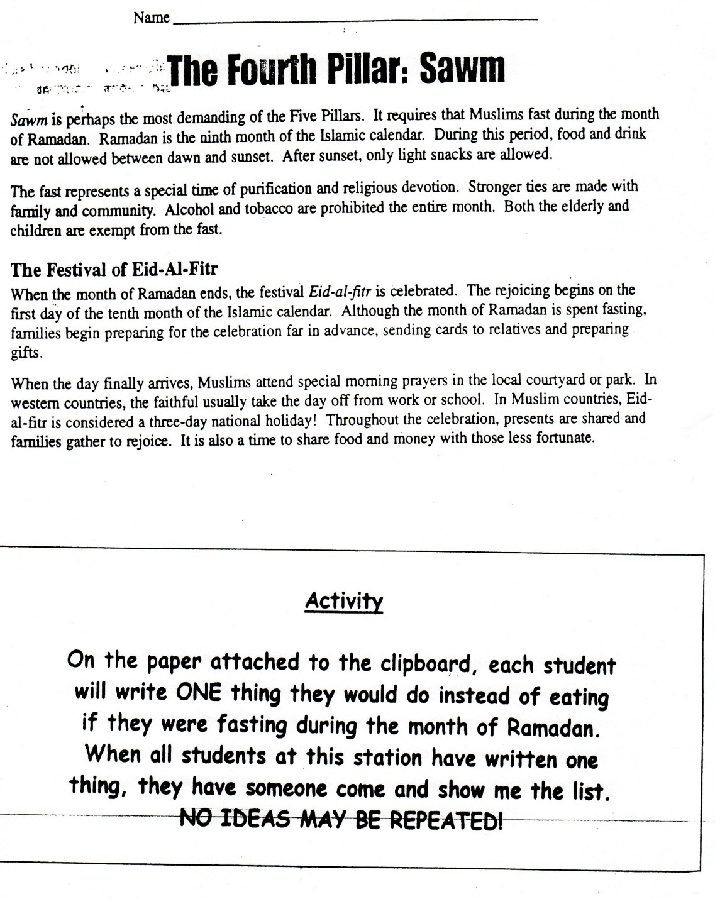
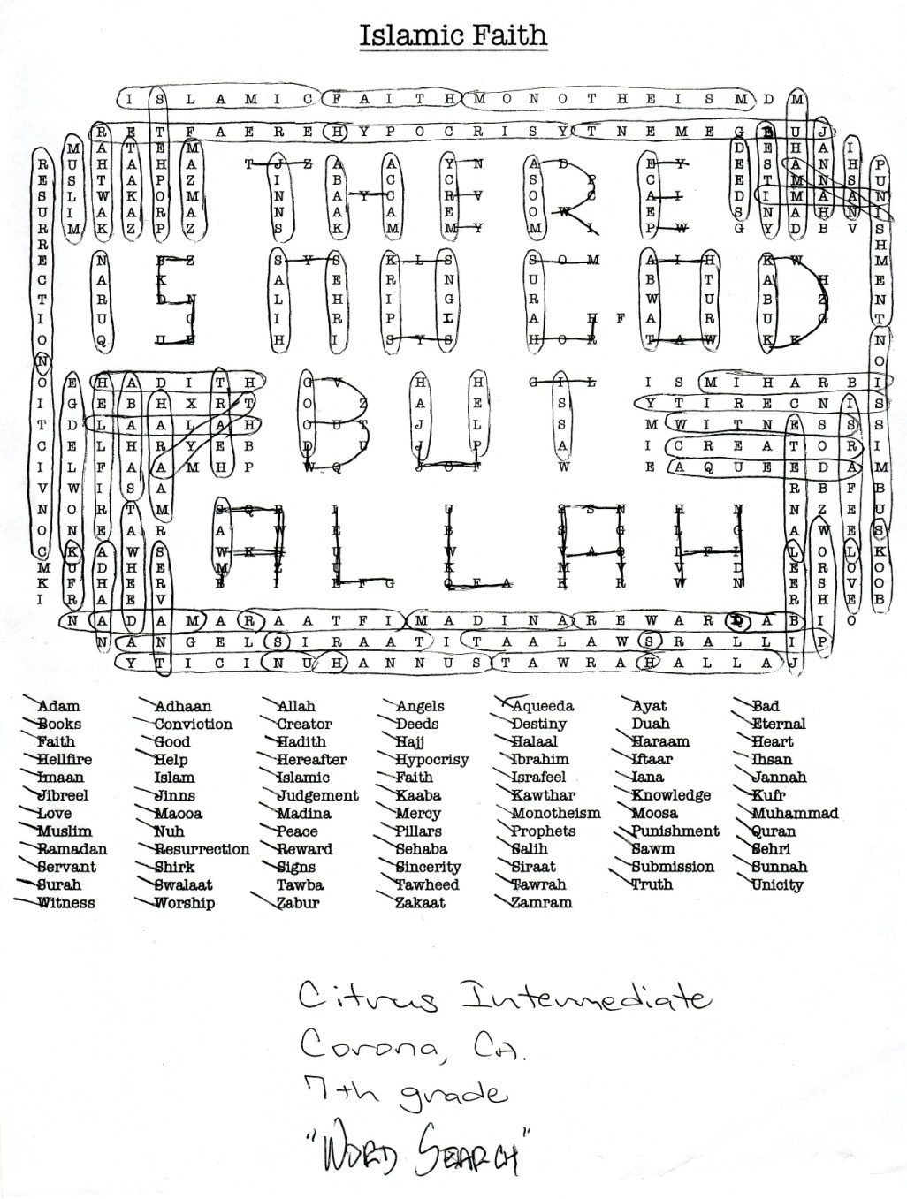
America In Bible Prophecy

Slide 62
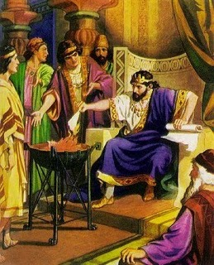
2 Kings 24:19, And he did that which was evil in the sight of the LORD, according to all that Jehoiakim had done.
2 Chronicles 36:5, Jehoiakim was twenty and five years old when he began to reign, and he reigned eleven years in Jerusalem: and he did that which was evil in the sight of the LORD his God.
America In Bible Prophecy

Slide 63
Daniel 1:1,2, “In the third year of the reign of Jehoiakim king of Judah came Nebuchadnezzar king of Babylon unto Jerusalem, and besieged it. And the Lord gave Jehoiakim king of Judah into his hand, with part of the vessels of the house of God: which he carried into the land of Shinar to the house of his god; and he brought the vessels into the treasure house of his god.”
America In Bible Prophecy

Slide 64
Romans 1:18-20
“For the wrath of God is revealed from heaven against all ungodliness and unrighteousness of men, who hold the truth in unrighteousness;. Because that which may be known of God is manifest in them; for God hath shewed it unto them. For the invisible things of him from the creation of the world are clearly seen, being understood by the things that are made, [even] his eternal power and Godhead; so that they are without excuse:”
America In Bible Prophecy

Slide 65
Romans 1:21-23
“Because that, when they knew God, they glorified [him] not as God, neither were thankful; but became vain in their imaginations, and their foolish heart was darkened. Professing themselves to be wise, they became fools, And changed the glory of the uncorruptible God into an image made like to corruptible man, and to birds, and fourfooted beasts, and creeping things.”
America In Bible Prophecy

Slide 66
Romans 1:24-26
“Wherefore God also gave them up to uncleanness through the lusts of their own hearts, to dishonour their own bodies between themselves: Who changed the truth of God into a lie, and worshipped and served the creature more than the Creator, who is blessed for ever. Amen. For this cause God gave them up unto vile affections: for even their women did change the natural use into that which is against nature:”
America In Bible Prophecy

Slide 67
Romans 1:27-29
“And likewise also the men, leaving the natural use of the woman, burned in their lust one toward another; men with men working that which is unseemly, and receiving in themselves that recompence of their error which was meet. And even as they did not like to retain God in [their] knowledge, God gave them over to a reprobate mind, to do those things which are not convenient; Being filled with all unrighteousness, fornication, wickedness, covetousness, maliciousness; full of envy, murder, debate, deceit, malignity; whisperers,”
America In Bible Prophecy

Slide 68
America In Bible Prophecy
America’s only Hope
for God’s Mercy

Slide 69
1 Timothy 2:1-2
“I exhort therefore, that, first of all, supplications, prayers, intercessions, and giving of thanks, be made for all men; For kings, and for all that are in authority; that we may lead a quiet and peaceable life in all godliness and honesty.”
America In Bible Prophecy

Slide 70
2 Chronicles 7:14
“If my people, which are called by my name, shall humble themselves, and pray, and seek my face, and turn from their wicked ways; then I will hear from heaven, and will forgive their sin, and will heal their land.”
America In Bible Prophecy

Slide 71
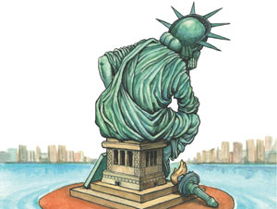
Daniel 9:2-23
America In Bible Prophecy
Daniel’s prayer for mercy for his people, Israel. Is a great example that Church should follow!

Slide 72
What does the Lord expect of America?
Be Salt and Light
“While there is still an opportunity to make a difference, we should get on our knees and pray for God’s protection (put on the whole armor of God), get off our knees and take a stand for Biblical values in our community, vote for Biblical candidates when possible and be “salt” and “light” to those we come in contact with.”
America In Bible Prophecy

Slide 73
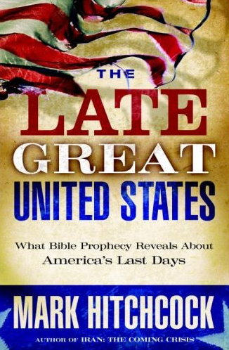
“But it seems that, by any measure, America has began to slide into moral decay. Estimates as to when the moral decline began may vary, but all the leading cultural indicators drive one to the conclusion that America is rotting from within.”

Slide 74
It’s Time to PRAY for America like you have never prayed before!

Slide 75
America In Bible Prophecy

