Slide 1
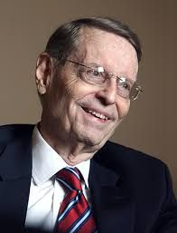
Charles C. Ryrie: The Man,
His Ministry, and
His Method
Presented by Dr. Paul Weaver
Pre-Trib Rapture Study Group Conference
December 5, 2022

Slide 2
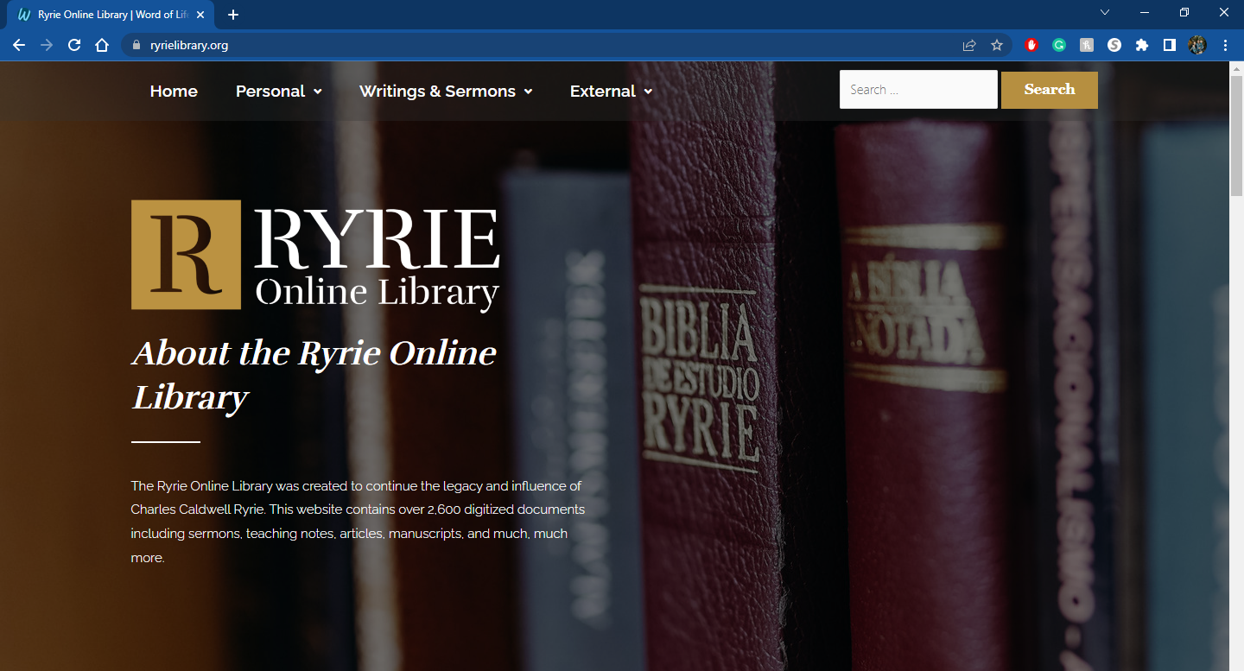

Slide 3
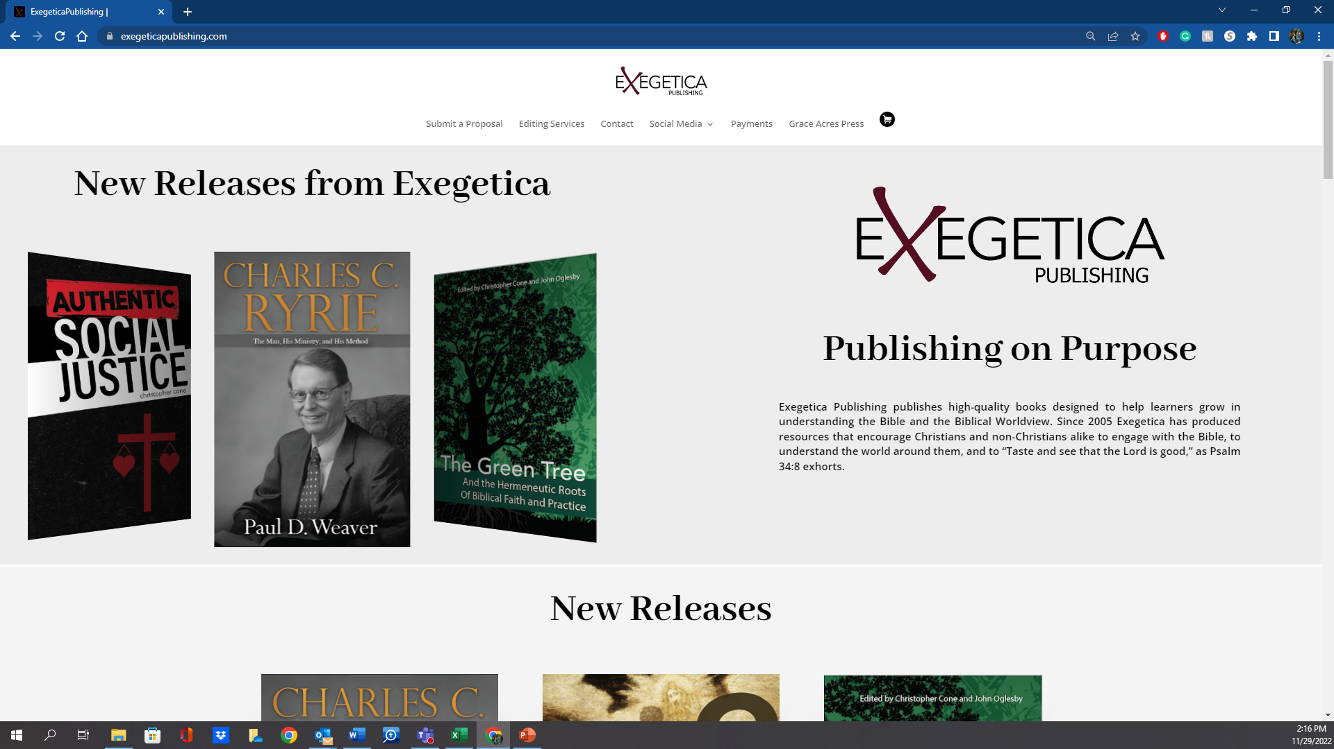

New Release!
“Paul Weaver has performed a vital service by writing this introduction to the life and legacy of Charles Ryrie. He shows why Dr. Ryrie was one of the most important theologians of the twentieth century. He loved the Word of God, and he loved sharing it with others. Though Dr. Ryrie has gone to heaven, his influence lives on around the world. Read this book and see for yourself.”

Slide 4
Charles C. Ryrie (1925-2016)
Part 1: The Man
His Early Life
His Education
Influential Individuals
Part 2: His Ministry
Professor and President
Prolific Writer
Pioneer
Apologist
Ordained Minister
Part 3: His Method (Theological Method)

Slide 5
Charles C. Ryrie (1925-2016)
Part 1: The Man
His Early Life

Slide 6
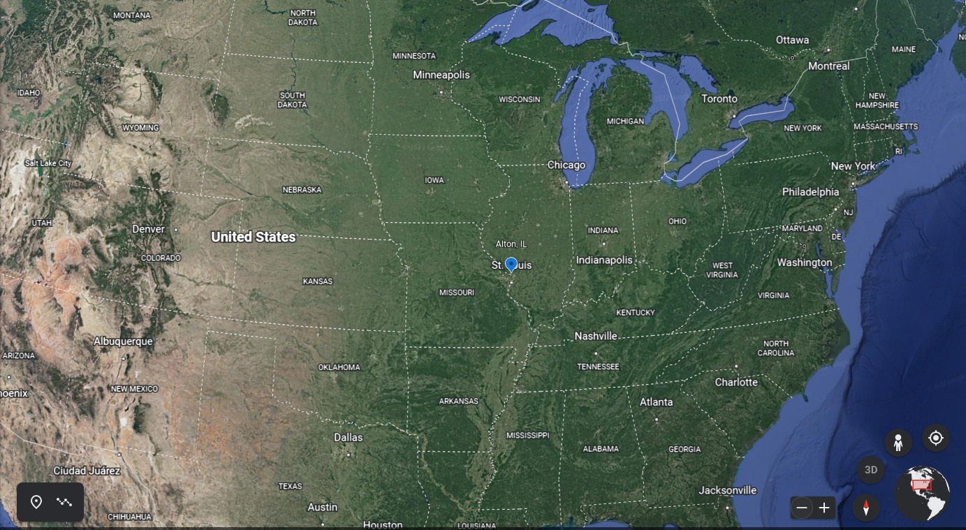

Slide 7
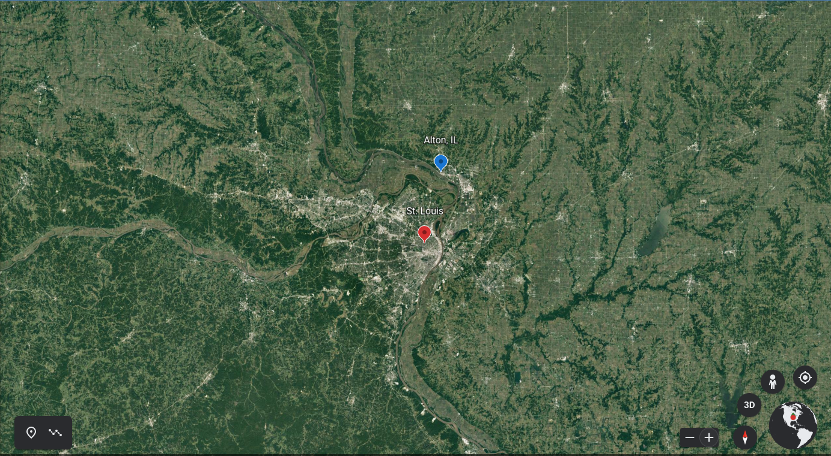

Slide 8
Charles C. Ryrie (1925-2016)
Part 1: The Man
His Early Life
  He was a fifth-generation attendee of the First Baptist Church of Alton.
  “It was not liberal but not particular deep”
  “Prophecy was incidental. No particular doctrine stands out.”
  Ryrie graduated high school in 1942 at the age of 16.
  Ryrie attended Stony Brook School in Long Island, NY for a semester.

Slide 9
Charles C. Ryrie (1925-2016)
Part 1: The Man
His Higher Education
  Ryrie attended Haverford College (Philadelphia, PA).
  Before graduating, Ryrie enrolled at Dallas Theological Seminary.
  Ryrie’s ThM thesis was on the New Covenant and Premillennialism.
  Ryrie returned to DTS to work on a ThD.
  Ryrie’s ThD dissertation was later published as The Basis of the Premillennial Faith.
  Ryrie earned a PhD from Edinburgh.
  Ryrie’s PhD dissertation was later published in 1970 by Moody as The Role of Women in the Church.

Slide 10
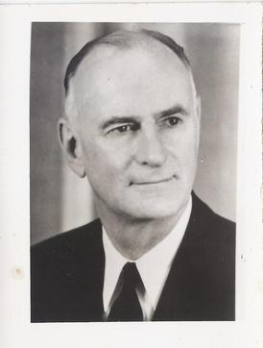
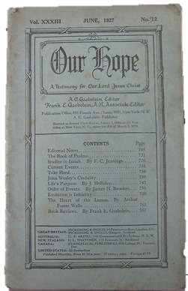

Charles C. Ryrie (1925-2016)
Part 1: The Man
Influential Individuals in the Life of Ryrie
Frank Gaebelein
Stony Brook School (Founder and Headmaster)

Slide 11
Charles C. Ryrie (1925-2016)
Part 1: The Man
Influential Individuals in the Life of Ryrie
“Oh yes… Dr. Frank Gaebelein was very involved with us students. It was only a male school in those days…Dr. Gaebelein taught senior Bible, he taught the book of Romans and I remember a lot from that class…He always presided and often spoke in chapel.”
-Ryrie, Personal Interview, Nov. 6, 2012.
Frank Gaebelein
Stony Brook School (Founder and Headmaster)

Slide 12
The Influence of Frank Gaebelein
“In the 60’s the Scofield Bible was being revised; Dr. Gaebelein was the editor. He wrote me a letter. I was at Dallas at that time. [This was during Ryrie’s first stint as a professor of theology, prior to becoming president of Philadelphia College of Bible] He said, ‘I think you should write a book on Dispensationalism. The Scofield Bible revision will be out and it would be great to have around the same time a book like that.’ Gaebelein said, ‘I will promise to write the foreword.’ So, that is what really urged me to write what was called Dispensationalism Today. It came out before the [New] Scofield Reference Bible because the Scofield was delayed. He wrote the foreword, and of course, it was revised and is now just called Dispensationalism. But he had a major part in that.”
-Ryrie, Personal Interview, Nov. 6, 2012.

Slide 13
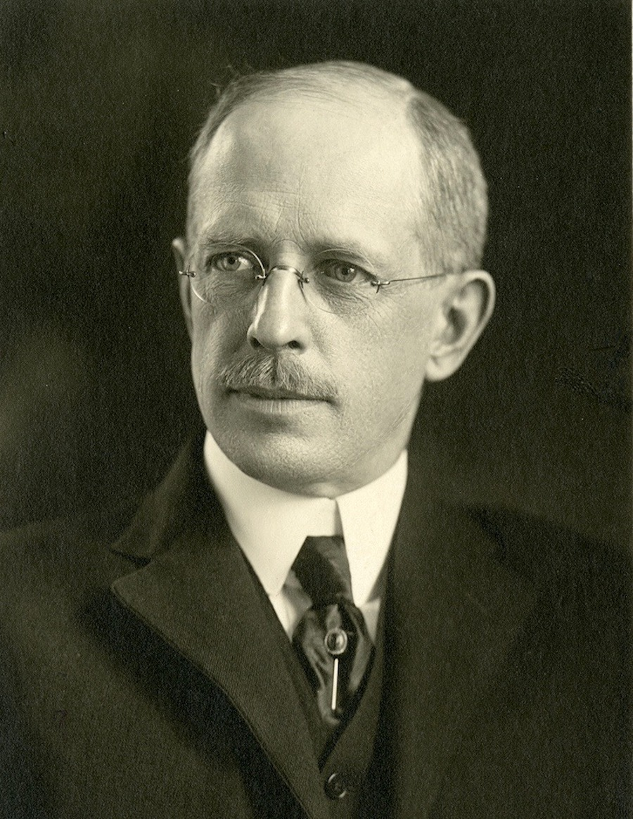
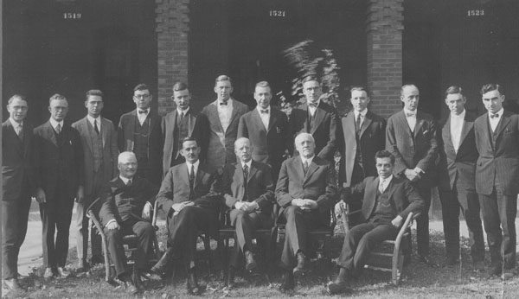
Charles C. Ryrie (1925-2016)
Part 1: The Man
Influential Individuals in the Life of Ryrie
Lewis Sperry Chafer
Founder, Dallas Theological Seminary

Slide 14
The Influence of Lewis Sperry Chafer
As a Child
“He was quite a musician. He was a tenor; Mrs. Chafer was an alto. I do have vivid memories of the two of them sitting at a piano in my folk’s home and singing duets.”
“Yes, I had an appreciation and knowledge for who he was, I think very much so.”
-Ryrie, Personal Interview, Nov. 6, 2012.
Lewis Sperry Chafer
Founder, Dallas Theological Seminary

Slide 15
The Influence of Lewis Sperry Chafer
As a Teenager
“I don’t know what you are going to do with your life, but there is not much competition in the field of having experts in the knowledge of the Word of God.”
-Ryrie, Personal Interview, Nov. 6, 2012.
Lewis Sperry Chafer
Founder, Dallas Theological Seminary

Slide 16
The Influence of Lewis Sperry Chafer
As a College Student
“Chafer is the reason I am in the ministry.”
“That night I felt a call to ministry…we talked and prayed. I date that night as two things, a dedication of life and call to Christian service.”
-Ryrie, Personal Interview, Nov. 6, 2012.
Lewis Sperry Chafer
Founder, Dallas Theological Seminary

Slide 17
The Influence of Lewis Sperry Chafer
As a Seminary Student
“we were all Chafer’s boys and as much as possible we were treated as such.”
“I was influenced on his position and insistence on grace and grace alone.”
“Almost anyone who had him as a teacher, what would they answer, almost uniformly grace.”
-Ryrie, Personal Interview, Nov. 6, 2012.
Lewis Sperry Chafer
Founder, Dallas Theological Seminary

Slide 18
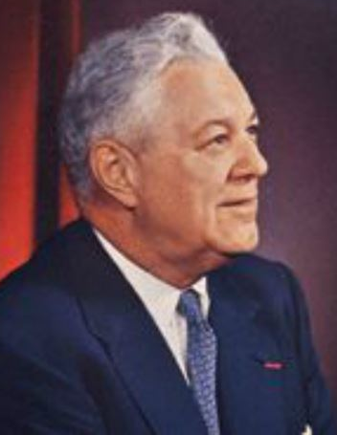
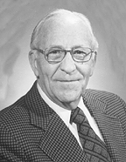
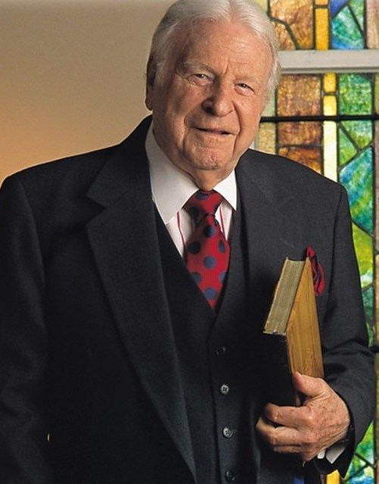
Charles C. Ryrie (1925-2016)
Part 1: The Man
The Influence of Other Individuals
Donald Grey Barnhouse
Pastor
Tenth Presbyterian - Philadelphia
Clarence Mason
Dean, Professor
Philadelphia College of Bible
W. A. Criswell
Pastor
First Baptist - Dallas

Slide 19
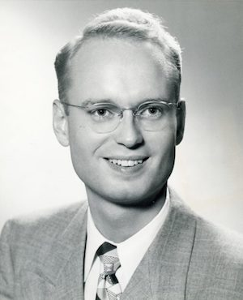
Charles C. Ryrie (1925-2016)
Part 2: His Ministry
Ryrie, the Professor and President
Midwest Bible and Missionary Institute (1947)
Westmont College (1948-1953)
Dallas Theological Seminary (1953-1958)

Slide 20
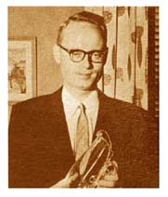
Charles C. Ryrie (1925-2016)
Part 2: His Ministry
Ryrie, the Professor and President
Midwest Bible and Missionary Institute (1947)
Westmont College (1948-1953)
Dallas Theological Seminary (1953-1958)
Philadelphia College of Bible (1958-1962)
“A very happy time. I liked teaching college-age kids. I liked teaching them because that is where many of them are making many life decisions.”
-Ryrie, Personal Interview, Nov. 6, 2012.

Slide 21
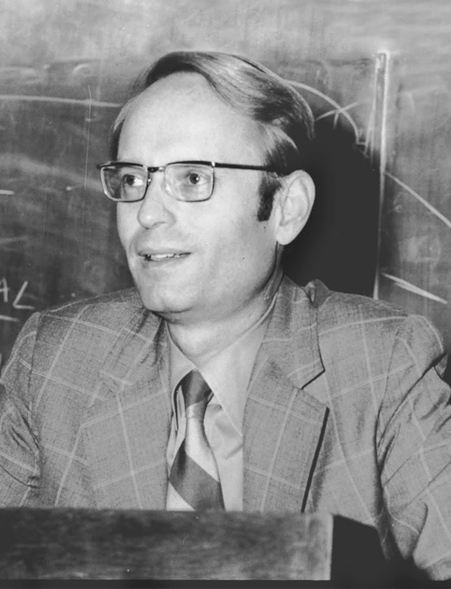
Charles C. Ryrie (1925-2016)
Part 2: His Ministry
Ryrie, the Professor and President
Midwest Bible and Missionary Institute (1947)
Westmont College (1948-1953)
Dallas Theological Seminary (1953-1958)
Philadelphia College of Bible (1958-1962)
Dallas Theological Seminary (1962-1983)

Slide 22
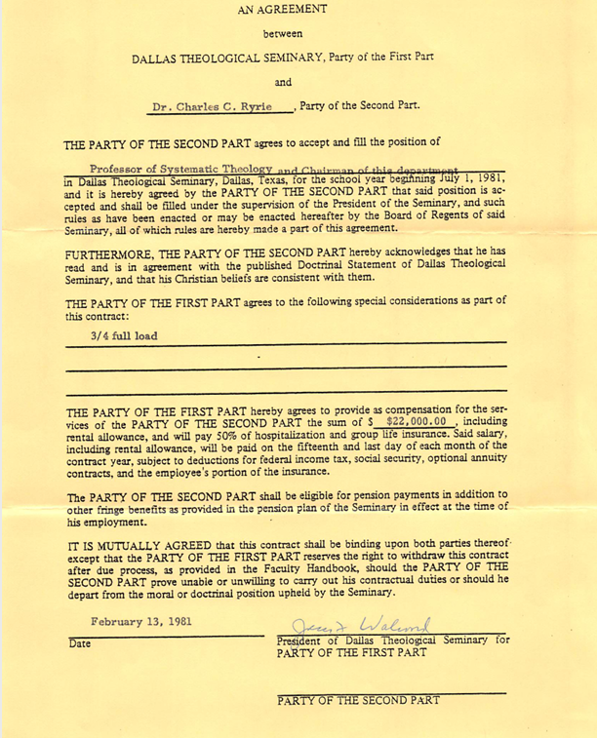
https://ryrielibrary.org/writings/contract-dts/

Slide 23
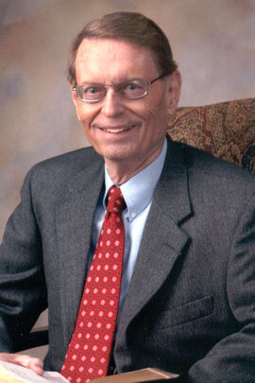
Charles C. Ryrie (1925-2016)
Part 2: His Ministry
Ryrie, the Professor and President
Midwest Bible and Missionary Institute (1947)
Westmont College (1948-1953)
Dallas Theological Seminary (1953-1958)
Philadelphia College of Bible (1958-1962)
Dallas Theological Seminary (1962-1983)
Leave of Absence (1982)

Slide 24
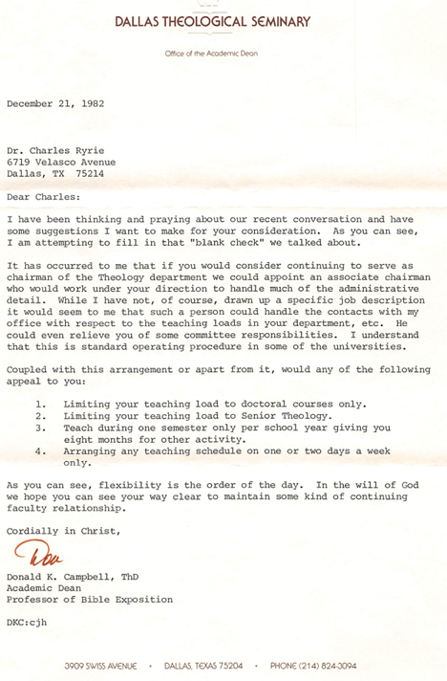
“flexibility is the order of the day”
Don Campbell, Academic Dean of DTS –
Letter to Ryrie
https://ryrielibrary.org/writings/correspondence-leave-of-absence/

Slide 25
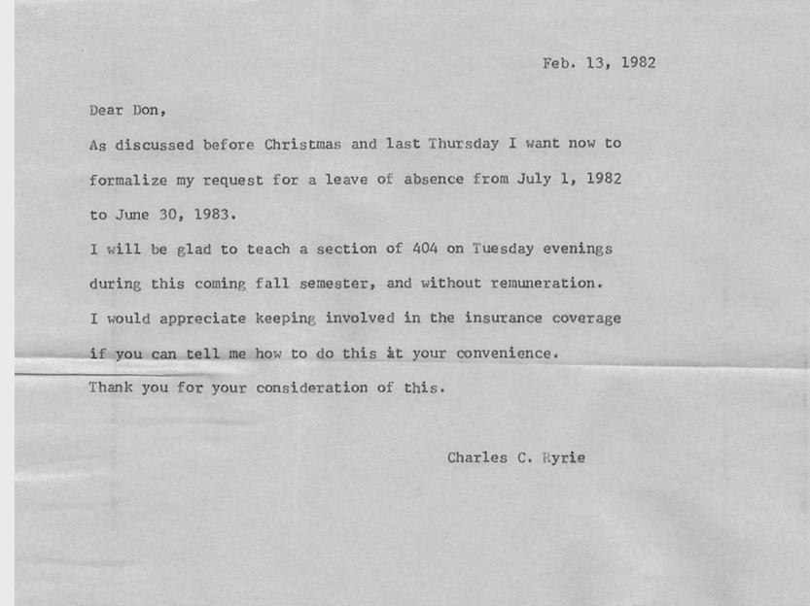
Ryrie – Leave of Absence Request
https://ryrielibrary.org/writings/correspondence-leave-of-absence/

Slide 26
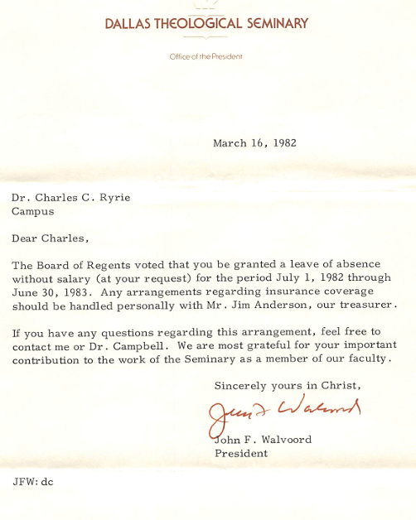
Walvoord - Leave of Absence Request Response
https://ryrielibrary.org/writings/correspondence-leave-of-absence/

Slide 27
Charles C. Ryrie (1925-2016)
Part 2: His Ministry
Ryrie, the Professor and President
Midwest Bible and Missionary Institute (1947)
Westmont College (1948-1953)
Dallas Theological Seminary (1953-1958)
Philadelphia College of Bible (1958-1962)
Dallas Theological Seminary (1962-1983)
Leave of Absence (1982)
Retired after 26 years at DTS (1983)

Slide 28
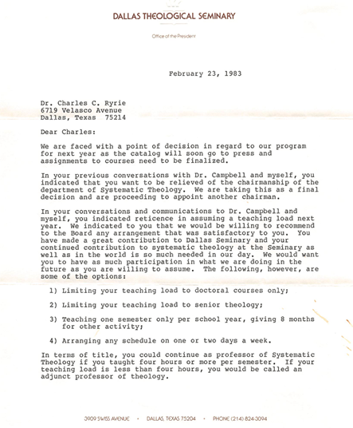
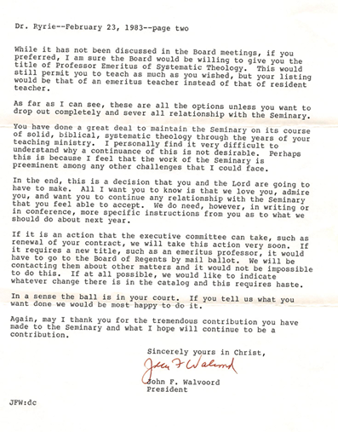
Walvoord Request to Ryrie
https://ryrielibrary.org/writings/correspondence-leave-of-absence/

Slide 29
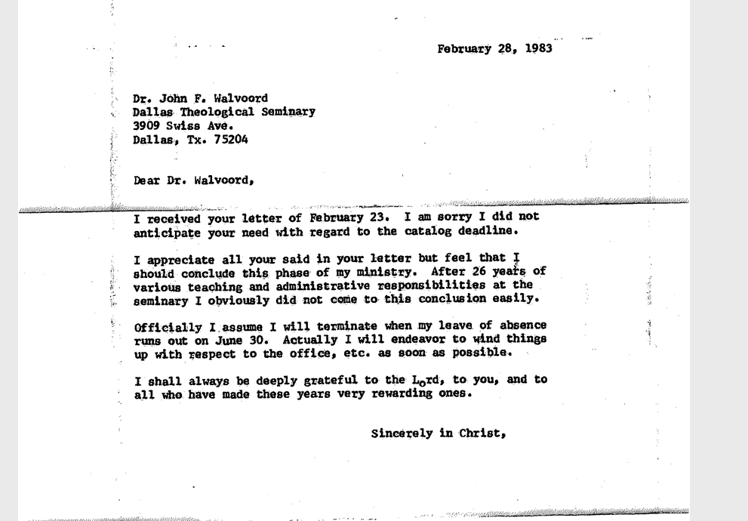
Ryrie’s Official Resignation
https://ryrielibrary.org/writings/correspondence-from-john-walvoord/

Slide 30
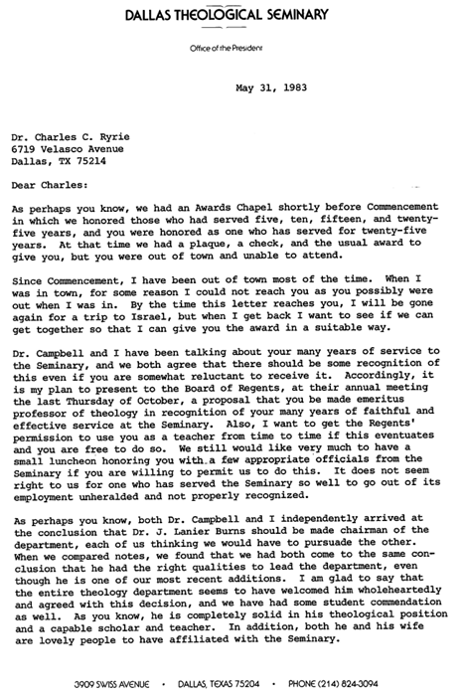
https://ryrielibrary.org/writings/correspondence-from-john-walvoord/

Slide 31
Charles C. Ryrie (1925-2016)
Part 2: His Ministry
Ryrie, the Professor and President
Midwest Bible and Missionary Institute (1947)
Westmont College (1948-1953)
Dallas Theological Seminary (1953-1958)
Philadelphia College of Bible (1958-1962)
Dallas Theological Seminary (1962-1983)
Leave of Absence (1982)
Retired after 26 years at DTS (1983)

Slide 32
Charles C. Ryrie (1925-2016)
Part 2: His Ministry
Ryrie, the Prolific Writer
32 Books sold over 1.5 million copies
Ryrie Study Bible 2.6 million copies

Slide 33
Theological Works
Basic Theology
Survey of Bible Doctrine
Dispensationalism
The Holy Spirit
Come Quickly Lord Jesus
The Best is Yet to Come
The Basis of the Premillennial Faith
The Final Countdown
What You Should Know About the Rapture

Slide 34
Contemporary Issues
The Role of Women in the Church
Neo-Orthodoxy
What You Should Know About Social Responsibility
Biblical Answers to Tough Questions
Biblical Answers to Contemporary Issues

Slide 35
Exegetical Works
Thessalonians
Acts
Revelation
The Miracles of Our Lord

Slide 36
Christian Living
Balancing the Christian Life
Making the Most of life

Slide 37
Miscellaneous Works
A History of the English Bible
2 Books on Object Lessons
Communicating Biblical Doctrine in a Practical Manner
The Young Christian’s Introduction to the Bible

Slide 38
Clarity and Charity
“May God give us discernment of the issues at stake, clear understanding for the truth, wholehearted committal to the authority of the Bible, God’s Word, and deep conviction of heart to speak the truth in love.”
-Ryrie, Neo-orthodoxy: What It Is and What It Does, 10.

Slide 39
Clarity and Charity
“When I was working on the Study Bible, I thought of the people in home Bible classes.”
-Baptist Bulletin, Have Something to Say, and Say It Clearly,

Slide 40
Clarity and Charity
“Dr. Ryrie is especially gifted in his ability to clarify profound theological truths in simple precise language. He has enabled people to understand biblical truth that they would otherwise not readily comprehend and in this he has made an inestimable contribution to the Christian world.”
-Paul Enns, Dictionary of Premillenial Theology, 67.

Slide 41
Clarity and Charity
“The difficulty is that too few conservative pastors and laymen have been able to study something concise, nontechnical, but accurate on this subject. To help meet this need is the purpose of this book.”
-Ryrie, Neo-orthodoxy, 10.

Slide 42
Clarity and Charity
“I list them without documentation since the point is not who said these but what was said, and to illustrate how varied and confusing these statements are.”
-Ryrie, So Great a Salvation, 23

Slide 43
Charles C. Ryrie (1925-2016)
Part 2: His Ministry
Ryrie, the Pioneer
The Role of Women in the Church (1954, 2011)

Slide 44
Ryrie, the Pioneer
“Again, Ryrie finds himself in the role of a prophetic scholar engaging in cutting-edge debate over a question that really had not been asked when he first penned this work as his doctoral dissertation in the mid-twentieth century, nor was the issue really of importance when Moody Publishers first issued his monograph on the subject.”
-Dorothy Patterson, Foreword to The Role of Women in the Church, xii.

Slide 45
Charles C. Ryrie (1925-2016)
Part 2: His Ministry
Ryrie, the Pioneer
The Role of Women in the Church (1954, 2011)
Dispensationalism Today (1965, 1995)
Ryrie Study Bible (1978)
Neo-Orthodoxy (1977)

Slide 46
Charles C. Ryrie (1925-2016)
Part 2: His Ministry
Ryrie, the Apologist
Inerrancy (1981)
Dispensationalism (1965, 1995)
Neo-Orthodoxy (1977)
So Great A Salvation (1989)
Difficult Issues (2008)

Slide 47
Charles C. Ryrie (1925-2016)
Part 2: His Ministry
Ryrie, the Apologist
Inerrrancy, “excuses against inerrancy”
So Great a Salvation, “straw men arguments”
Dispensationalism, “attacks” of opponents

Slide 48
Responding to Neo-Orthodoxy
“A theological hoax– that’s how one might describe Barthinianism…it has been hailed as the new or neo-orthodoxy; in reality it is nothing but a false or pseudo-orthodoxy.”
-Ryrie, Neo-orthodoxy, 9-10.
“The damage that liberalism has done to the Bible can never be estimated, and this is what neo-orthodoxy sides with.”
-Ryrie, Neo-orthodoxy, 10.

Slide 49
Responding to Neo-Orthodoxy
“[Neo-Orthodoxy] speaks of important and real truths about God, sin, man, and the cross. But, because of neo-orthodoxy’s acceptance of the liberal view of the Scriptures, the truths are based on nothing more than good stories, which may contain a grain of truth, but which also are greatly embellished. Original sin is the truest thing in the world, but the account of it in Genesis is only a story. The resurrection of Christ is the truest thing in the world, but the Gospel accounts of it are: hopelessly garbled. Christ is the Bread of Life, but of course, not one word of the Gospel of John is historical.”
-Ryrie, Neo-orthodoxy, 45.

Slide 50
Responding to Neo-Orthodoxy
“To sum up: their doctrine includes orthodox terminology built on liberal exegesis; it attempts to have inspiration without infallibility, and authority without actuality. What kind of Bible is that?”
-Ryrie, Neo-orthodoxy, 60.

Slide 51
Charles C. Ryrie (1925-2016)
Part 2: His Ministry
Ryrie, the Ordained Minister
Ordained by First Baptist Church of Alton, IL
Taught at Dallas First Baptist
Itinerate Preaching / Teaching Ministry

Slide 52
Charles C. Ryrie (1925-2016)
Part 3: His Method
Ryrie’s “First Theology”

Slide 53
Ryrie’s “First Theology”
“It is difficult to talk of God without appealing to the Bible, just as it is difficult to treat the Bible as Scripture without appealing to God.”
-Kevin Vanhoozer, First Theology: God, Scripture & Hermeneutics, 16.

Slide 54
Ryrie’s “First Theology”
“The Trinitarian believes God is Triunity. That is a belief gleaned from the Bible. Therefore, he also believes the Bible to be true.”
-Ryrie, Basic Theology, 16.

Slide 55
Ryrie’s First Theology
“basic presupposition”
-Ryrie, Basic Theology, 16.
“The theist believes there is a God. He mounts confirmatory evidence to support that belief, but basically he believes.”
-Ryrie, Basic Theology, 16.

Slide 56
Charles C. Ryrie (1925-2016)
Part 3: His Method
Ryrie’s “First Theology”
Ryrie’s View of God
Ryrie’s View of the Bible

Slide 57
Ryrie’s View of the Bible
“Those represent passages currently being used as illustrations of errors…reasonable explanations are at hand. We need not conclude that errors are present in the text except for, possibly, occasional copyists’ errors. How one views those suggestions will be a reflection of one’s underlying confidence, or lack of it, in the Bible itself.”
Ryrie, Basic Theology, 88-89.

Slide 58
Ryrie’s View of the Bible
“If someone comes to the Bible expecting or allowing for error, he can make a case for an errant Scripture. But if he comes expecting the Bible to be inerrant, he can find plausible solutions, and even if he cannot honestly accept any of the suggested solutions, he can still believe that the Bible is inerrant and that we simply don’t yet have enough facts to solve some of the problems.”
Ryrie, Basic Theology, 98.

Slide 59
Ryrie’s View of the Bible
Ryrie’s theological method begins with a presupposition that the triune God of the Bible exists, and He has revealed Himself to humanity in the inspired, inerrant Scriptures.

Slide 60
Charles C. Ryrie (1925-2016)
Part 3: His Method
Ryrie’s “First Theology”
Ryrie’s View of God
Ryrie’s View of the Bible
Ryrie’s Hermeneutic

Slide 61
Ryrie’s Hermeneutic: Historical, Grammatical, Literal (HGL)
“[literal] might also be called plain interpretation so that no one receives the mistaken notion that the literal principle rules out figures of speech.”
-Ryrie, Dispensationalism, 80.

Slide 62
Ryrie’s Hermeneutic: Historical, Grammatical, Literal (HGL)
“God intended you to understand what the Bible teaches. This does not mean that you will comprehend all its truths at first reading or even in a lifetime, but it does mean that you can expect to learn a great deal. God used language which He meant to be taken just as normally and plainly as the words in this book.”
-Ryrie, A Survey of Bible Doctrine, 9-10.

Slide 63
Ryrie’s Hermeneutic: Historical, Grammatical, Literal (HGL)
“The concept of a literal interpretation always raises questions since it seems to preclude anything symbolic, and the book [or Revelation] obviously contains symbols. Perhaps saying ‘normal’ or ‘plain’ interpretation would be better than ‘literal,’ since futurists do recognize the presence of symbols in the book. The difference between the literalist and the spiritualizer is simply that the former sees the symbols as conveying a plain meaning.”
-Ryrie, Revelation, 9.

Slide 64
Ryrie’s Three Rationales for HGL
1. The Nature of Language

Slide 65
Ryrie’s Three Rationales for HGL
“If God be the originator of language and if the chief purpose of originating it was to convey His message to humanity, then it must follow that He, being all-wise and all-loving, originated sufficient language to convey all that was in His heart to tell mankind. Furthermore, it must also follow that He would use language and expect people to understand it in its literal, normal, and plain sense. The Scriptures, then, cannot be regarded as an illustration of some special use of language so that in the interpretation of these Scriptures some deeper meaning of the words must be sought.”
-Ryrie, Dispensationalism, 81.

Slide 66
Ryrie’s Three Rationales for HGL
The Nature of Language
The Example of Fulfilled Old Testament Prophecies
The Only Means for Objectivity
“If literalism is the valid hermeneutical principle then that is an approach to the Scriptures which if consistently applied can only lead to dispensational theology.”
-Ryrie, “The Necessity of Dispensationalism,” BibSac, (July 1957): 249.

Slide 67
Ryrie’s Three Rationales for HGL
The Nature of Language
The Example of Fulfilled Old Testament Prophecies
The Only Means for Objectivity
“As basic as one believes literal interpretation to be, to that extent he will of necessity become a dispensationalist.”
-Ryrie, “The Necessity of Dispensationalism,” BibSac, (July 1957): 249.

Slide 68
Ryrie’s General Hermeneutical Principles
Interpret grammatically
Interpret according to the context
Compare Scripture with Scripture
Recognize the progressiveness of Scripture
.

Slide 69
Ryrie’s Special Hermeneutics of Prophecy
Consistency in principle
Compare prophecy with prophecy
Interpretation differs from application
Understanding the nature of figurative language
Law of fulfillment
Law of double fulfillment
Law of time relationship
.

Slide 70
Ryrie’s Special Hermeneutics of Prophecy
“It is God who desired to give man His Word. It is God who also gave the gift of language so He could fulfill that desire. He gave us His Word in order to communicate, not confound. We should seek to understand that communication plainly, for that is the normal way beings communicate.”
-Ryrie, Basic Theology, 115.
.

Slide 71
Ryrie’s View of Israel and the Church
“The one who fails to distinguish Israel and the church consistently will inevitably not hold to dispensational distinctions; and one who does will.”
“Israel does not replace the church, they are two separate people groups with two clearly delineated purposes.”
-Ryrie, Dispensationalism, 39.
.

Slide 72
Ryrie’s View of Israel and the Church
“In no sense have these promises made to Israel been abrogated or fulfilled by the church, which is a distinct body in this age having promises and a destiny different from Israel’s.”
-Ryrie, The Basis of the Premillennial Faith, 12.
.

Slide 73
Ryrie’s View of Israel and the Church
If one interprets literally, he arrives at the premillennial system…There is no disagreement over the fundamental rules of interpretation…the disagreement is in the interpretation of prophecy. The amillennialst’s answer is special hermeneutics which are special in the sense that they contradict all regular hermeneutical principles. The premillennialist’s answer includes some special considerations in interpreting prophecy…while at the same time being harmonious with the basic principles of hermeneutics.
-Ryrie, The Basis of the Premillennial Faith, 47.
.

Slide 74
Ryrie’s Response to Covenant Theology
The “Mystery” (μυστήριον / musterion) of the Church
The Inception of the Church
The “New Man” in Ephesians
-Ryrie, “The Mystery in Ephesians 3”, BibSac, (January 1966).

Slide 75
Ryrie’s Response to Covenant Theology
The “Mystery” (μυστήριον / musterion) of the Church

Slide 76
The Mystery (μυστήριον) of the Church
“The idea of a mystery being something secret in Old Testament times but revealed in the New Testament is clearly seen in a passage like Colossians 1:26…Thus the concept of a mystery is basically a secret which only the initiated share. This includes two ideas: (1) a time when the secret was not known followed by a time when it became known; and (2) deeper or higher wisdom which is revealed to the one initiated into an understanding of the mystery… In other words, the mystery concerns Jews and Gentiles as joint-heirs, in a joint-body, and joint-sharers of the promise in Christ…

Slide 77
The Mystery (μυστήριον) of the Church
… That the mystery contains the fact that Gentiles are included in God’s plan of redemption is clear, and most non-dispensational writers stop at this point. But is this all there is to the mystery? If so, there is little mystery in that, for the Old Testament made this clear (Gen. 12:3; Isa. 42:6-7). If this is the mystery then Paul was wrong to label it a mystery, for it is neither something new nor some higher truth. The heart of the mystery is that there would be a ‘joint-body’ for Jews and Gentiles.”
-Ryrie, “The Mystery in Ephesians 3”, BibSac, (January 1966): 25.

Slide 78
Ryrie’s Response to Covenant Theology
The “Mystery” (μυστήριον / musterion) of the Church
The Inception of the Church
.

Slide 79
The Inception of the Church
“Therefore, the inescapable conclusion is that the body of Christ did not come into existence until the day of Pentecost when the first members of the body were joined to the risen Head…If by stretch of the interpretive imagination the body could be said to have existed before Pentecost, then it was without a head.”
-Ryrie, “The Mystery in Ephesians 3”, BibSac, (January 1966): 27-28.

Slide 80
Ryrie’s Response to Covenant Theology
The “Mystery” (μυστήριον / musterion) of the Church
The Inception of the Church
The “New Man” in Ephesians
.

Slide 81
The “New Man” of Ephesians
“That body-church is called a “new-man” (Eph. 2:15), not a continuation or remaking of Israel, but something new and distinct from the Israel of the Old Testament…Just as the redeemed before Abrahams’ day (like Enoch and Noah) were not a part of Israel, so the redeemed of this age are not either.”
-Ryrie, “The Mystery in Ephesians 3”, BibSac, (January 1966): 28.
.

Slide 82
Ryrie’s Response to “Complementary Hermeneutics”
“In making complementary additions… it does not jettison old promises. The enhancement is not at the expense of the original promise.”
-Blaising and Bock, Dispensationalism, Israel and the Church, 392-392.
“allows the New Testament to introduce changes and additions to Old Testament Revelation.”
-Ryrie, Dispensationalism, 164.

Slide 83
Ryrie’s Response to “Complementary Hermeneutics”
“Are there limits on the use of a complementary hermeneutic, and, if so, how are these limits to be determined and by whom?”
-Ryrie, Dispensationalism, 175.

Slide 84
Ryrie’s Response to “Complementary Hermeneutics”
“If one does not employ normal interpretation, then objectivity is lost to the extent that he does not use it consistently… [This] results in different, inconsistent, and often contradictory interpretations.”
-Ryrie, Basic Theology, 113.

Slide 85
Ryrie: The Man, His Ministry, and Method
Typology
Progressive Revelation
The New Testament’s Use of the Old Testament
The Mosaic Covenant
The Abrahamic Covenant
The Davidic Covenant
The New Covenant
Integration of the Bible w/ other Disciplines (archaeology, science, etc.)
Central Unifying Principle of Interpretation
A Summary of Ryrie’s Theological Method

Slide 86
New Release!
“Paul Weaver has performed a vital service by writing this introduction to the life and legacy of Charles Ryrie. He shows why Dr. Ryrie was one of the most important theologians of the twentieth century. He loved the Word of God, and he loved sharing it with others. Though Dr. Ryrie has gone to heaven, his influence lives on around the world. Read this book and see for yourself.”

