Slide 1

THE IMPORTANCE OF PROPHECY TO THE BELIEVER’S WALK 2 Peter 3:3–15
Andrew Marshall Woods, Th.M., JD., PhD.
Sr. Pastor, Sugar Land Bible Church
President – Chafer Theological Seminary

Slide 2

FALSE TEACHERS ARE COMING!
Heresies of Gnostics:
Salvation via special knowledge “gnosis”
License (indulgence)

Slide 3
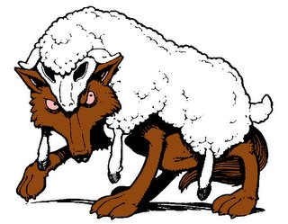
Purpose
To build up his readers in the faith so that they will be insulated from the coming false teachers

Slide 4
Structure
2 Peter 1 – Call to maturity
2 Peter 2 – Characteristics of false teachers
2 Peter 3 – Doctrine of the false teachers

Slide 5
Structure
2 Peter 1 – Call to maturity
2 Peter 2 – Characteristics of false teachers
2 Peter 3 – Doctrine of the false teachers

Slide 6


2 Peter 2:14
¹⁴ having eyes full of adultery that never cease from sin, enticing unstable souls, having a heart trained in greed, accursed children.

Slide 7

Portrait of Growth 1:5-7

Slide 8
Structure
2 Peter 1 – Call to maturity
2 Peter 2 – Characteristics of false teachers
2 Peter 3 – Doctrine of the false teachers

Slide 9
2 Peter 2 Outline
Predicted arrival (2:1a)
Devices (2:1b-3)
Doom (2:4-9)
Depravity (2:10-16)
Emptiness (2:17-19)
Regression (2:20-22)

Slide 10
Structure
2 Peter 1 – Call to maturity
2 Peter 2 – Characteristics of false teachers
2 Peter 3 – Doctrine of the false teachers

Slide 11
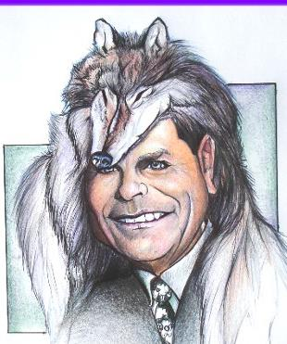
MESSAGE
Protection from the negative influence of the coming false teachers is accomplished through exhortation toward maturity and exposing the characteristics and doctrines of these coming false teachers.

Slide 12
Overview 2 Peter 3:3-15
Heresy of the false teachers (v3-4)
Motive of the false teachers (v3-4)
Peter’s rebuttal (v5-10)
Application (v11-15)

Slide 13
Overview 2 Peter 3:3-15
Heresy of the false teachers (v3-4)
Motive of the false teachers (v3-4)
Peter’s rebuttal (v5-10)
Application (v11-15)

Slide 14

Doctrine of False Teachers V.3-4
Deny 2nd coming
Scoffing
Future tense

Slide 15
Apostasy is A Massive NT Subject
Gospels (Matt 13)
Early church (Acts 20:29-31)
Pauline letters (Rom 16:17-18; Gal 1:6-9; 2 Cor 11:1-15; Philip 3:2, 18-19; Col 2:8; 1 Tim 4; 2 Tim 3–4; Titus 1:10)
General letters (Heb 2:1-4; 2 Pet 2–3; Jude; 1 John 4:1-6)
Revelation (2–3)

Slide 16
Apostasy Impacts Every Major Doctrine
The faith (1 Tim 4:1)
God (Jude 4)
Christ and His death (2 Pet 2:1)
Christ’s return (2 Pet 3:3-4)
Sound doctrine (2 Tim 4:3-4)
Resurrection (2 Tim 2:16-18)
God as creator (2 Pet 3:5)

Slide 17

Eusebius
Ecclesiastical History, 3.39.12-13
“Papias...says that there will be a millennium after the resurrections of the dead, when the kingdom of Christ will be set up in material form on this earth. I suppose that he got these notions by a perverse reading of the apostolic accounts, not realizing that they had spoken mystically and symbolically. For he was a man of very little intelligence, as is clear from his books. But he is responsible for the fact that so many Christian writers after him held the same opinion, relying on his antiquity, for instance Irenaeus and whoever else appears to have held the same views.”

Slide 18
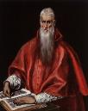
“How must we understand what the Saviour says in Matthew: ‘But I say to you, I will not drink again of this fruit of the vine until that day when I drink it new with you in the Kingdom of my Father’? (Matth. 26. 29). This passage is the origin of a certain fable of a thousand years, in which they say that Christ will reign in the flesh and will drink that wine which He has not drunk since that time until the end of the world…For the kingdom of God isn’t food and drink, but justice, joy and peace in the Holy Spirit (Rom. 14. 17).”
Jerome
http://www.tertullian.org/fathers/jerome_letter_120.htm

Slide 19
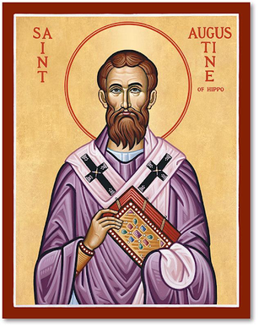
Augustine
The City of God, trans., Marcus Dods (NY: Random House, 1950), Book XX, chap. 7, p. 719.
“And this opinion would not be objectionable, if it were believed that the joys of the saints in that Sabbath shall be spiritual, and consequent on the presence of God; for I myself, too, once held this opinion. But, as they assert that those who then rise again shall enjoy the leisure of immoderate carnal banquets, furnished with an amount of meat and drink such as not only to shock the feeling of the temperate, but even to surpass the measure of credulity itself, such assertions can be believed only by the carnal. They who do believe them are called by the spiritual Chiliasts, which we may literally reproduce by the name Millenarians.”

Slide 20
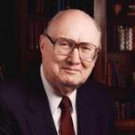
Dr. John Walvoord "An Interview: Dr. John Walvoord Looks at Dallas Seminary," Dallas Connection (Winter 1994, Vol. 1, No. 3), p. 4.
In 1994, "What do you predict will be the most significant theological issues over the next ten years?" He responded, "The hermeneutical problem of not interpreting the Bible literally, especially the prophetic areas. The church today is engulfed in the idea that one cannot interpret prophecy literally.”

Slide 21

“EFCA Now Considers Premillennialism a Non-Essential,”
by Daniel Silliman, Christianity Today, 8/23/19
“The denomination drops end times doctrine from its statement of faith in a move to ‘major on the majors’ and ‘minor on the minors.’ The Evangelical Free Church of America (EFCA) changed its position on end times theology, voting this summer to drop the word ‘premillennial’ from the denomination’s statement of faith… Premillennialism has been a ‘denominational distinctive’ for the EFCA, according to the document, but shouldn’t be overemphasized.”

Slide 22

Rick Warren
Purpose Driven Life, 285-86.
“When the disciples wanted to talk about prophecy, Jesus quickly switched the conversation to evangelism. He wanted them to concentrate on their mission in the world. He said in essence, ‘The details of my return are none of your business. What is your business is the mission I have given you. Focus on that!’ If you want Jesus to come back sooner, focus on fulfilling your mission, not figuring out prophecy. Speculating on the exact timing of Christ’s return is futile, because Jesus said, ‘No one knows about that day or hour, not even the angels in heaven, nor the Son, but only the Father.’ Since Jesus said He didn’t know the day or hour, why should you try to figure it out? What we do know for sure is this: Jesus will not return until everyone God wants to hear the Good News has heard it.”

Slide 23
Rick Warren
Purpose Driven Life, 285-86.
“Jesus said, ‘The Good News about God’s kingdom will be preached in all the world, to every nation. Then the end will come.’ If you want Jesus to come back sooner, focus on fulfilling your mission, not figuring out prophecy. It is easy to get distracted and sidetracked from your mission because Satan would rather have you do anything besides sharing your faith. He will let you do all kinds of good things as long as you don’t take anyone to heaven with you. But the moment you become serious about your mission, expect the Devil to throw all kinds of diversions at you. When that happens, remember the words of Jesus: ‘Anyone who lets himself be distracted from the work I plan for him is not fit for the Kingdom of God.’”

Slide 24

Eschatology A Sin?
“Therefore, I conclude that it is sin to divide the body of Christ—to divide the body that he prayed would be united. Therefore for us to conclude that we must agree upon a certain view of alcohol, or a certain view of schooling, or a certain view of meat sacrificed to idols, or a certain view of the millennium in order to have fellowship together is, I think, not only unnecessary for the body of Christ, but it is therefore both unwarranted and therefore condemned by scripture. So if you’re a pastor and you’re listening to me, you understand me correctly if you think I’m saying you are in sin if you lead your congregation to have a statement of faith that requires a particular millennial view. I do not understand why that has to be a matter of uniformity in order to have Christian unity in a local congregation.”
24
Justin Taylor, “Dever: ‘You Are in Sin If You Lead Your Congregation to Have a Statement of Faith that Requires a Particular Millennial View,’” online: https://www.thegospelcoalition.org/blogs/justin-taylor/dever-you-are-in-sin-if-you-lead-your/, July 14 2009, accessed May 28, 2019.
Notes:
WRONG!!!

Slide 25
Doctrine of False Teachers V.3-4
Deny 2nd coming
Scoffing
Future tense

Slide 26
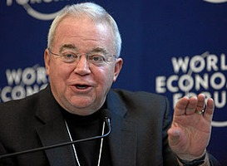
Jim Wallis
Jim Wallis, cited in Mary Danielsen, What You Need to Know About Jim Wallis and the Social-Justice "Gospel" (Eureka, MT: Lighthouse Trails, 2014), 13.
“It’s all too easy to make fun of the extreme examples of prophecy belief that we encounter on bumper stickers and best-seller lists. When people talk breathlessly of the dangers of Universal Product Codes and automated teller machines as signs of the impending Tribulation, giggles and headshaking are hard to repress…when we ridicule apocalyptic interpretations of bar codes and the European Common Market, we are…properly rejecting an interpretive method that suggests a correspondence between biblical events and symbols, and our own lives. Ought Revelation to be included within the family of Christian texts, or should it be thrown on the fire of apocalyptic excesses?”

Slide 27
Overview 2 Peter 3:3-15
Heresy of the false teachers (v3-4)
Motive of the false teachers (v3-4)
Peter’s rebuttal (v5-10)
Application (v11-15)

Slide 28
Motive of False Teachers V.3-4
Deny 2nd coming
Lust & denial of judgment
Uniformitarianism; naturalism

Slide 29
Motive of False Teachers V.3-4
Deny 2nd coming
Lust & denial of judgment
Uniformitarianism; naturalism

Slide 30
Motive of False Teachers V.3-4
Deny 2nd coming
Lust & denial of judgment
Uniformitarianism; naturalism

Slide 31
Uniformitarianism Defined
https://www.britannica.com/science/uniformitarianism
“Uniformitarianism, in geology, the doctrine suggesting that Earth’s geologic processes acted in the same manner and with essentially the same intensity in the past as they do in the present and that such uniformity is sufficient to account for all geologic change. This principle is fundamental to geologic thinking and underlies the whole development of the science of geology... When William Whewell, a University of Cambridge scholar, introduced the term in 1832, the prevailing view (called catastrophism) was that Earth had originated through supernatural means and had been affected by a series of . . .

Slide 32
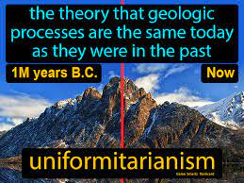
Uniformitarianism Defined
https://www.britannica.com/science/uniformitarianism
“. . . catastrophic events such as the biblical Flood. In contrast to catastrophism, uniformitarianism postulates that phenomena displayed in rocks may be entirely accounted for by geologic processes that continue to operate—in other words, the present is the key to the past.”

Slide 33

Colossians 2:8
“See to it that no one takes you captive through philosophy and empty deception, according to the tradition of men, according to the elementary principles of the world, rather than according to Christ.”

Slide 34
Overview 2 Peter 3:3-15
Heresy of the false teachers (v3-4)
Motive of the false teachers (v3-4)
Peter’s rebuttal (v5-10)
Application (v11-15)

Slide 35
Peter’s Rebuttal V.5-10
Arguments from:
History (5-7)
Scripture (8)
God’s character (9)
Divine promise (10)

Slide 36
Peter’s Rebuttal V.5-10
Arguments from:
History (5-7)
Scripture (8)
God’s character (9)
Divine promise (10)

Slide 37

History V. 5-7
Creation (5)
Flood (6-7)
God will judge again via fire

Slide 38
History V. 5-7
Creation (5)
Flood (6-7)
God will judge again via fire

Slide 39

Genesis 1:1-3
“¹ In the beginning God created the heavens and the earth. ² The earth was formless and void, and darkness was over the surface of the deep, and the Spirit of God was moving over the surface of the waters. ³ Then God said, ‘Let there be light’; and there was light.”

Slide 40
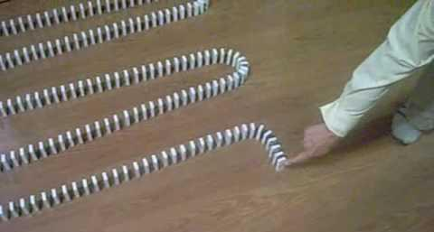
Dominoes in a Row

Slide 41

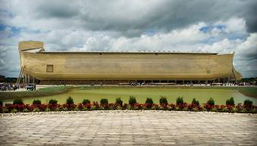
2 Peter 3:5 (KJV)
“For this they willingly are ignorant of [thelō], that by the word of God the heavens were of old, and the earth standing out of the water and in the water.”

Slide 42
Romans 1:18–20
¹⁸ For the wrath of God is revealed from heaven against all ungodliness and unrighteousness of men who suppress the truth in unrighteousness, ¹⁹ because that which is known about God is evident within them; for God made it evident to them. ²⁰ For since the creation of the world His invisible attributes, His eternal power and divine nature, have been clearly seen, being understood through what has been made, so that they are without excuse.

Slide 43
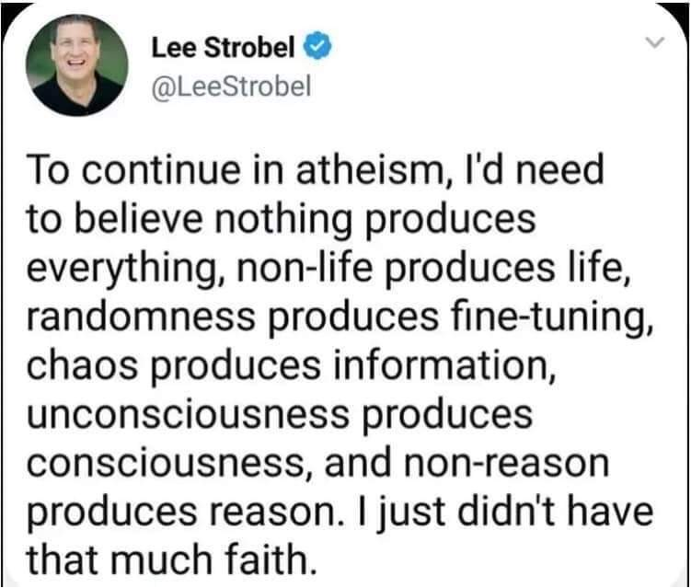

Slide 44
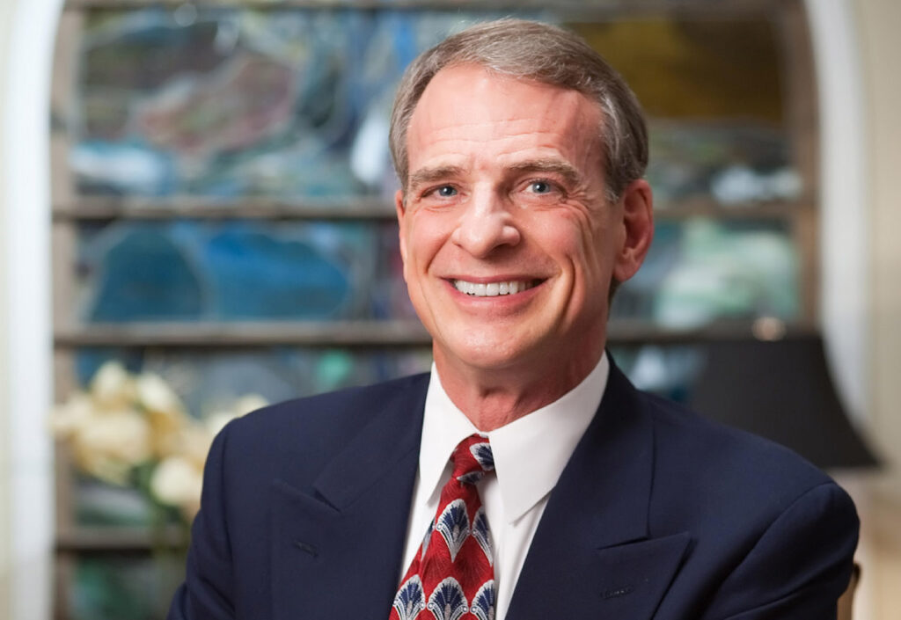
William Lane Craig “See William Lane Craig, "Dr. Craig on Collins vs Dawkins on Design of Universe," January 20, 2013, https://www.reasonablefaith.org/media/reasonable-faith-podcast/dr.-craig-on-collins-vs-dawkins-on-design-of-universe/.”.
“…I've seen a comparable statistic that says that over 50% of evangelical pastors think that the world is less than ten thousand years old. Now, when you think about that … that is just hugely embarrassing; that over half of our ministers really believe that the universe is only around ten thousand years old. This is just scientifically nonsense, and yet this is the view that the majority of our pastors hold. It's really quite shocking when you think about it.”

Slide 45
History V. 5-7
Creation (5)
Flood (6-7)
God will judge again via fire

Slide 46
Genesis 7:19-23
They rose greatly on the earth, and all the high mountains under the entire heaven were covered…Every living thing that moved on the earth perished—birds, livestock, wild animals, all the creatures that swarm over the earth, and all mankind. Everything on dry land that had the breath of life in its nostrils died. Every living thing on the face of the earth was wiped out; men and animals and the creatures that move along the ground and the birds of the air were wiped from the earth. Only Noah was left, and those with him in the ark.”

Slide 47

H.C. Leupold
Exposition of Genesis (Grand Rapids: Baker, 1942), vol. 1, p. 301-302.
“… ‘all the high mountains under all the heavens.’ One of these expressions alone would almost necessitate the impression that the author intends to convey the idea of the absolute universality of the Flood…Yet since ‘all’ is known to be used in a relative sense, the writer removes all ambiguity by adding the phrase ‘under all the heavens.’ A double ‘all’ (kol) cannot allow for so relative a sense. It almost constitutes a Hebrew superlative. So we believe that the text disposes of the question of the universality of the flood. By way of objection to this interpretation, those who believe in a limited flood…urge the . . .

Slide 48
H.C. Leupold
Exposition of Genesis (Grand Rapids: Baker, 1942), vol. 1, p. 301-302.
. . . fact that kol is used in a relative sense, as is clearly the case in passages such as Genesis 41:57; Exodus 9:25, 10:15; Deuteronomy 2:25; and 1 Kings 10:24. However, we still insist that this fact could overthrow a single kol, never a double kol, as our verse has it.”

Slide 49
Reasons Against a Local Flood
Analogy to global Second Advent (Matt 24:37-39; Rev 1:7; 2 Pet 3:5-7)
Size of the ark (450 ft. long, 75 ft. wide, 45 ft. deep)?
Animals and birds on the ark?

Slide 50

Matthew 24:36-39
³⁶ “But of that day and hour no one knows, not even the angels of heaven, nor the Son, but the Father alone. ³⁷ For the coming of the Son of Man will be just like the days of Noah. ³⁸ For as in those days before the flood they were eating and drinking, marrying and giving in marriage, until the day that Noah entered the ark, ³⁹ and they did not understand until the flood came and took them all away; so will the coming of the Son of Man be.”

Slide 51

Dr. Henry Morris
The Revelation Record, 14
“The Book of Revelation is the sequel to the Book of Genesis, the two books together bounding all history and bounding all of God’s revelations to mankind. They constitute the alpha and omega of God’s written Word, the Book of Beginnings, and the Book of Unveilings.”

Slide 52
Uniformitarianism is not Biblicism
Era | Scripture | Distinctives
1. Creation | Gen. 1-2 | No death
2. Fall | Gen. 3-6 | Death, painful pregnancy & toil, long life spans, no human government
3. Flood | Gen. 7-10 | Shorter life spans, one language, no nations, human government
4. Babel | Gen. 11-present | No global government, multiple languages, nations, ethnicities

Slide 53
Uniformitarianism is not Biblicism
Era | Scripture | Distinctives
5. Antichrist | Rapture to 2nd Advent | Global government, restrainer removed
6. Kingdom | Rev. 20:1-10 | Long life spans, kingdom conditions, reality of death, renovated earth
7. Eternal State | Rev. 21-22 | No death, new earth

Slide 54
Peter’s Rebuttal V.5-10
Arguments from:
History (5-7)
Scripture (8)
God’s character (9)
Divine promise (10)

Slide 55
Scripture V. 8
God’s timing is not the same as ours

Slide 56

Romans 8:29-30
²⁹ For those whom He foreknew, He also predestined to become conformed to the image of His Son, so that He would be the firstborn among many brethren; ³⁰ and these whom He predestined, He also called; and these whom He called, He also justified; and these whom He justified, He also glorified.

Slide 57
Jude 14–15
¹⁴ It was also about these men that Enoch, in the seventh generation from Adam, prophesied, saying, “Behold, the Lord came with many thousands of His holy ones, ¹⁵ to execute judgment upon all, and to convict all the ungodly of all their ungodly deeds which they have done in an ungodly way, and of all the harsh things which ungodly sinners have spoken against Him.”

Slide 58
Peter’s Rebuttal V.5-10
Arguments from:
History (5-7)
Scripture (8)
God’s character (9)
Divine promise (10)

Slide 59

2 Peter 3:9
“The Lord is not slow about His promise, as some count slowness, but is patient toward you, not wishing for any to perish but for all to come to repentance.”

Slide 60
God’s Character V. 9
Delay ≠ no 2nd Coming
Delay = patience

Slide 61
Genesis 6:1-4
“¹ Now it came about, when men began to multiply on the face of the land, and daughters were born to them, ² that the sons of God saw that the daughters of men were beautiful; and they took wives for themselves, whomever they chose. ³ Then the Lord said, ‘My Spirit shall not strive with man forever, because he also is flesh; nevertheless his days shall be one hundred and . . .

Slide 62
Genesis 6:1-4
. . . twenty years.’ ⁴ The Nephilim were on the earth in those days, and also afterward, when the sons of God came in to the daughters of men, and they bore children to them. Those were the mighty men who were of old, men of renown.”

Slide 63
1 Peter 3:19-20
“¹⁹ in which also He went and made proclamation the spirits now in prison, ²⁰ who once were disobedient, when the patience of God kept waiting in the days of Noah, during the construction of the ark, in which a few, that is, eight persons, were brought safely through the water.”

Slide 64


Genesis 15:16
“Then in the fourth generation they will return here, for the wrongdoing of the Amorite is not yet complete.”

Slide 65
2 Peter 3:9
“The Lord is not slow about His promise, as some count slowness, but is patient toward you, not wishing for any to perish but for all to come to repentance.”

Slide 66
2 Peter 3:9
Douay-Rheims 1899 American Edition (DRA)
“The Lord delayeth not his promise, as some imagine, but dealeth patiently for your sake, not willing that any should perish, but that all should return to penance.”

Slide 67
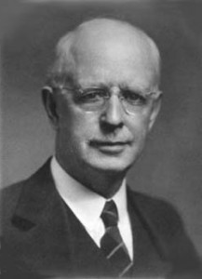
Lewis Sperry Chafer vol. 7, Systematic Theology (Grand Rapids, MI: Kregel Publications, 1993), 265-66.
“This vital newness of mind is a part of believing, after all, and therefore it may be and is used as a synonym for believing at times (cf. Acts 17:30; 20:21; 26:20; Rom. 2:4; 2Tim. 2:25; 2 Pet. 3:9). Repentance nevertheless cannot be added to believing as a condition of salvation, because upwards of 150 passages of Scripture condition salvation upon believing only (cf. John 3:16; Acts 16:31).”

Slide 68

Acts 17:30-31
“³⁰ Therefore having overlooked the times of ignorance, God is now declaring to men that all people everywhere should repent [metanoeō], ³¹ because He has fixed a day in which He will judge the world in righteousness through a Man whom He has appointed, having furnished proof to all men by raising Him from the dead.”

Slide 69
Peter’s Rebuttal V.5-10
Arguments from:
History (5-7)
Scripture (8)
God’s character (9)
Divine promise (10)

Slide 70
God’s Promise V. 10
Despite delay,
the day will come:
Like a thief
According to God’s promise

Slide 71
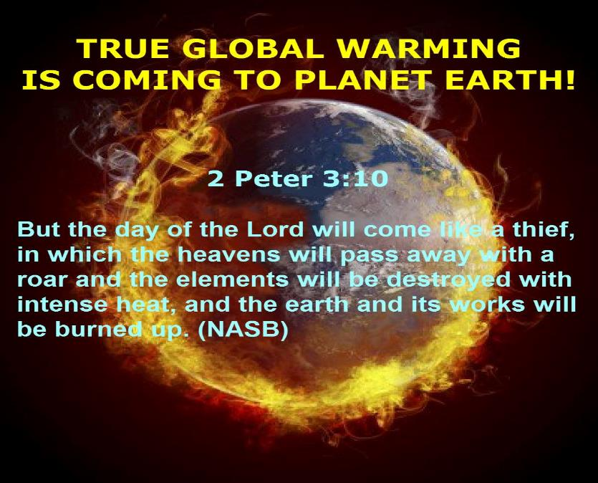

Slide 72


2 Cor. 4:18
“…while we look not at the things which are seen, but at the things which are not seen; for the things which are seen are temporal, but the things which are not seen are eternal.”

Slide 73
Genesis 3:17-19
¹⁷ Then to Adam He said, “Because you have listened to the voice of your wife, and have eaten from the tree about which I commanded you, saying, ‘You shall not eat from it’; Cursed is the ground because of you; In toil you will eat of it All the days of your life. ¹⁸ “Both thorns and thistles it shall grow for you; And you will eat the plants of the field; ¹⁹ By the sweat of your face You will eat bread...”

Slide 74

Romans 8:19-23
¹⁹ “For the anxious longing of the creation waits eagerly for the revealing of the sons of God. ²⁰ For the creation was subjected to futility, not willingly, but because of Him who subjected it, in hope ²¹ that the creation itself also will be set free from its slavery to corruption into the freedom of the glory of the children of God. ²² For we know that the whole creation groans and suffers the . . .

Slide 75
Romans 8:19-23
. . . pains of childbirth together until now. ²³ And not only this, but also we ourselves, having the first fruits of the Spirit, even we ourselves groan within ourselves, waiting eagerly for our adoption as sons, the redemption of our body.”

Slide 76
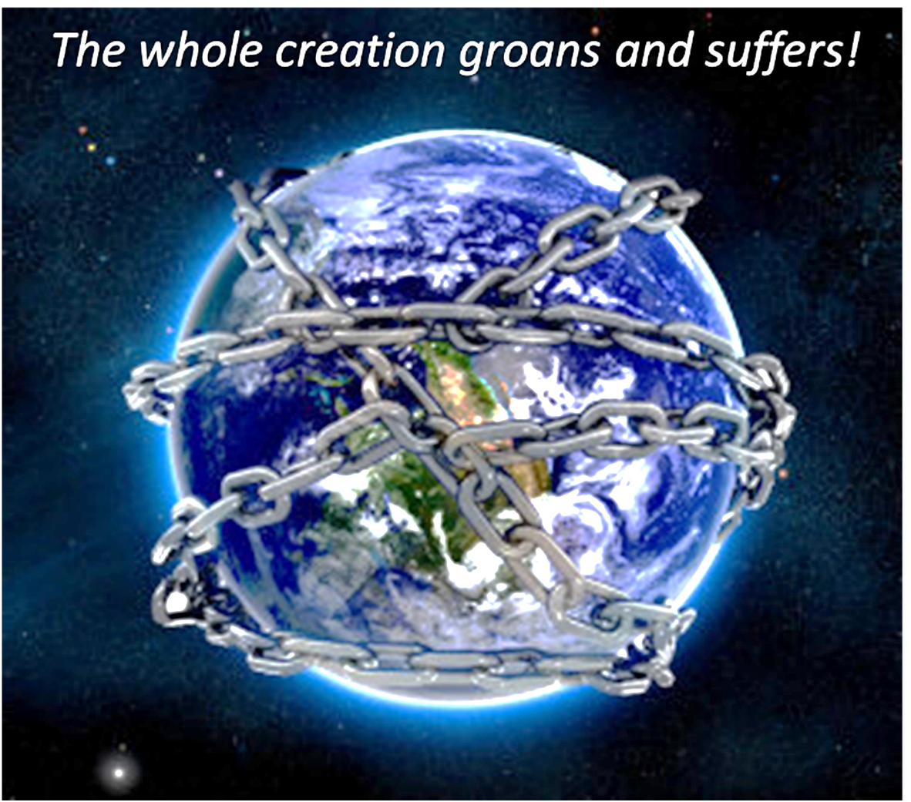

Slide 77
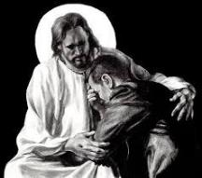
Revelation 21:4
“and He will wipe away every tear from their eyes; and there will no longer be any death; there will no longer be any mourning, or crying, or pain; the first things have passed away.”

Slide 78
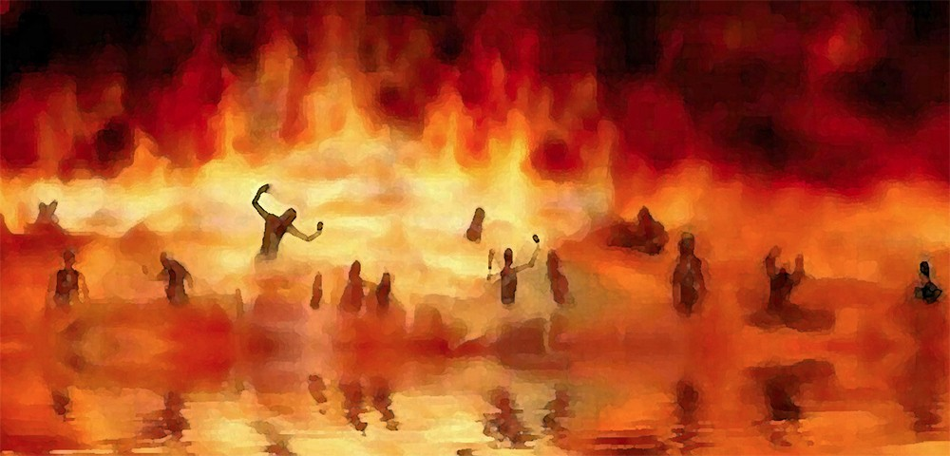
Revelation 21:8
“But for the cowardly and unbelieving and abominable and murderers and immoral persons and sorcerers and idolaters and all liars, their part will be in the lake that burns with fire and brimstone, which is the second death.”

Slide 79
Revelation 21:1, 4
¹ Then I saw a new heaven and a new earth; for the first heaven and the first earth passed away [apérchomai], and there is no longer any sea…⁴ and He will wipe away every tear from their eyes; and there will no longer be any death; there will no longer be any mourning, or crying, or pain; the first things have passed away [apérchomai].

Slide 80
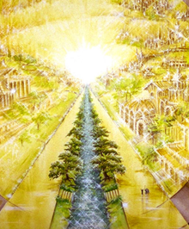
Eternal State is Future
No Satan (Rev 20:10)
No sea (Rev 21:1)
No death, crying, or pain (Rev 21:4)
No Sun (Rev 22:5)
No Moon (Rev 21:23)
No temple (Rev. 21:22)
No night (Rev 21:25)
No evil (Rev 21:27)
No curse (Rev 22:3)

Slide 81

Matthew 5:18; 24:35
“^{5:18} For truly I say to you, until heaven and earth pass away, not the smallest letter or stroke shall pass from the Law until all is accomplished. . . .^{24:35} Heaven and earth will pass away, but My words will not pass away.”

Slide 82
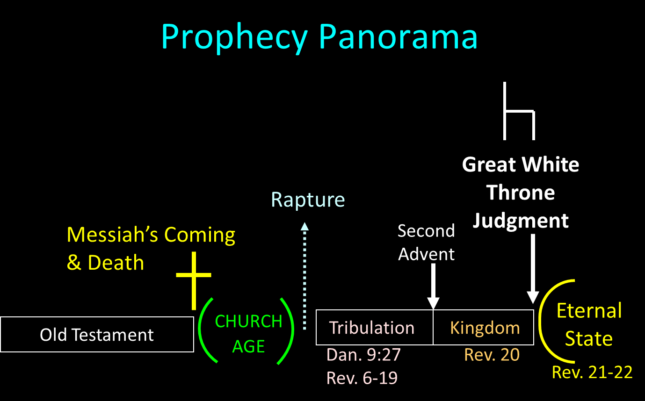

Slide 83
Millennium Rev.20 | Eternal State Rev.21-22
Sin restrained | Sin removed
Curse restrained | Curse removed
Death | No death
Mortals / resurrected | Resurrected only
Mortals Destinies undecided | All Destinies sealed
Renovation | Recreation
Temporary | Eternal
Transitional | Non-transitional

Slide 84
Millennium and Eternal State
 | Rev 20:1-10 | Rev 21–22
Time | 20:4 | 22:5
Luminaries | Isa 30:26 | 21:23; 22:5
Temple | Ezek 40–48 | 21:22
Death | Isa 65:20 | 21:4
Satanic activity | 20:7 | 20:10
Rebellion | 20:8-9 | 21:27

Slide 85
Overview 2 Peter 3:3-15
Heresy of the false teachers (v3-4)
Motive of the false teachers (v3-4)
Peter’s rebuttal (v5-10)
Application (v11-15)

Slide 86

2 Peter 3:10-11
“¹⁰ But the day of the Lord will come like a thief, in which the heavens will pass away with a roar and the elements will be destroyed with intense heat, and the earth and its works will be burned up. ¹¹ Since all these things are to be destroyed in this way, what sort of people ought you to be in holy conduct and godliness.”

Slide 87
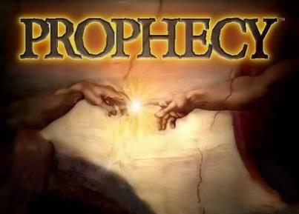
Biblical Prophecy: Importance
27% of Scripture was prophetic at the time it was written
2 Peter 1:19

Slide 88

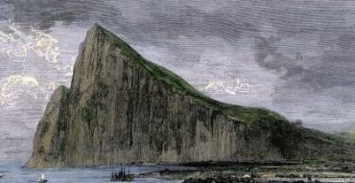
2 Peter 1:19
“So we have the prophetic word made more sure, to which you do well to pay attention as to a lamp shining in a dark place, until the day dawns and the morning star arises in your hearts.”

Slide 89

Authority of Scripture V. 19

Slide 90
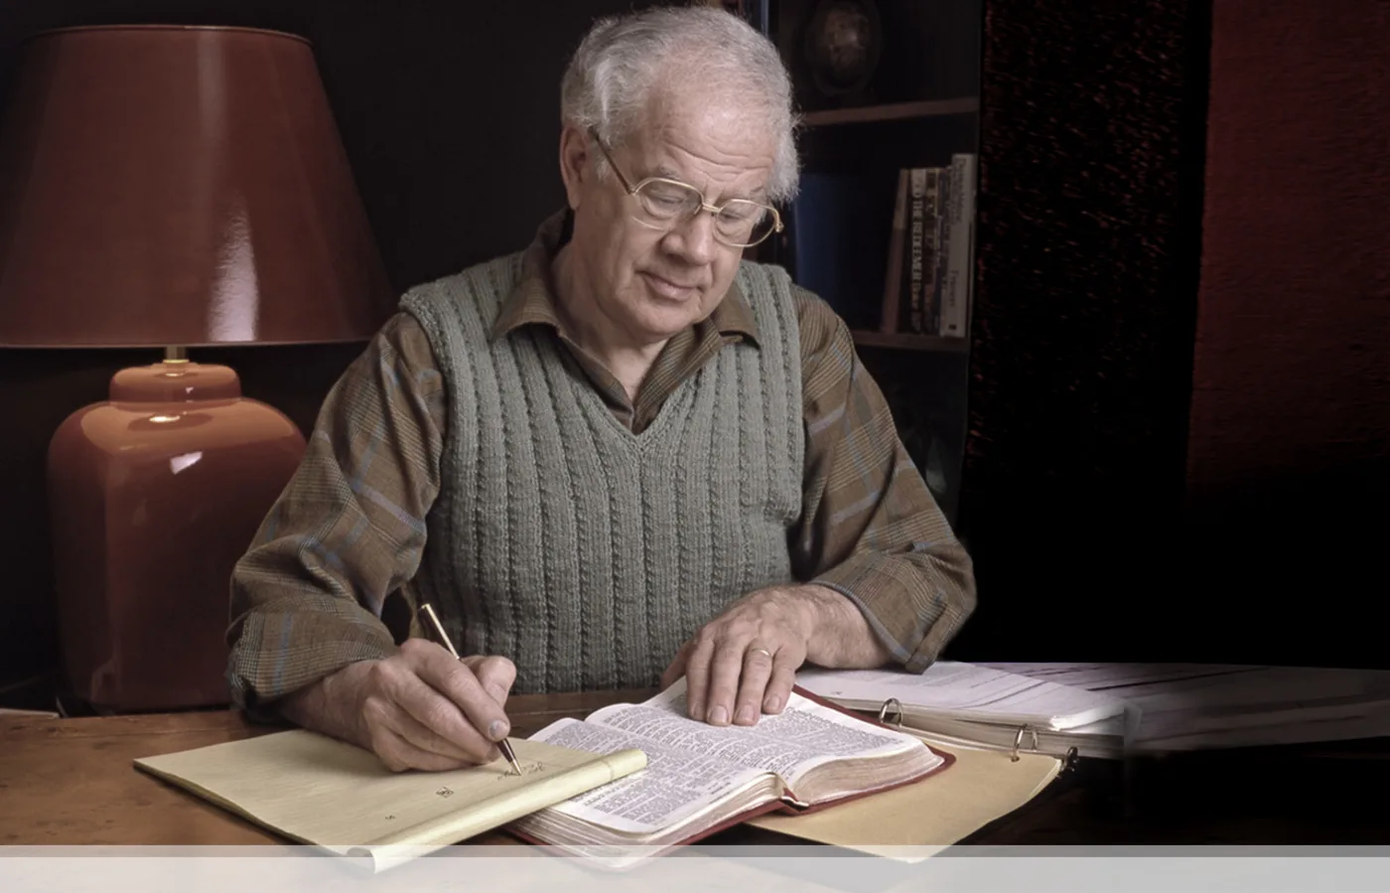

J. Dwight Pentecost
Prophecy For Today, Page 20
“A short time ago, I took occasion to go through the New Testament to mark each reference to the coming of the Lord Jesus Christ and to observe the use made of that teaching about His coming. I was struck a new with the fact that almost without exception, when the coming of Christ is mentioned in the New Testament, it is followed by an exhortation to godliness and holy living.”

Slide 91
1 Thessalonians 4:16-18
¹⁶ For the Lord Himself will descend from heaven with a shout, with the voice of the archangel and with the trumpet of God, and the dead in Christ will rise first. ¹⁷ Then we who are alive and remain will be caught up together with them in the clouds to meet the Lord in the air, and so we shall always be with the Lord. ¹⁸ Therefore comfort one another with these words."

Slide 92
Application V. 11-15
Holy Living (11b, 14)
Evangelism (12)
Hope (13)
Patience (15)

Slide 93
Application V. 11-15
Holy Living (11b, 14)
Evangelism (12)
Hope (13)
Patience (15)

Slide 94

1 Peter 1:15-16
“¹⁵ but like the Holy One who called you, be holy yourselves also in all your behavior; ¹⁶ because it is written, “You shall be holy, for I am holy.’”

Slide 95
Application V. 11-15
Holy Living (11b, 14)
Evangelism (12)
Hope (13)
Patience (15)

Slide 96
2 Peter 3:12
“looking for and hastening [speudō] the coming of the day of God, because of which the heavens will be destroyed by burning, and the elements will melt with intense heat!.”

Slide 97
2 Peter 3:9
“The Lord is not slow about His promise, as some count slowness, but is patient toward you, not wishing for any to perish but for all to come to repentance.”

Slide 98

Romans 11:25
“For I do not want you, brethren, to be uninformed of this mystery—so that you will not be wise in your own estimation—that a partial hardening has happened to Israel until the fullness of the Gentiles has come in.”

Slide 99
Application V. 11-15
Holy Living (11b, 14)
Evangelism (12)
Hope (13)
Patience (15)

Slide 100
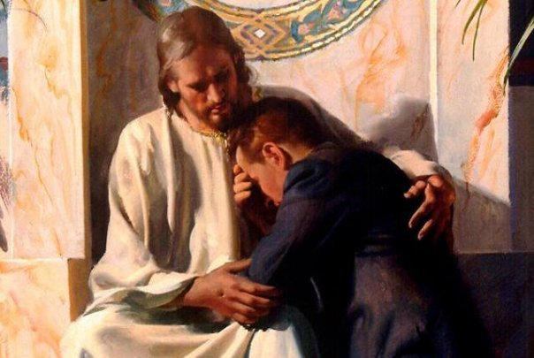
Revelation 21:4
“and He will wipe away every tear from their eyes; and there will no longer be any death; there will no longer be any mourning, or crying, or pain; the first things have passed away.”

Slide 101
Application V. 11-15
Holy Living (11b, 14)
Evangelism (12)
Hope (13)
Patience (15)

Slide 102
2 Peter 3:9
“The Lord is not slow about His promise, as some count slowness, but is patient toward you, not wishing for any to perish but for all to come to repentance.”

Slide 103
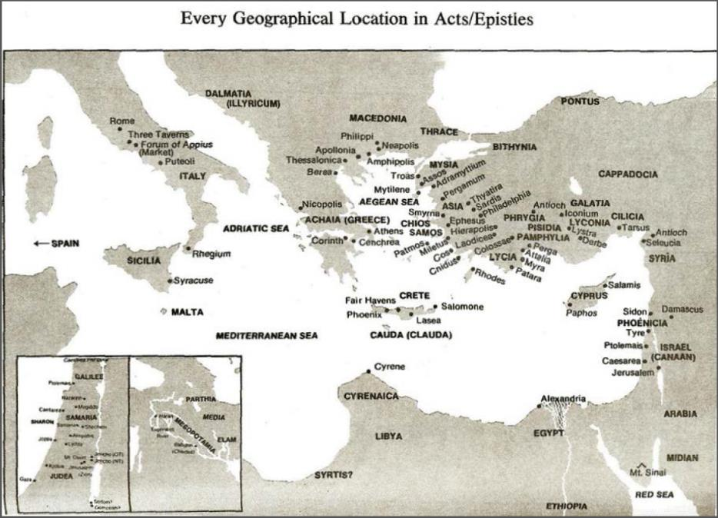

Slide 104
Acts 8:3-4; 11:19
“³ But Saul began ravaging the church, entering house after house, and dragging off men and women, he would put them in prison. ⁴ Therefore, those who had been scattered went about preaching the word…¹⁹ So then those who were scattered because of the persecution that occurred in connection with Stephen made their way to Phoenicia and Cyprus and Antioch, speaking the word to no one except to Jews alone.”

Slide 105
Regard the Grace of God (3:15)
2 Peter 3:9
Paul as an example of God’s grace
God even used Paul to author Scripture

Slide 106
CONCLUSION

Slide 107
Overview 2 Peter 3:3-15
Heresy of the false teachers (v3-4)
Motive of the false teachers (v3-4)
Peter’s rebuttal (v5-10)
Application (v11-15)

Slide 108
