Slide 1
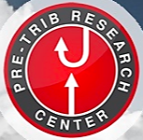

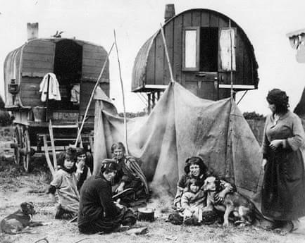
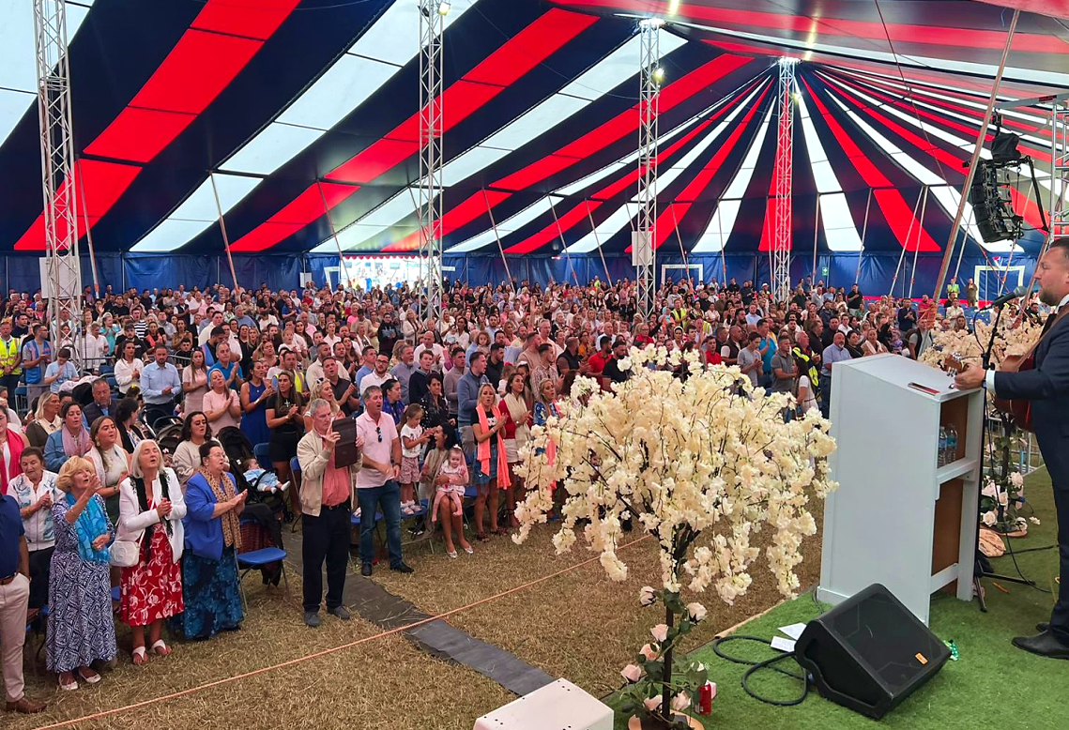
The Beautiful Simplicity of the Rapture
______
A Gypsy Testimony

Slide 2
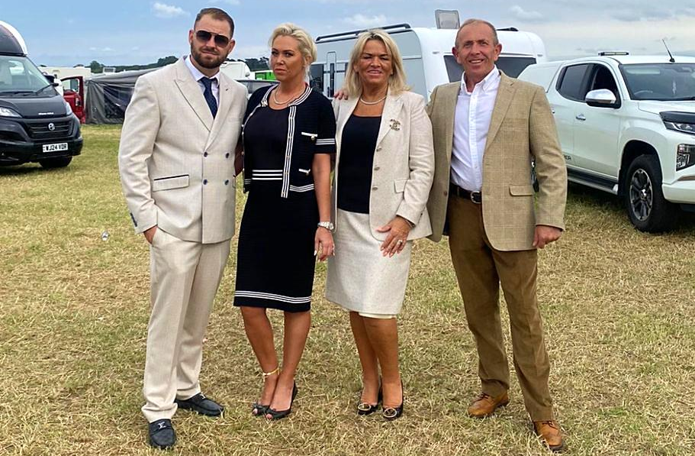
Pastor Patrick McDonagh Pastor Billy Winter
& Tammy & Tutty

Slide 3
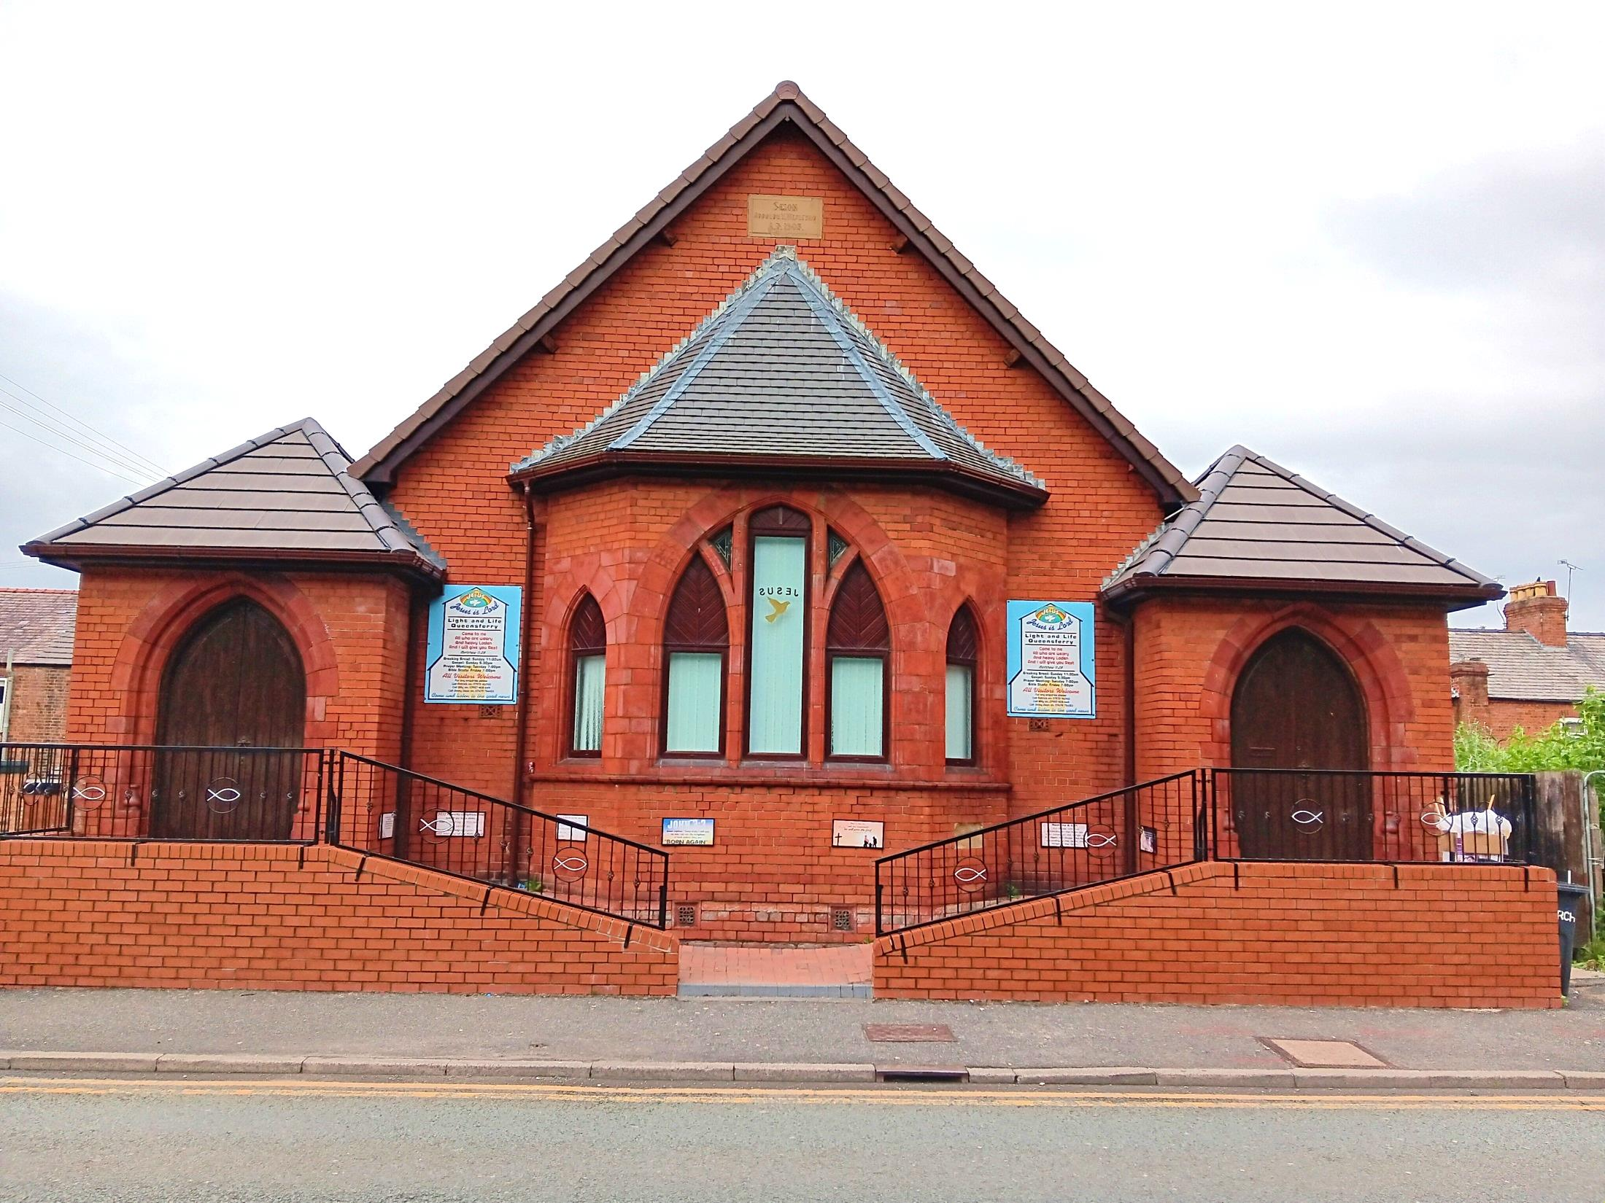


Slide 4
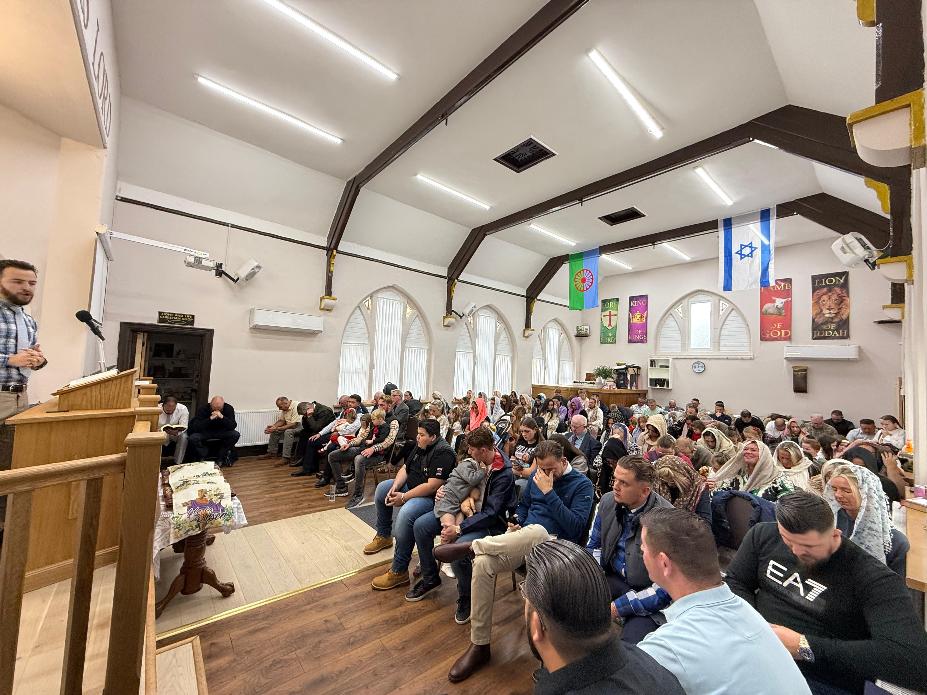

Slide 5
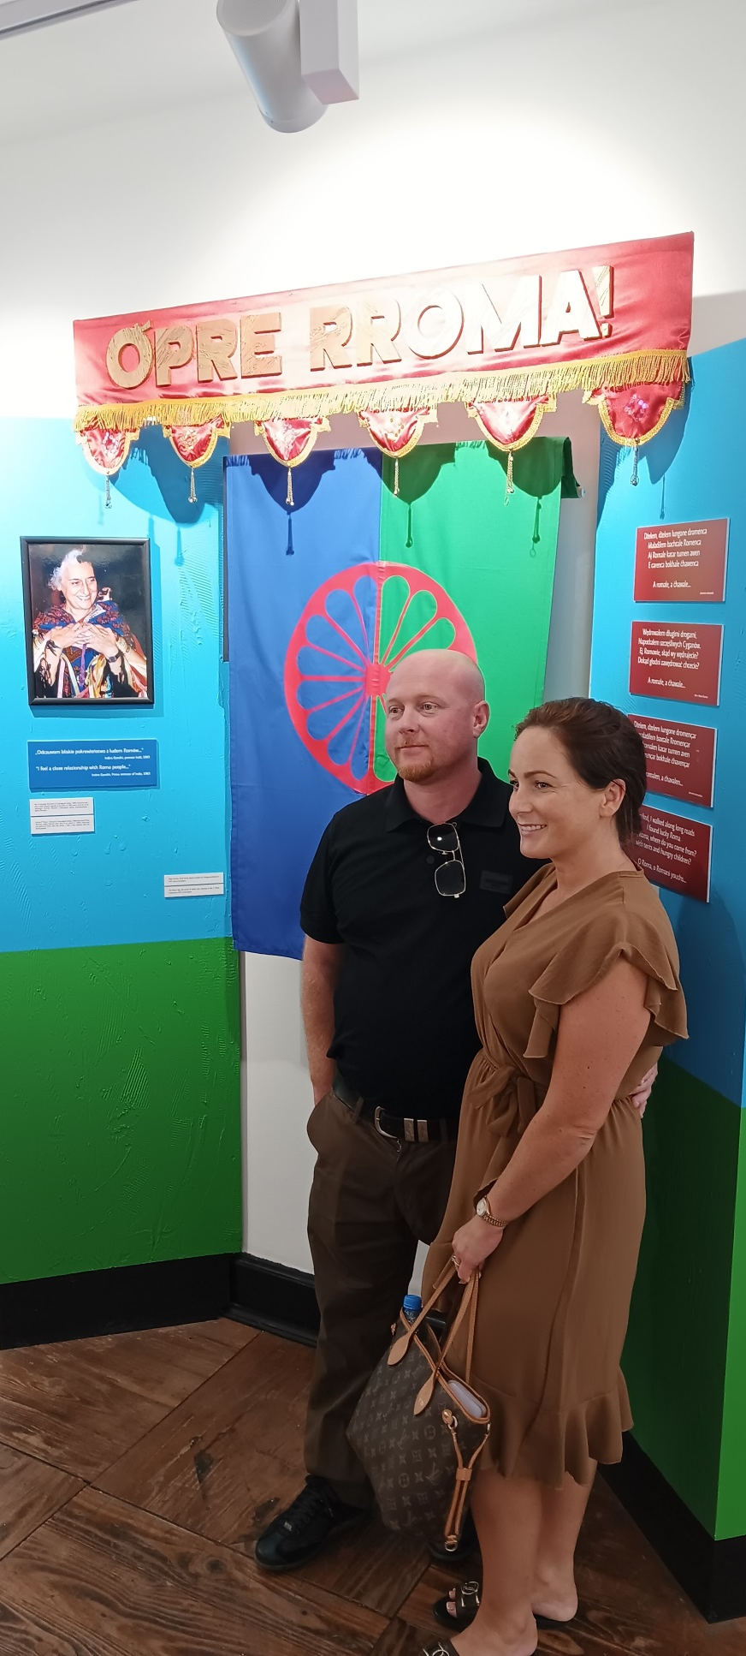
June 2022
Pastor Matthew &
Lulu Daly

Slide 6
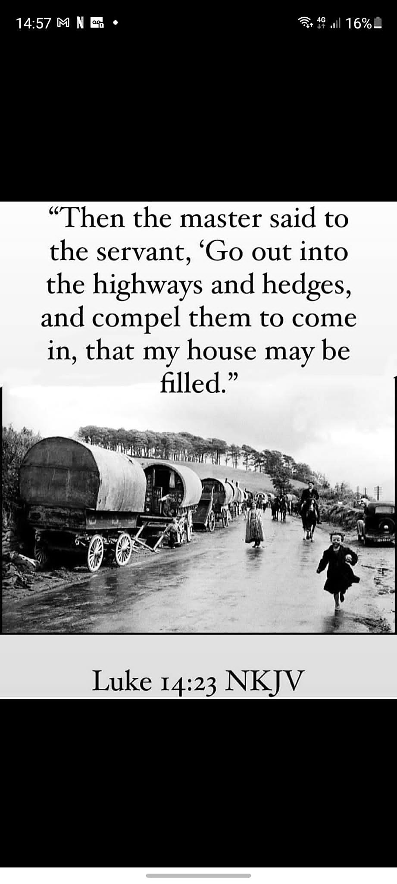
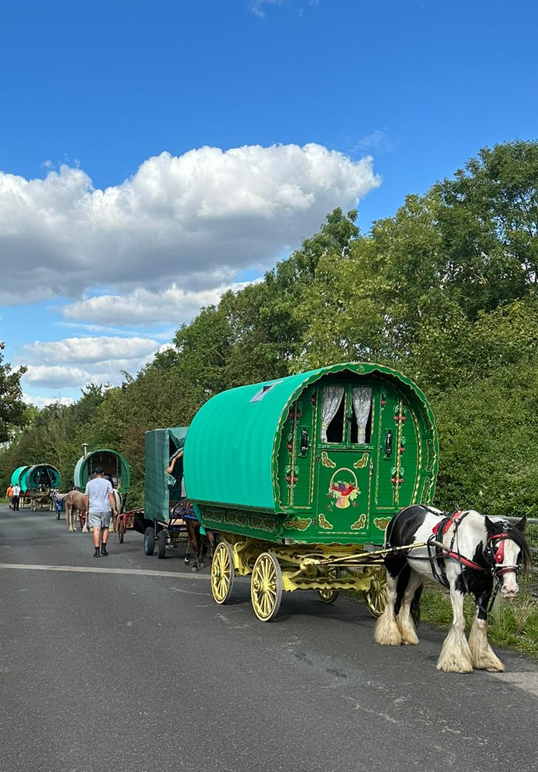

Slide 7
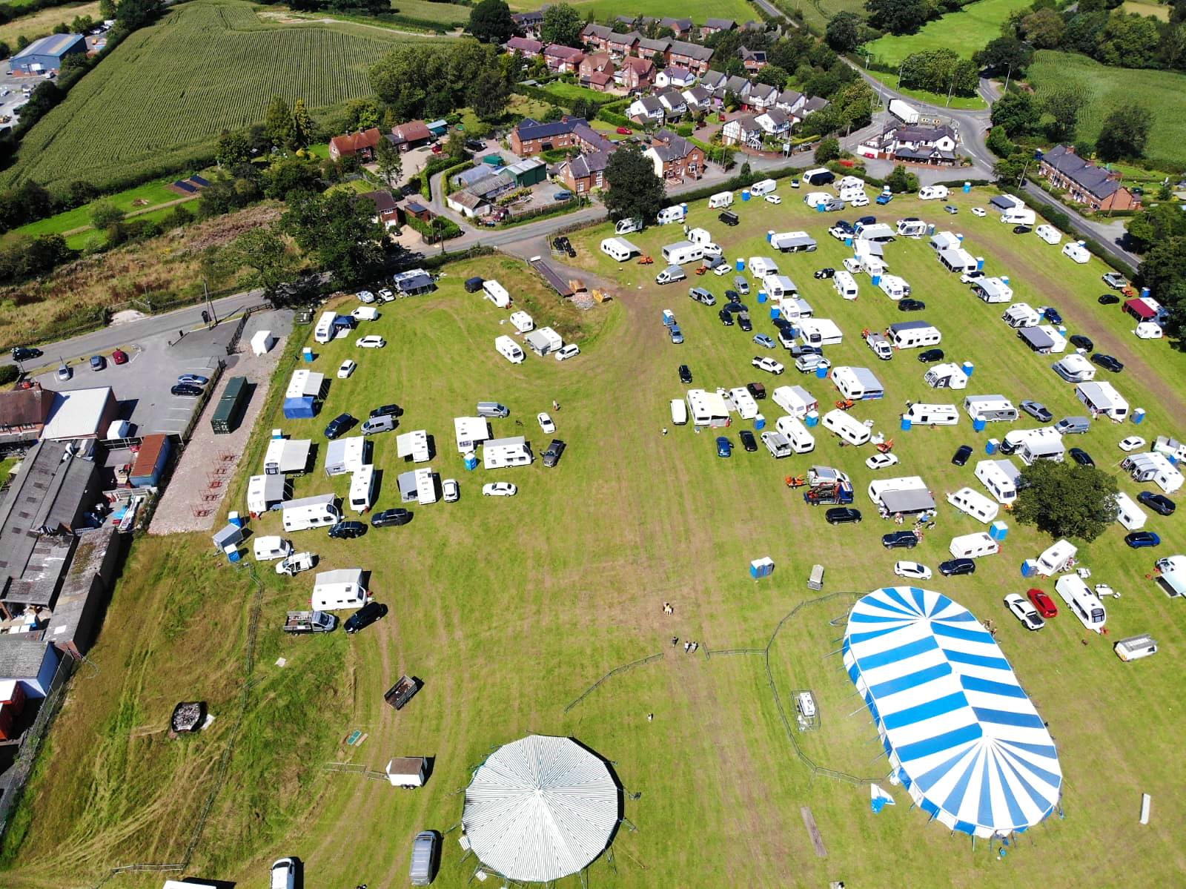
Queensferry Mission 2023

Slide 8
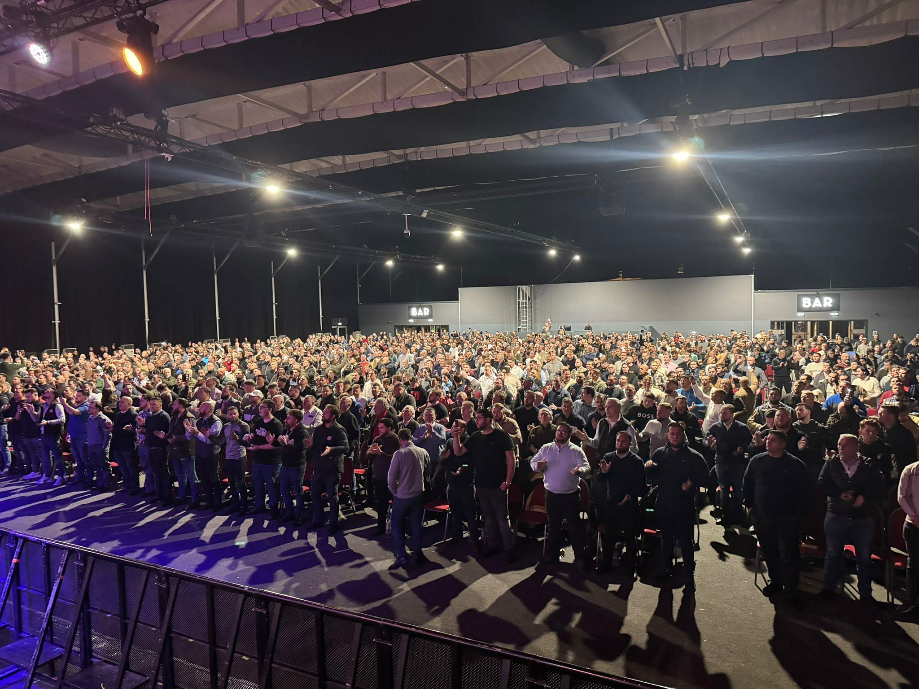
Men’s Seminar 2024

Slide 9
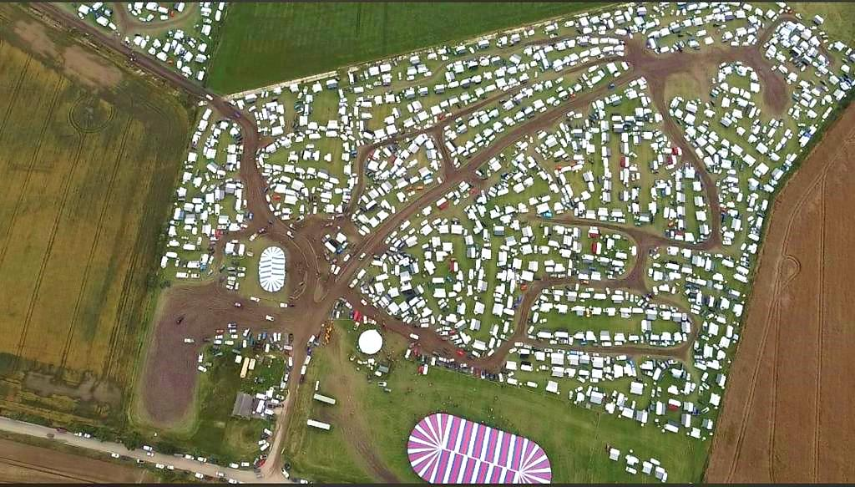
Convention 2024

Slide 10
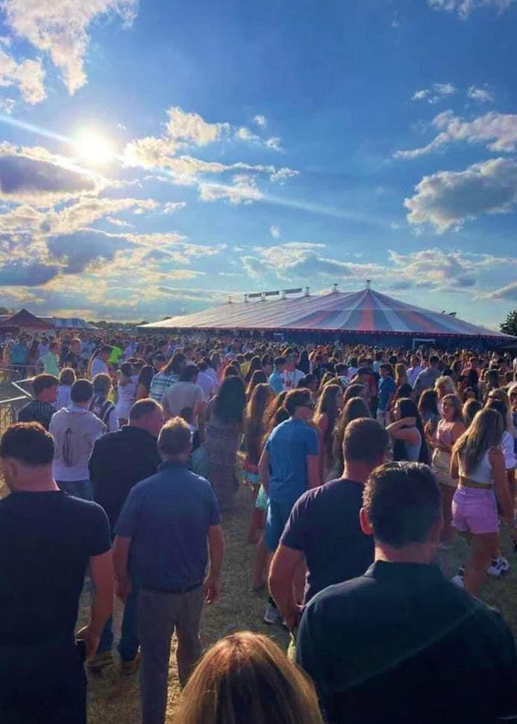

Slide 11
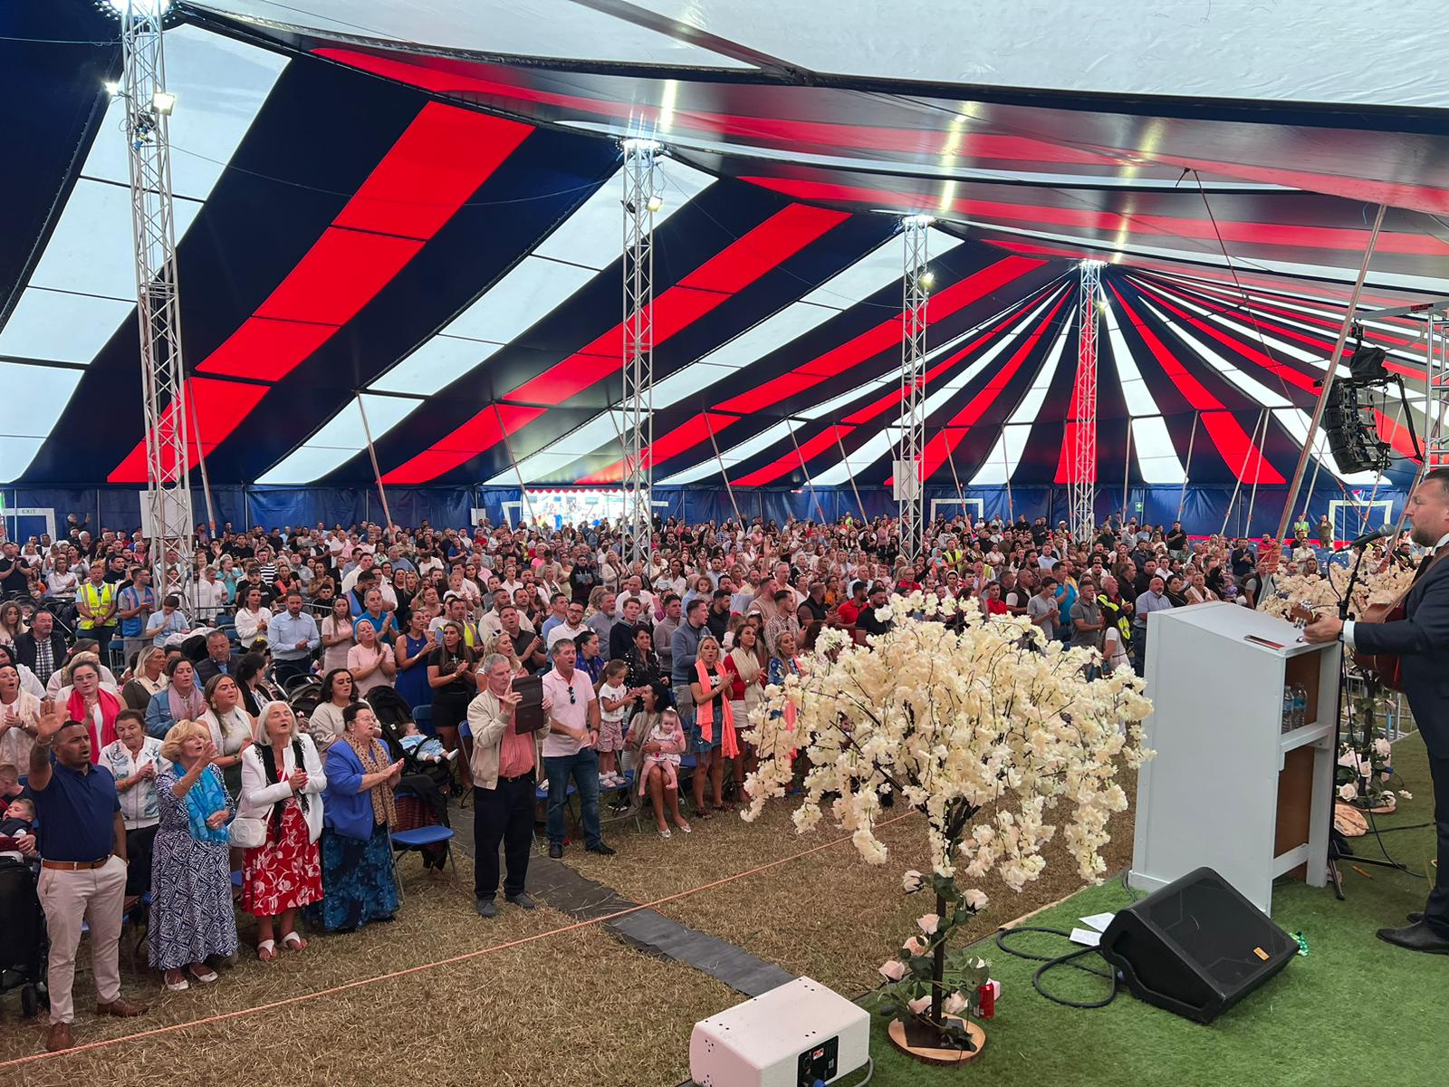

Slide 12
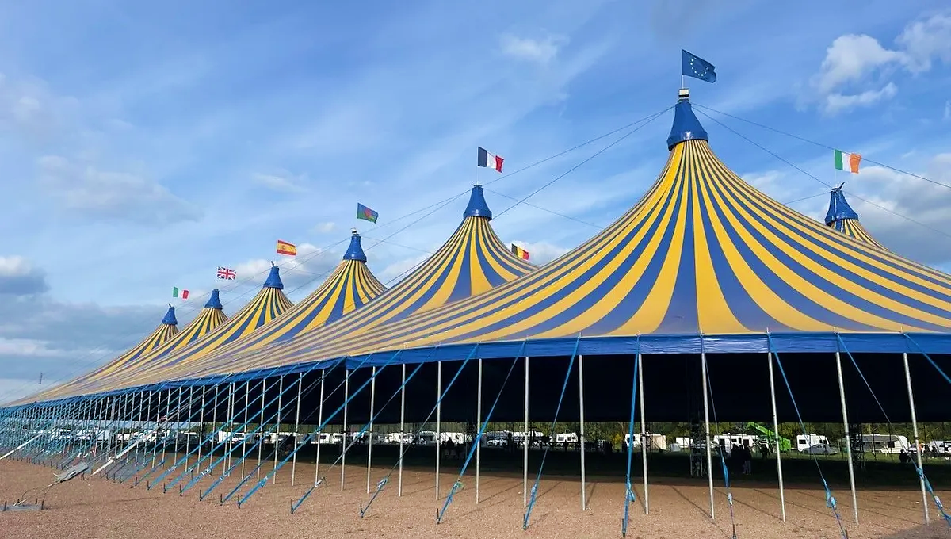


Slide 13
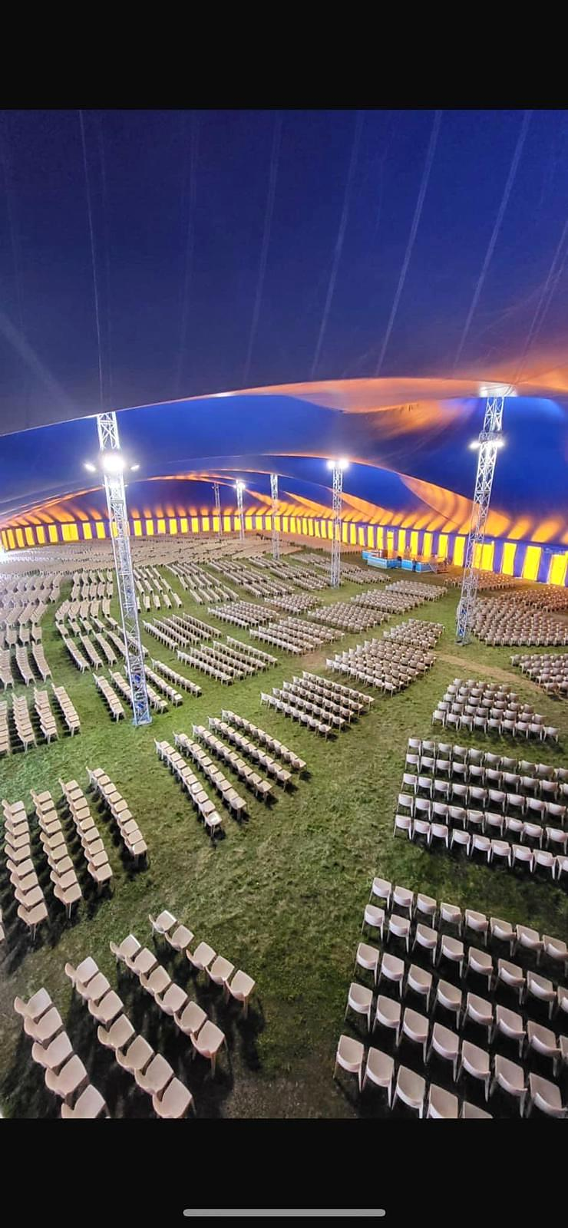

Slide 14
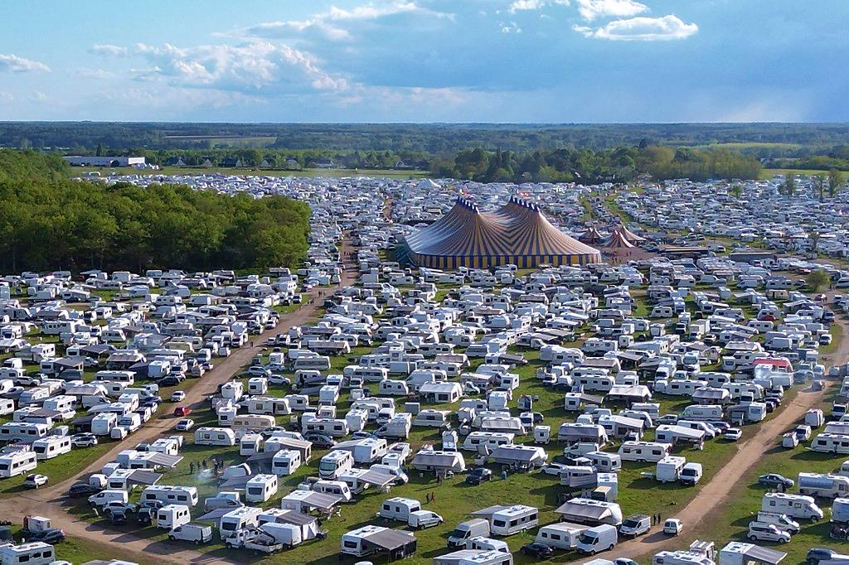

Slide 15
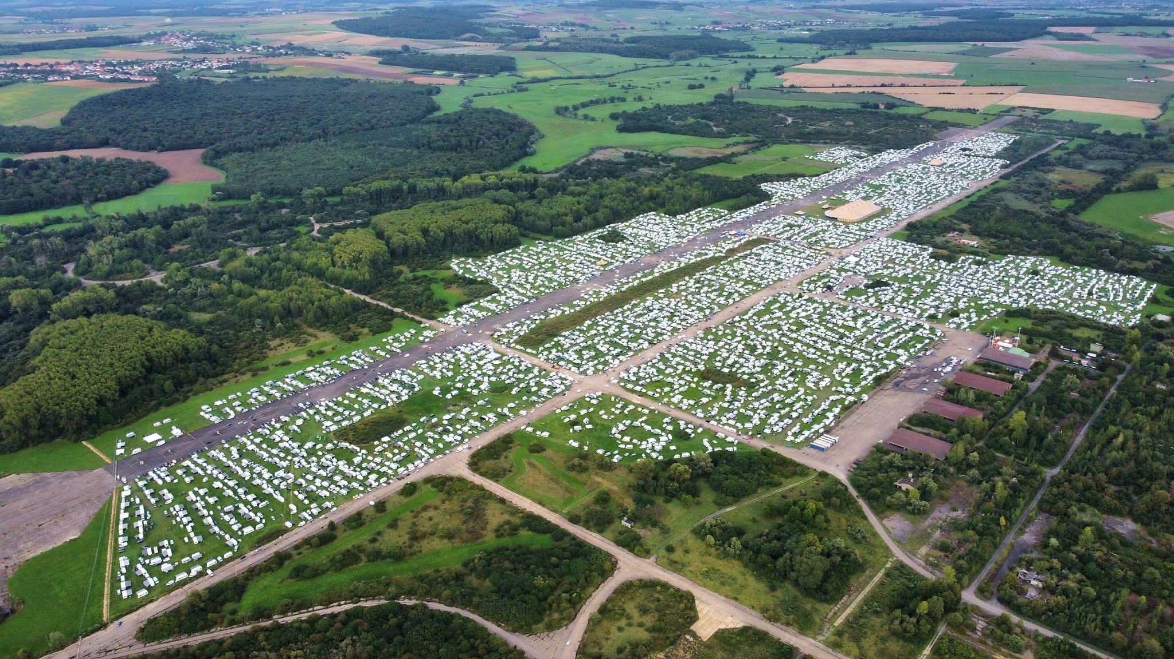

Slide 16
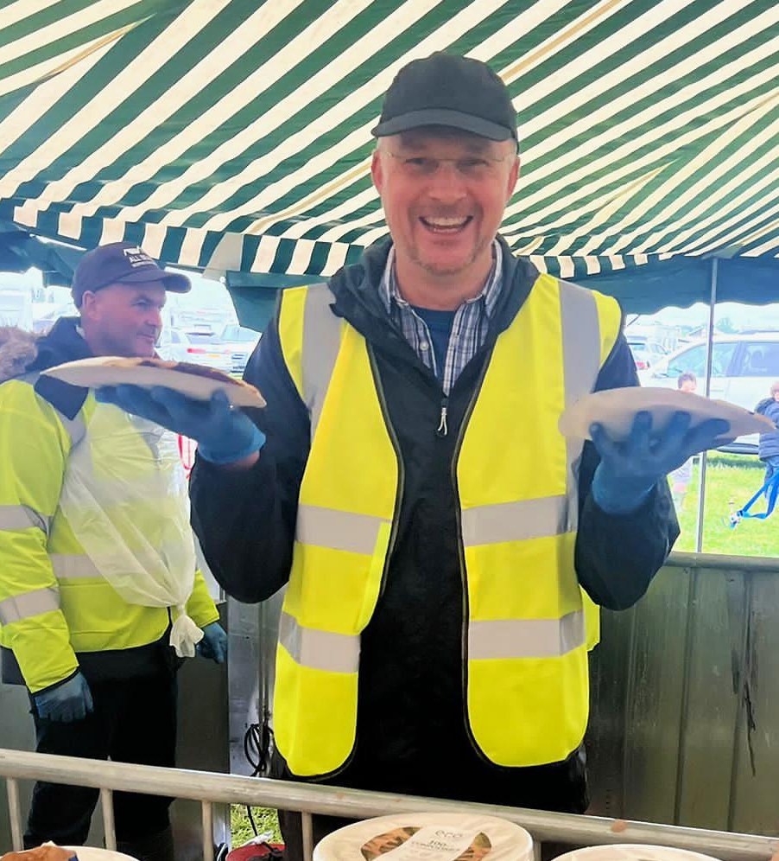
Pancake
Paul

Slide 17
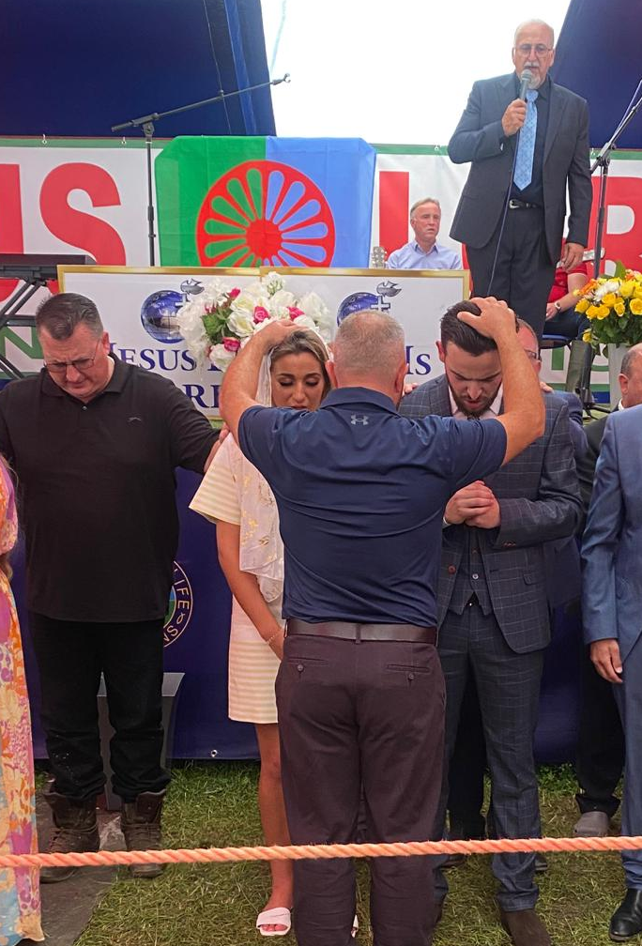
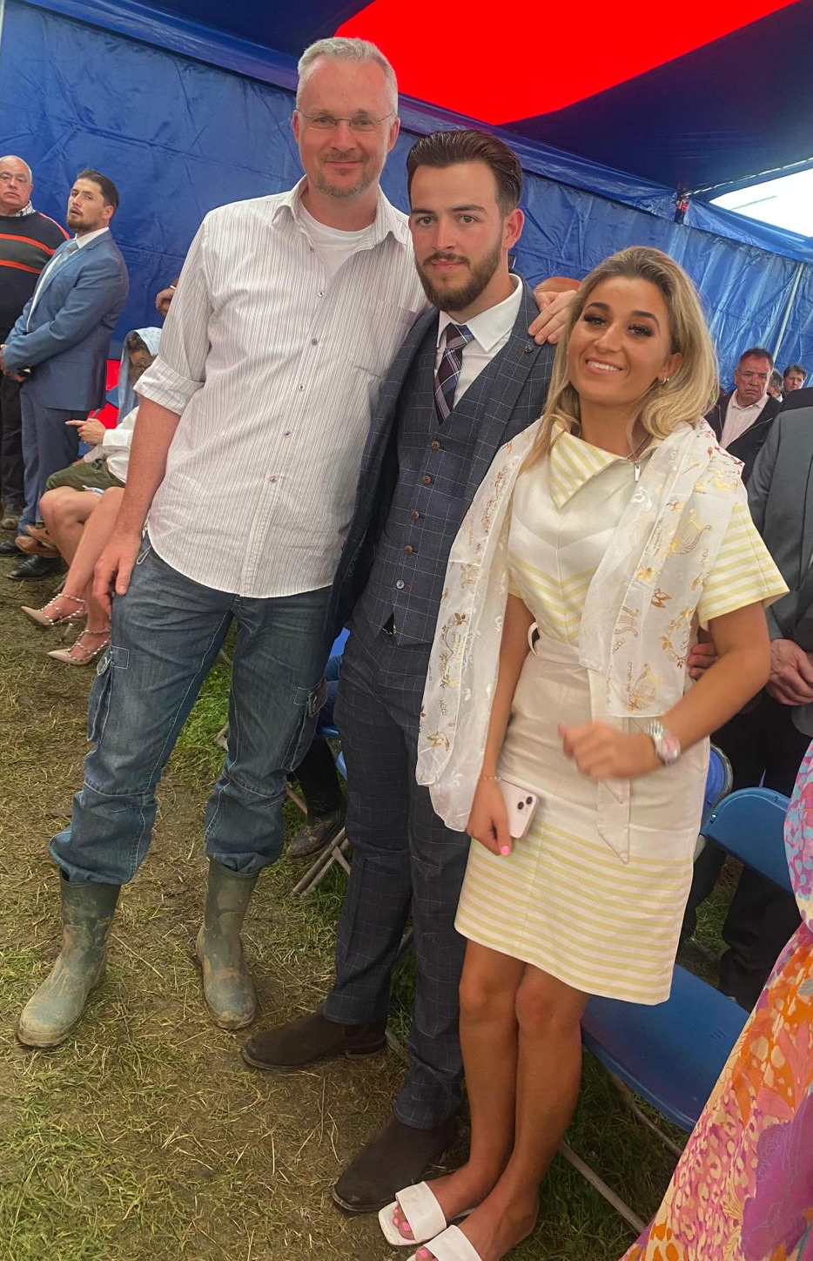

Slide 18
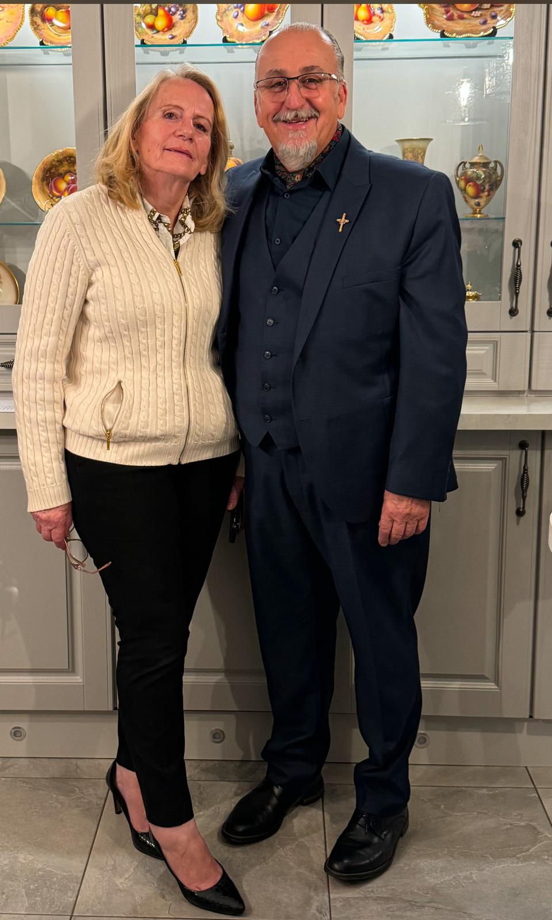
Jackie & Mary Boyd

Slide 19
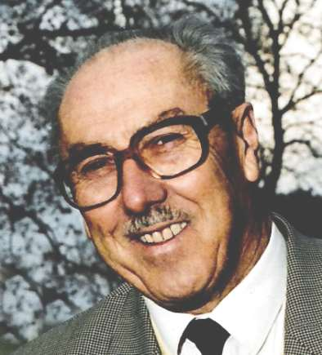
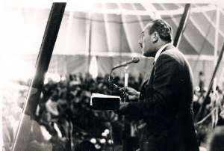
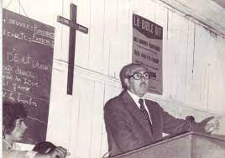
Pastor
Clément Le Cossec
1921-2001

Slide 20
“When I grow up I want to preach the Gospel to the poor.”
Clément Le Cossec

Slide 21
First Encounter
1946

Slide 22
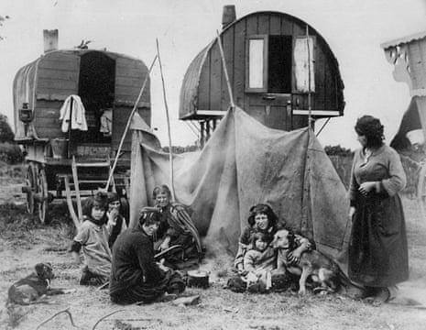

Slide 23
“The poor woman had a very serious heart complaint and was lying on a worn old mattress on the floor. The family was gathered around her and I spoke to them about salvation in Jesus Christ. Then I read some words from the Bible.
Their faces radiated a sincere and almost childlike faith. I knelt down by the sick woman and laid hands on her while I quoted the words of Christ, ‘These signs shall follow those who believe – they shall lay hands on the sick and they shall be healed.’ (Mark 16:18) Immediately after the prayer she got up and was completely healed!”

Slide 24
Second Encounter
1950

Slide 25
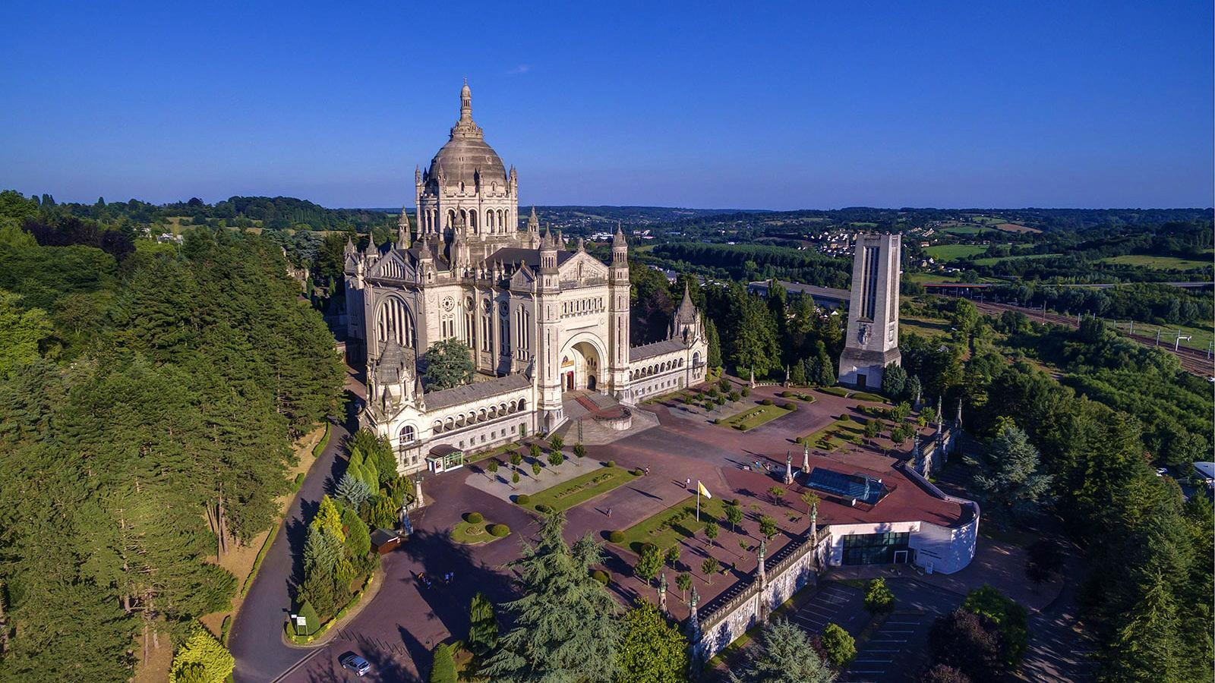
Lisieux, Normandy

Slide 26
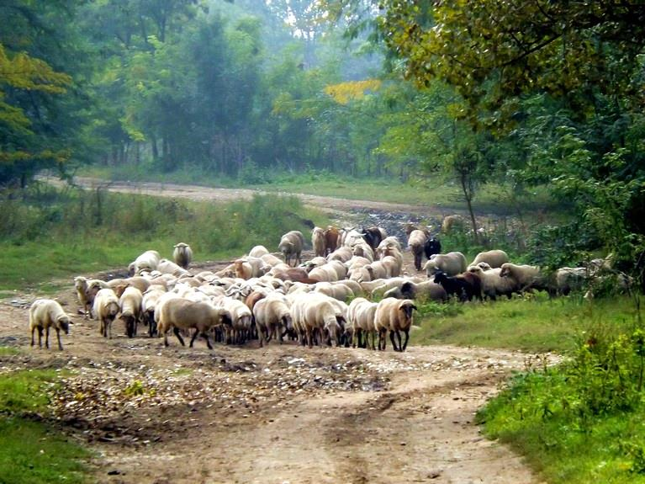
“God had set His stamp on me with a call that I could not have foreseen.”

Slide 27
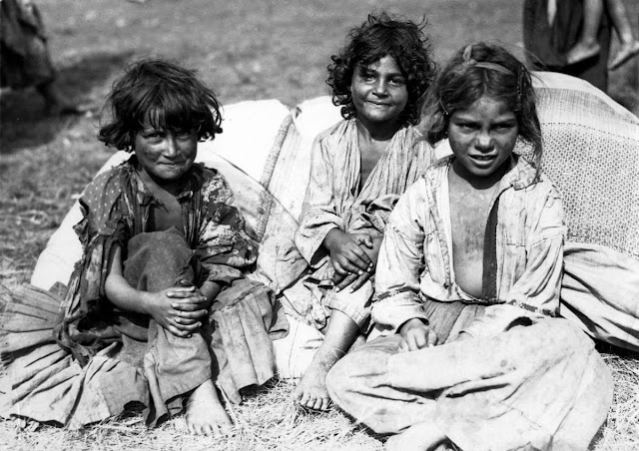

Slide 28
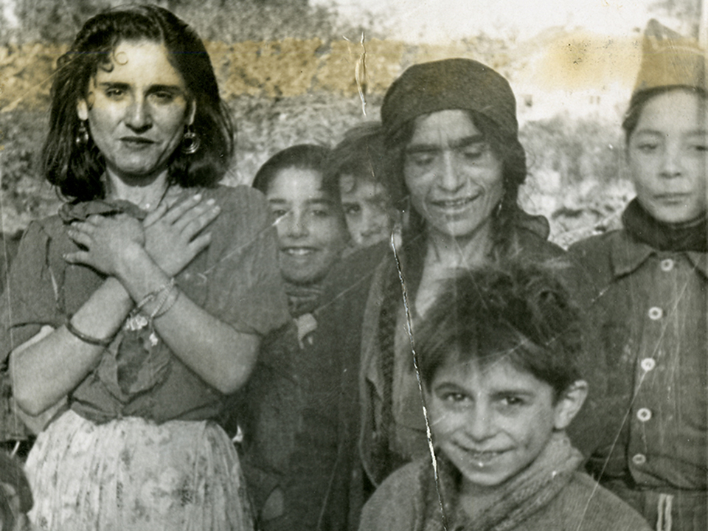

Slide 29
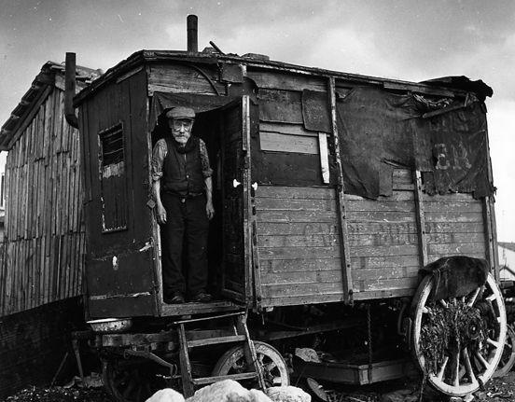

Slide 30
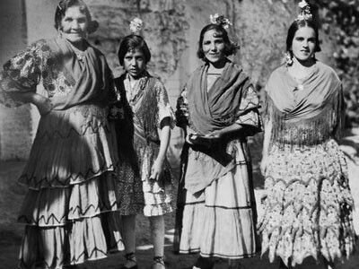

Slide 31
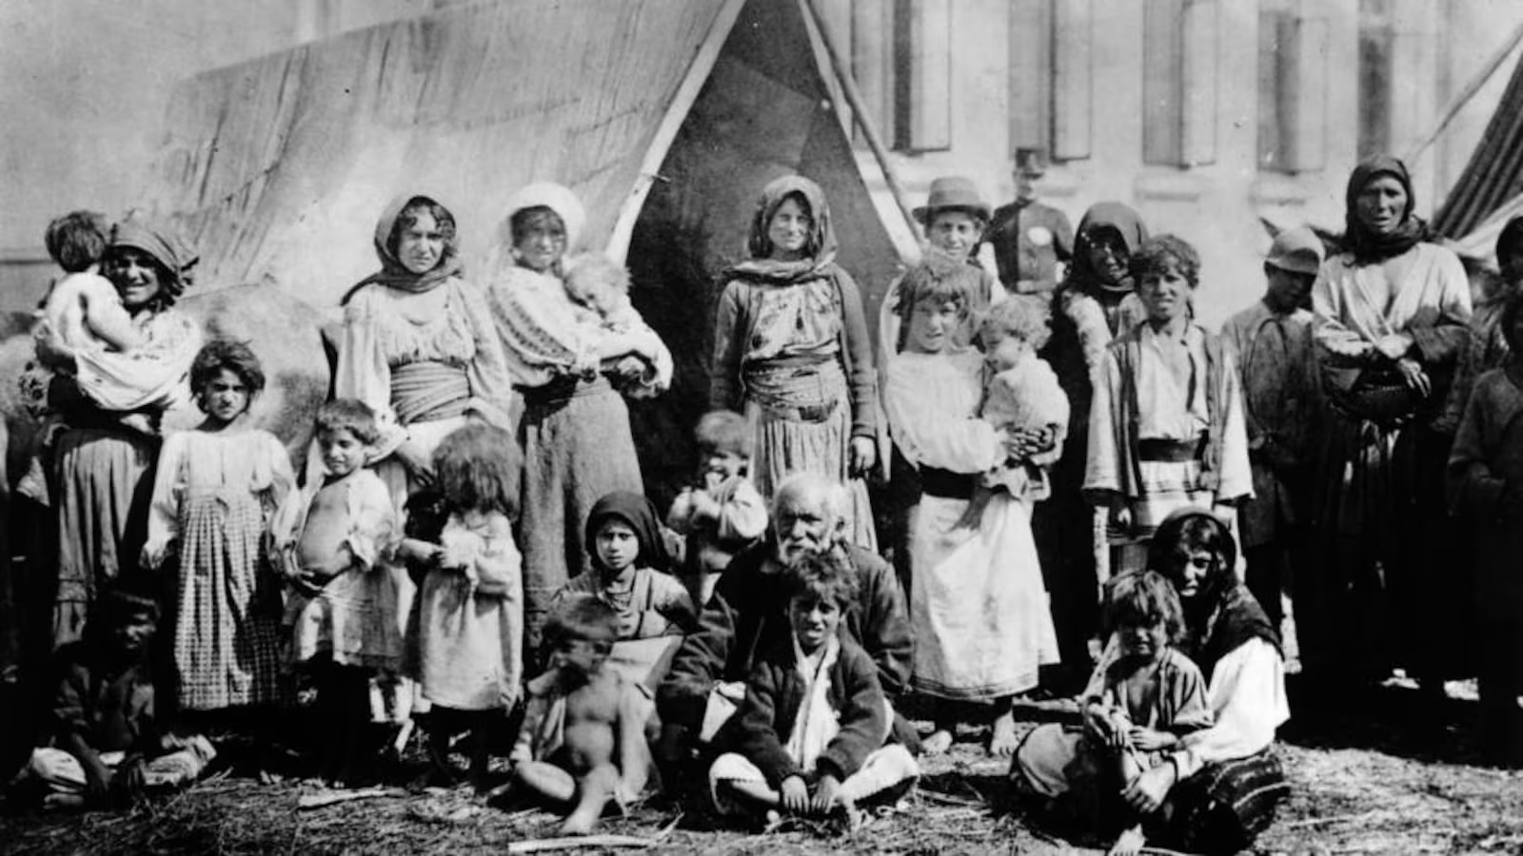

Slide 32
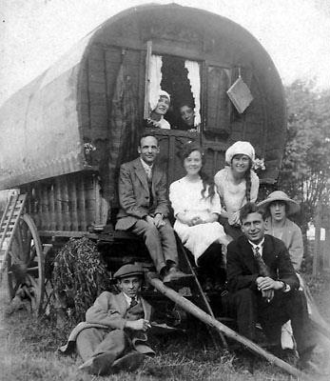

Slide 33
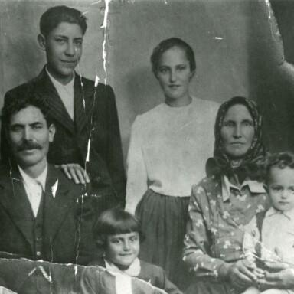

Slide 34
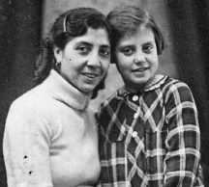
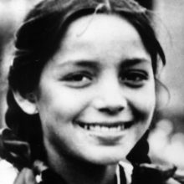
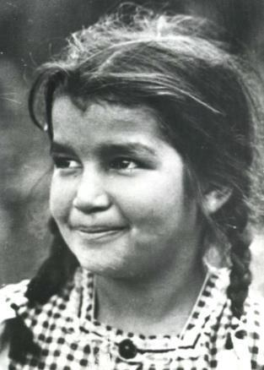
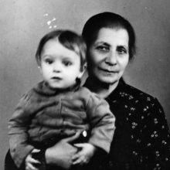

Slide 35
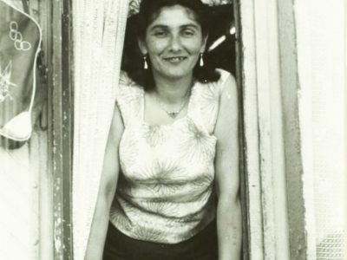

Slide 36
“a mysterious people”
“simple and spontaneous faith”

Slide 37
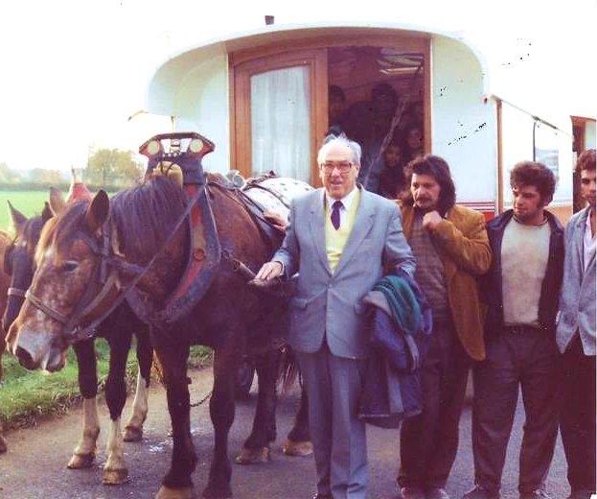

Slide 38
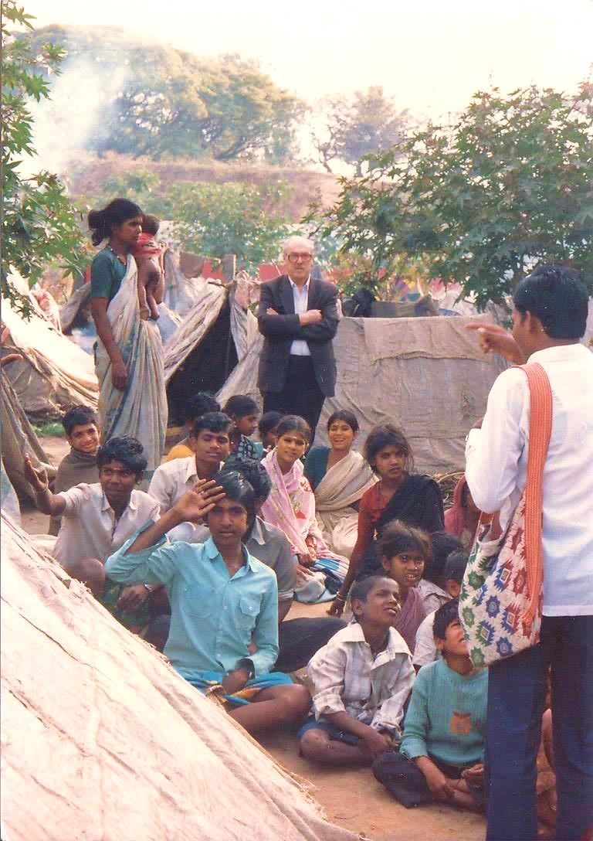

Slide 39
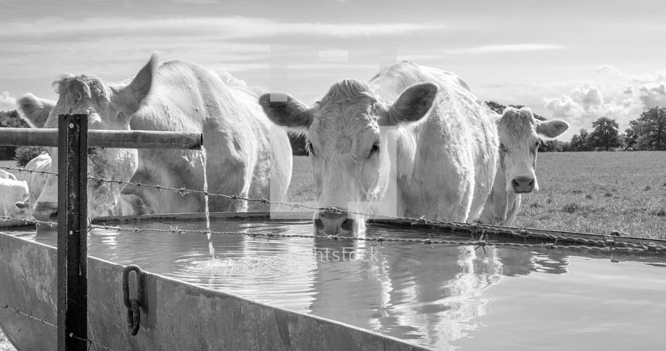
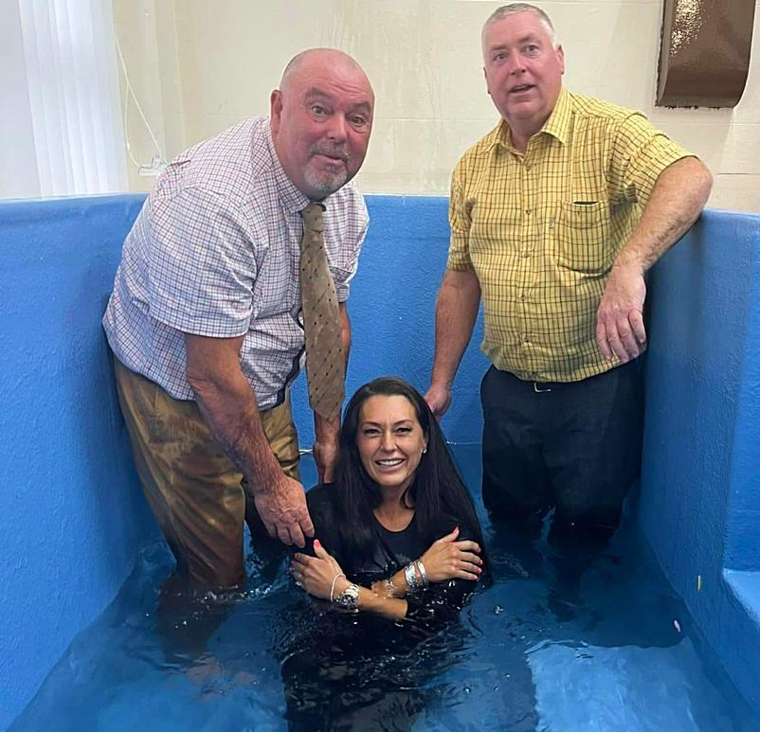
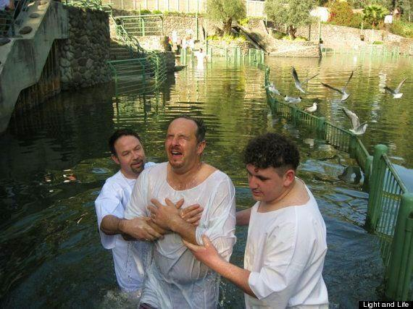
Baptisms

Slide 40

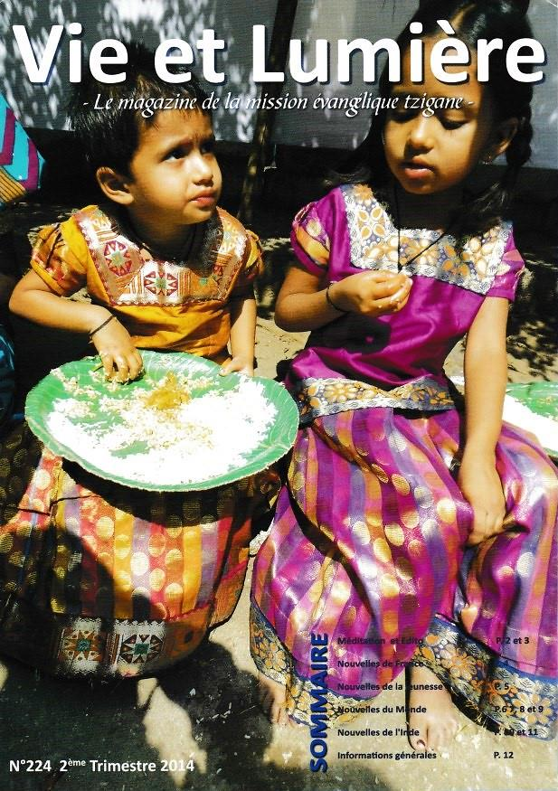

Slide 41
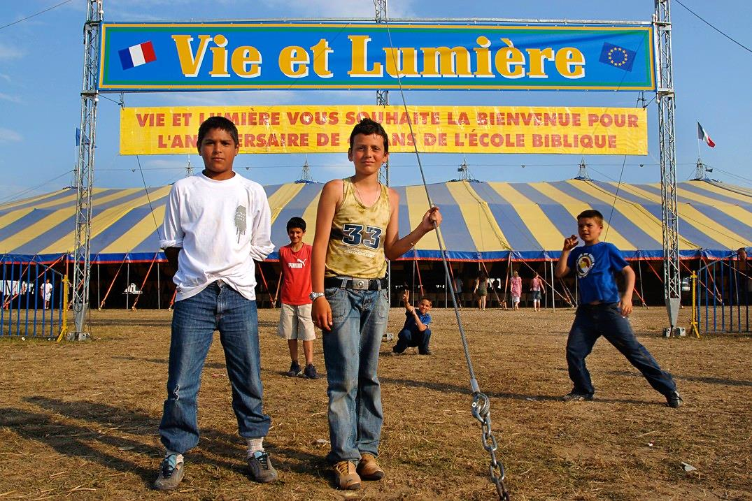

Slide 42
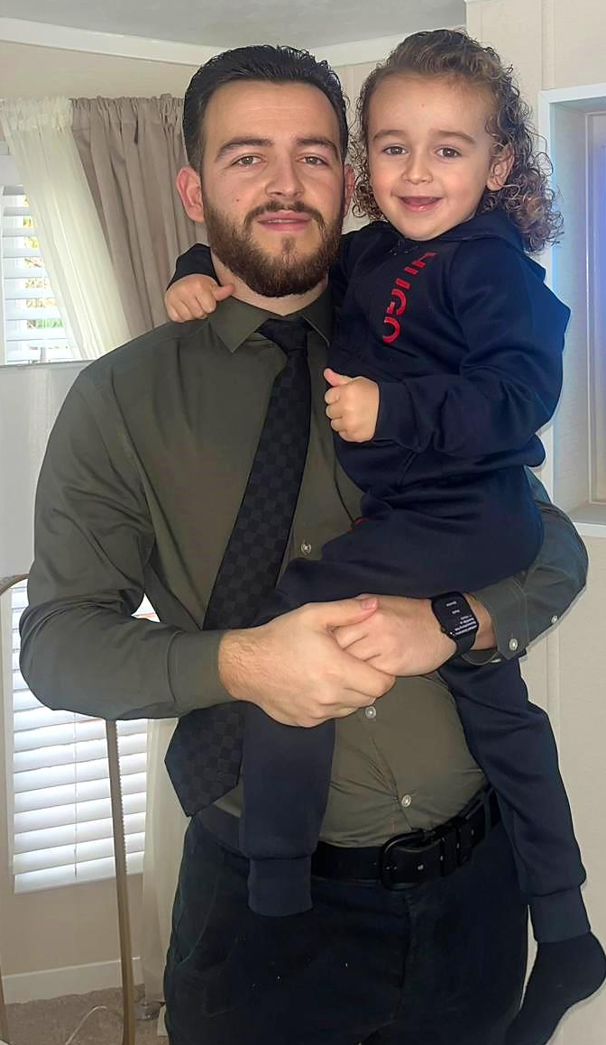
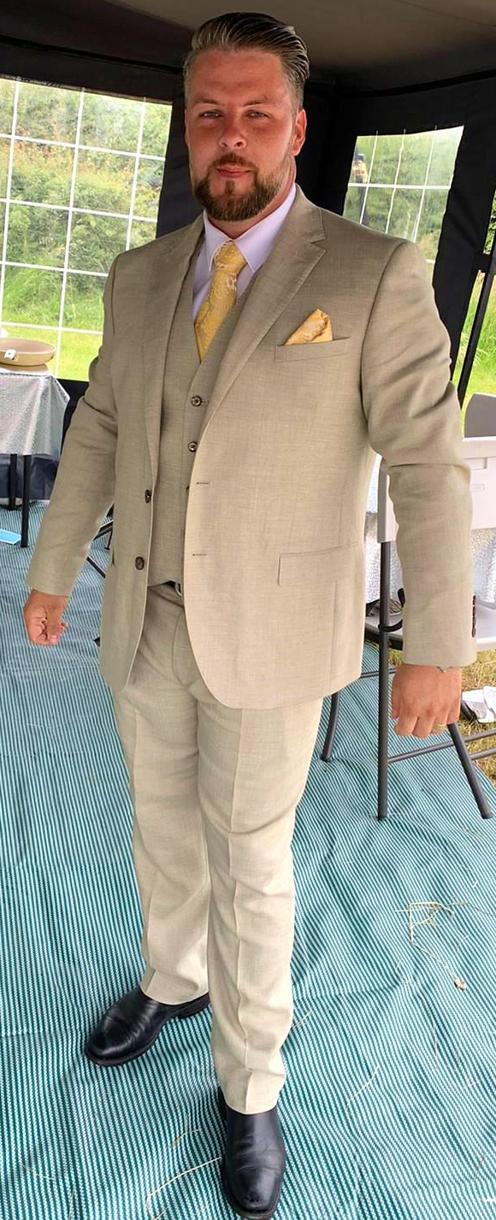
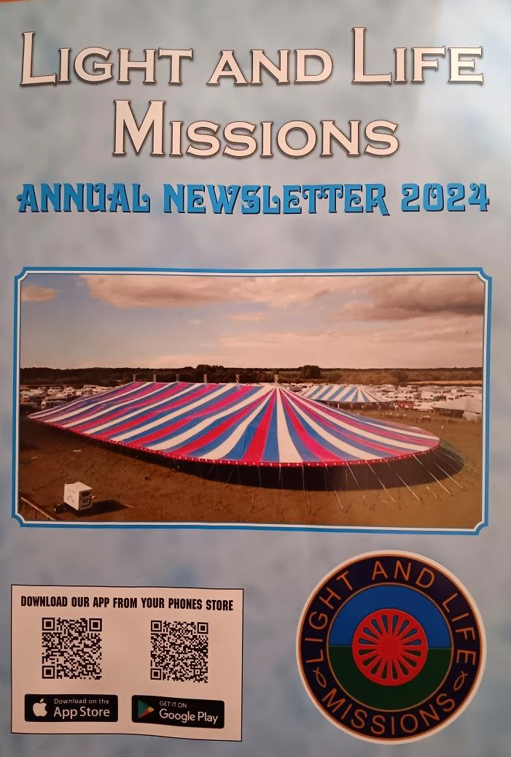
Jimmy Dean Winter
Dougie Winter

Slide 43

“I have had the privilege to visit Israel about thirty times over the years … I have been closely watching all the events since the war of independence of 1948 and studied Biblical prophetic texts concerning the people of Israel.”
Clement Le Cossec, Israel: Key Events of the Past and Future, Bible Truths series #8, https://clement-le-cossec.org/

Slide 44
“All that is happening in Israel and around Israel represents a serious warning to remind us that JESUS the MESSIAH will return very soon, firstly to take away his disciples before the great and dreadful catastrophe, and [then] to establish with his disciples and the chosen ones of Israel his reign of peace.”

Slide 45

“While on a journey to Israel, aboard a cruise liner JERUSALEM, I had the opportunity to speak with Prime Minister Ben Gurion who was on board.”

Slide 46

“He invited me to ‘come live in Israel, you will be welcome.’”

Slide 47


General Yigael Yadin

Slide 48

27th Zionist Congress, Jerusalem
June 9 – 19, 1968

Slide 49


Slide 50


Slide 51

Ayrshire,
SCOTLAND

Slide 52

Newton-le-Willows,
ENGLAND

Slide 53

Sandbach,
ENGLAND

Slide 54

Caldicot, WALES

Slide 55

Wrexham,
WALES

Slide 56

Queensferry,
WALES

Slide 57
September 2023
Queensferry Church
Holocaust Tour to Poland

Slide 58


Slide 59



Slide 60

“the Devouring”

Slide 61

Robert Ritter, head of the Racial Hygiene and Demographic Biology Research Unit of Nazi Germany’s Criminal Police, interviewing a Romani woman in 1936

Slide 62

Marzahn, Germany – first internment camp for Roma (Gypsies) in the Third Reich
United States Holocaust Memorial Museum (ushmm.org)

Slide 63

Roma (Gypsy) prisoners line up for roll call in the Dachau concentration camp.
Germany (June 1938)

Slide 64


Slide 65

Austrian police round up Gypsy families from Vienna for deportation to Poland, 1939

Slide 66

Deportation of Serbs and Roma (Gypsies) to Croatian concentration camps, July 1942

Slide 67

Persecution of Gypsies by Yugoslavian Soldiers https://daily.jstor.org/roma/

Slide 68

Gypsy women inspected at Ravensbrück concentration camp, Germany

Slide 69

Surviving Gypsy women at Bergen-Belsen (April 1945)

Slide 70


www.roma-sinti-holocaust-memorial-day.eu/history/children/

Slide 71

www.travellerstimes.org.uk/news/2014/11/roma-holocaust

Slide 72


Slide 73


Slide 74

“the girl with the headdress”
Anna Maria (Settela) Steinbach, aged 9

Slide 75


Slide 76


Slide 77

Manchester
November 23, 2024

Slide 78


Slide 79

Rapture Truth
Beautiful & Simple

Slide 80

“In principle the Gypsies don’t discuss what the Bible says. They just take God at His own word!”
Clément Le Cossec

Slide 81


Slide 82

Light & Life Bible College
Pentrenant Hall, Wales

Slide 83

“Since my commitment to serve Christ in 1940, I have applied [myself] to study the prophecies of the Bible concerning the return of Jesus Christ. I have kept repeating, year after year, that ‘Jesus Christ will return soon.’ Today, more than ever, this message must be proclaimed high.”
Clément Le Cossec, The Return of Jesus Christ: The Revelation for Tomorrow, Bible Truths series #4 https://clement-le-cossec.org/

Slide 84

Tribulationism
Mid-Trib
Pre-Wrath
Post-Trib
“blasts the hope out of the Rapture”

Slide 85


The Pre-Wrath Rapture Myth = “the most confusing interpretation of end-time events ever put together, a concept that no one except this author [Marvin Rosenthal] would come to on his own – unless he just wanted to be different.”

Slide 86



Slide 87
Parting & Betrothal
Reunion & Marriage
“Let not your hearts be troubled; you believe in God, believe also in me. In my Father’s house are many rooms. If it were not so, I would have told you. I go to prepare a place for you. And if I go and prepare a place for you, I will come again and will take you to myself, that where I am you may be also.”
John 14:1-3
2 Cor. 11:2-3; Eph. 5:22-33; Rev. 19:6-10

Slide 88


Slide 89

Parting & Betrothal
Reunion & Marriage
John 14:1-3
2 Cor. 11:2-3; Eph. 5:22-33; Rev. 19:6-10
Song of Songs 3:6-9
“The Shulamite”

Slide 90
Parting & Betrothal
Reunion & Marriage
John 14:1-3
2 Cor. 11:2-3; Eph. 5:22-33; Rev. 19:6-10

Slide 91


Slide 92
Sorrow & Uncertainty
Comfort & Assurance
“But we do not want you to be uninformed, brothers, about those who are asleep, that you may not grieve as others do who have no hope.
For since we believe that Jesus died and rose again, even so, through Jesus, God will bring with Him those who have fallen asleep.”
1 Thessalonians 4:13-14

Slide 93


Epicurus (341-270 B.C.)
“Death does not concern us, because as long as we exist, death is not here. And when it does come, we no longer exist.”

Slide 94
“For this we declare to you by a word from the Lord, that we who are alive, who are left until the coming of the Lord, will not precede those who have fallen asleep. For the Lord Himself will descend from heaven with a cry of command, with the voice of an archangel, and with the sound of the trumpet of God. And the dead in Christ will rise first. Then we who are alive, who are left, will be caught up together with them in the clouds to meet the Lord in the air, and so we will always be with the Lord. Therefore encourage one another with these words.”
Sorrow & Uncertainty
Comfort & Assurance
1 Thessalonians 4:15-18

Slide 95


Slide 96
Mystery – “What happens?”
Revealed – “This happens!”
“Behold! I tell you a mystery. We shall not all sleep, but we shall all be changed, in a moment, in the twinkling of an eye, at the last trumpet. For the trumpet will sound, and the dead will be raised imperishable, and we shall be changed.”
1 Corinthians 15:51-52

Slide 97


“in the twinkling of an eye”
(Greek = en atomō)
1 Corinthians 15:52

Slide 98


Slide 99

IF

Slide 100


Slide 101
Keep the Faith
Kept from the Trial
“Because you have kept my word about patient endurance, I will keep you from the hour of trial that is coming on the whole world, to try those who dwell on the earth.”
Revelation 3:10

Slide 102

Those who have “settled down on the Earth”
But “our citizenship is in Heaven, and from it we await a Savior, the Lord Jesus Christ” (Phil. 3:20)
We are “strangers and pilgrims on the Earth” (Heb. 11:13; cp. 1 Pet. 2:11)

Slide 103

Dr. Jobe Martin
President, Biblical Discipleship Ministries
“He who has an ear, let him hear what the Spirit says to the churches.”
Revelation 2:7, 11, 17, 29; 3:6, 13, 22

Slide 104
“He who has an ear, let him hear what the Spirit says to the churches.”
Revelation 2:7, 11, 17, 29; 3:6, 13, 22
Compare and Contrast
GOSPELS (past): “He who has ears to hear, let him hear” Matt. 11:15; 13:9,43; Lk. 14:35
REVELATION (future): “If anyone has an ear, let him hear” Rev. 13:9

Slide 105
Keep the Faith now
Kept from the Trial then
Revelation 3:10

Slide 106


Slide 107
“I have fought the good fight, I have finished the race, I have kept the faith. Henceforth there is laid up for me the crown of righteousness, which the Lord, the righteous judge, will award to me on that day, and not only to me but also to all who have loved His appearing.”
Run the Race (with longing)
Receive the Reward
2 Timothy 4:7-8

Slide 108

“The Lord Jesus is not only coming soon,
He is coming next!”
Leonard ‘Fuzzy’ Lee

Slide 109


Slide 110


Slide 111


Slide 112


Slide 113


Slide 114


Slide 115


Slide 116


Slide 117


Slide 118
Beautiful & Simple
& Childlike

